Slide 1
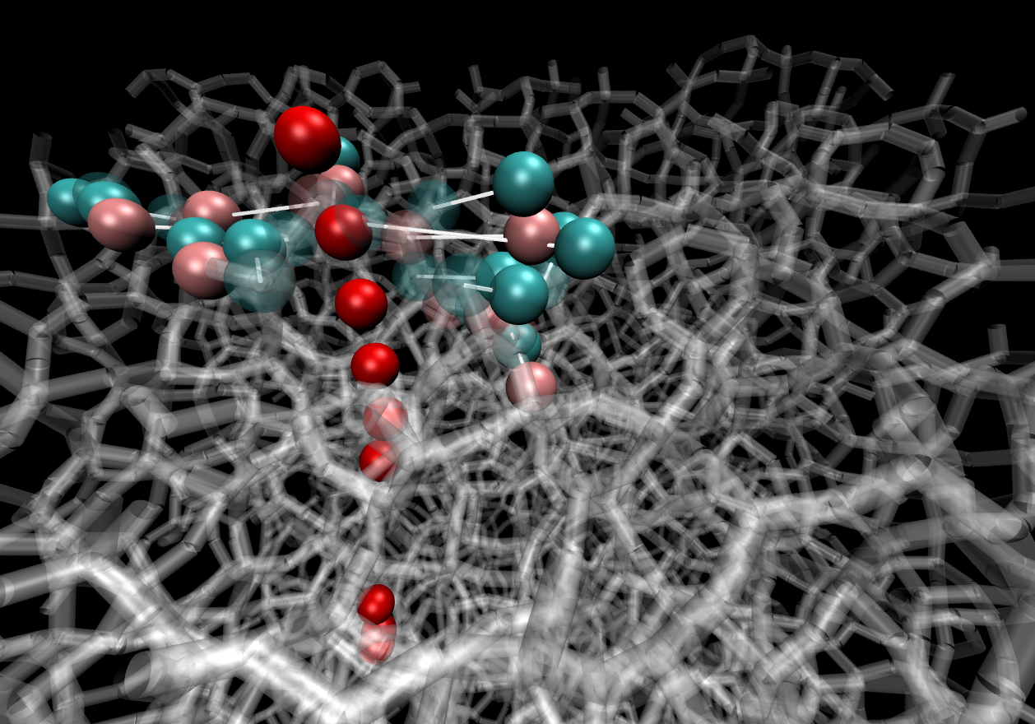
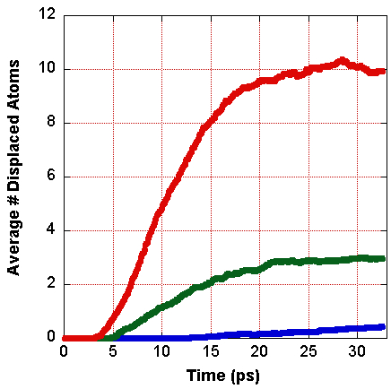
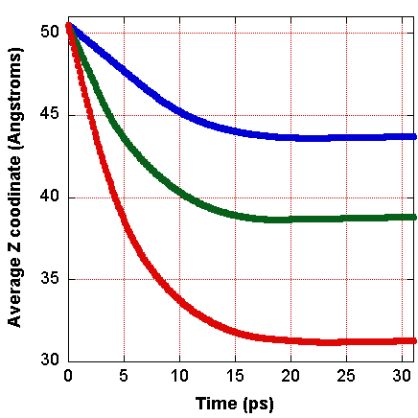
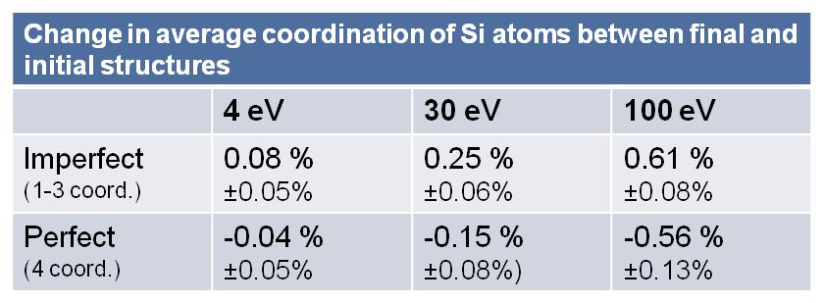
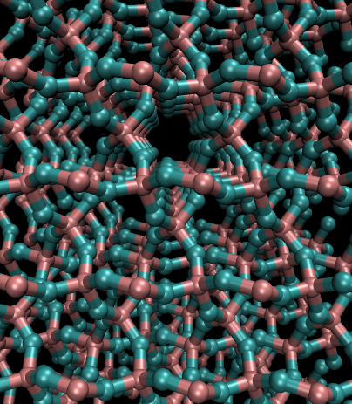
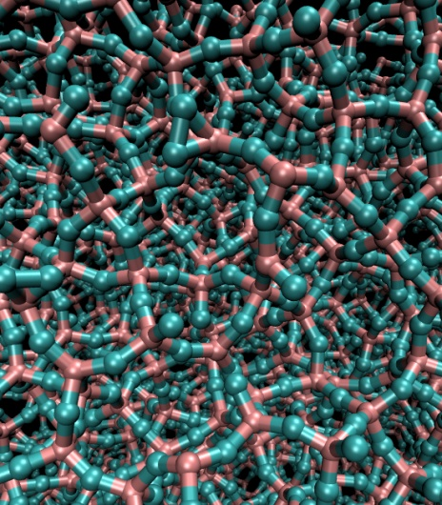
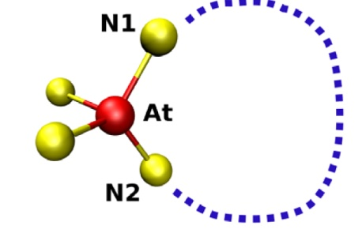
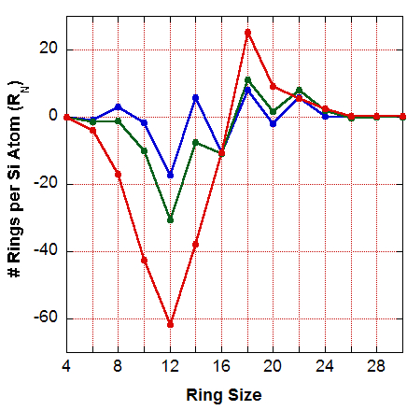
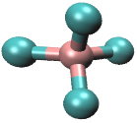
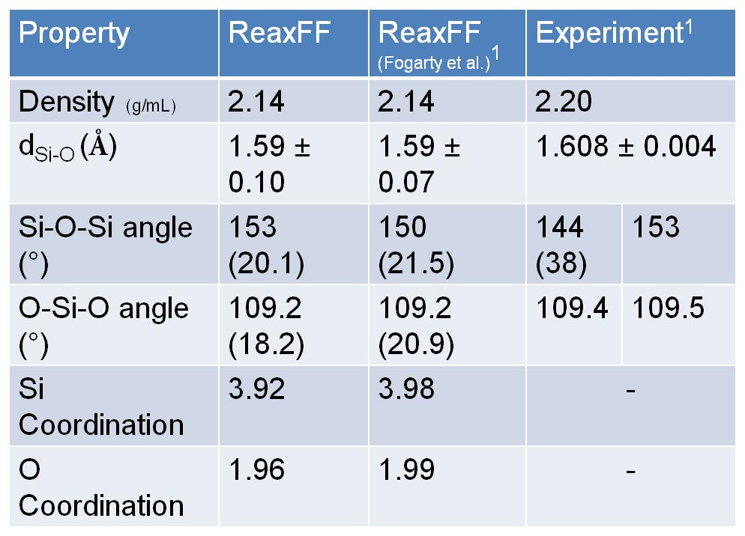
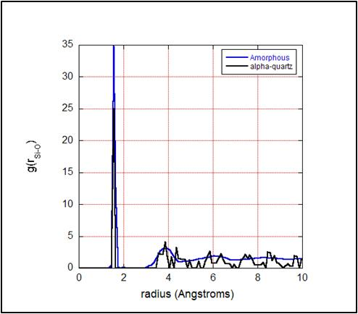
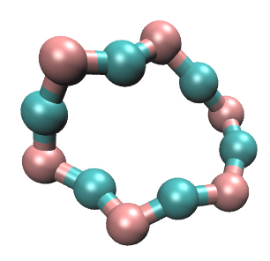

Molecular Dynamics Simulations of Radiation Damage in Amorphous Silica:
Effects of Hyperthermal Atomic Oxygen
Vanessa Oklejas
Space Materials Laboratory
The Aerospace Corporation
Molecular dynamics simulations were used to investigate the damage created in amorphous silica by hyperthermal atomic oxygen (AO) as a function of incident kinetic energy.
Motivation
Radiation Simulations
Results
Neutral atomic oxygen is the dominant species in low earth orbit (LEO).
Spacecraft materials undergo significant erosion due to atomic oxygen in LEO; the mitigation of radiation damage of spacecraft materials is a major concern.
Use MD simulations to understand how radiation modifies the molecular and mechanical properties of materials.
Examine radiation-induced changes in the material at the atomic level
Averaged Displacement Damage
AO Penetration Depth
100 eV
4 eV
surface
Methods
Small amount of displacement damage observed for AO with energies below E_{d} .
30 eV
A reactive force field (ReaxFF) was used to represent inter-atomic interactions.¹
  Preparation of amorphous silica substrate:
  A simulation box of 2000 SiO₂ moieties was heated to 4000 K and cooled at a rate of ~ 10¹³ K/sec. (τ = 0.25 fs)
  The first annealing cycle was performed using the NVT ensemble followed by a final annealing cycle in the NPT ensemble.
  A free surface was generated at the xy- plane.
30 eV
Penetration depth is commensurate with displacement damage.
4 eV
100 eV
MD simulation parameters:
  NVE ensemble; τ = 0.125 fs.
  Oxygen atom placed 5 Å above silica surface.
  Total simulation time was 32 ps.
Image details:
  AO shown as red sphere.
  Displaced atoms shown as pink (O) or cyan (Si) spheres.
  Original positions of atoms are rendered transparent.
  Silicate network shown as transparent sticks.
High energy AO projectiles introduce chemical changes in the silica model that, over time, will develop into stable defects. Defects are associated with performance degradation of amorphous silica (e.g., darkening, development of charge traps, decrease in mechanical strength).
Radiation-induced chemical changes
Conclusions & Future Work
Amorphous Silica Model
  Significant displacement damage was observed for simulations of AO projectile atoms with 100 eV energies, which was accompanied by changes in ring structure.
Limited damage was also observed for AO projectiles with energies below those typically used to model displacement damage (i.e., the threshold displacement damage, E_{d}).
Simulate and identify the formation of stable silica defects due to radiation-induced damage.
α-quartz
amorphous silica
Radiation-induced changes in silicate ring structure
Silicate ring structure describes connectivity in amorphous silicate materials.²
An increase in the larger ring sizes and a loss of most stable ring sizes was observed.
Silica tetrahedrons are connected to one another by bridging O atoms
4 eV
30 eV
100 eV
Larger rings are associated with nanoscale void formation.
12 node ring
References
Fogarty, J.C.; Aktulga, H.M.; Grama, A.Y.; van Duin, A.C.T.; Pandit, S.A., J. Chem. Phys., 132, 174704 (2010).
Le Roux, S.; Jund, P., Comp. Mater. Sci., 49, 70-83 (2010).
© 2013 The Aerospace Corporation
This work was supported under The Aerospace Corporation's Independent Research and Development Program.

