Slide 1
SNAP: Automated Generation of Quantum Accurate Potentials for Large-Scale Atomistic Materials Simulation
Aidan Thompson, Stephen Foiles, Peter Schultz,
Laura Swiler, Christian Trott, Garritt Tucker
Sandia National Laboratories
SAND Numbers: 2013-2093C, 2013-4097P
Notes:
-Large-scale MD simulation –s widely used to simulate materials behavior.
-Where things get hard is in the prediction of specific behaviors of specific materials.
-Interatomic potentials are either non-existent or insufficiently inaccurate.

Slide 2
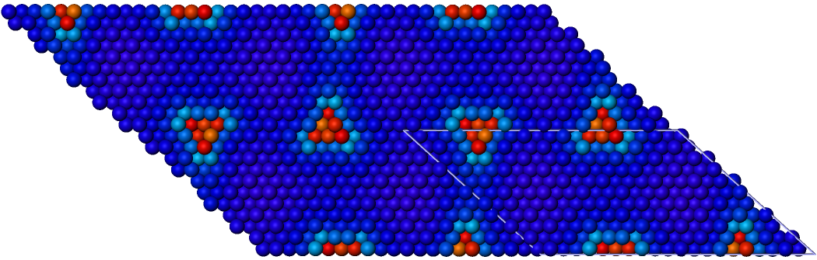
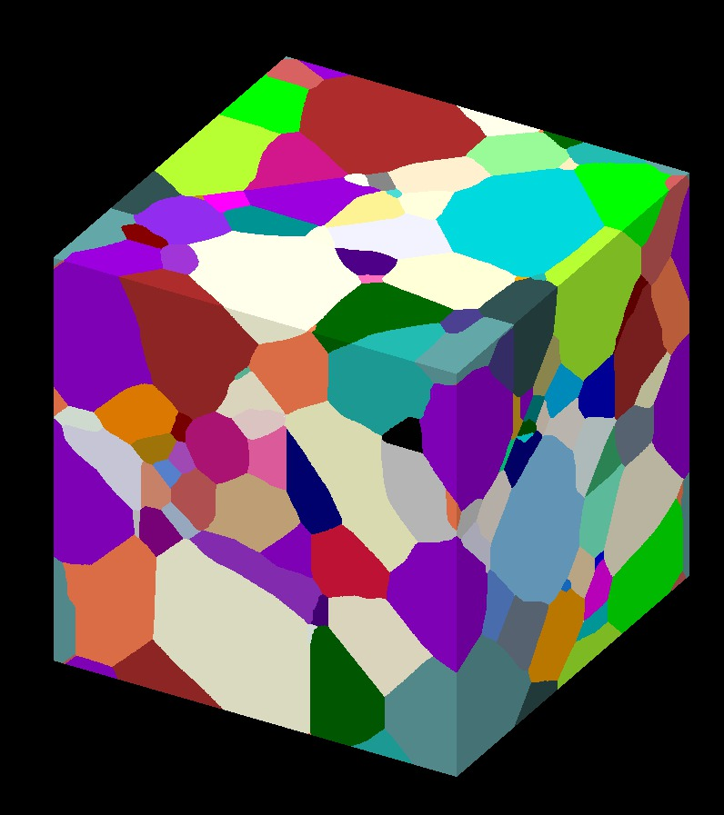
Explosive Growth in Complexity of Interatomic Potentials
Driver: Availability of Accurate QM data
Exposes limitations of existing potentials
Provides more data for fitting
Moore’s Law for Interatomic Potentials
Plimpton and Thompson, MRS Bulletin (2012).
Screw Dislocation Motion in BCC Tantalum
VASP DFT
N≈100
<110>
Weinberger, Tucker, and Foiles, PRB (2013)
Polycrystalline Tantalum Sample
http://lammps.sandia.gov/bench.html#potentials
LAMMPS MD
N≈10⁸
Notes:
-Large-scale MD simulation –s widely used to simulate materials behavior.
-Where things get hard is in the prediction of specific behaviors of specific materials.
-Interatomic potentials are either non-existent or insufficiently inaccurate.

Slide 3
Bispectrum: Invariants of Atomic Neighborhood
Example: Neighbor Density on 1-sphere (circle)
GAP Potential: Bartok et al., PRL 104 136403 (2010)
Local density around each atom expanded in 4D hyperspherical harmonics
Bond-orientational order parameters: Steinhardt et al. (1983), Landau (1937)
“Shape” of atomic configurations captured by lowest-order coefficients in series
Bispectrum coefficients are a superset of the bond-orientational order parameters, in 4D space.
Preserve universal physical symmetries: invariance w.r.t. rotation, translation, permutation
Hexatic neighborhood
Bispectrum peaks at (0,0), (0,6), (6,0),…
θ
Power spectrum peaks at k = 0,6,12,…
In 3D, use 3-sphere

Slide 4
SNAP: Spectral Neighbor Analysis Potentials
GAP (Gaussian Approximation Potential): Bartok, Csanyi et al., Phys. Rev. Lett, 2010. Uses 3D neighbor density bispectrum and Gaussian process regression.
SNAP (Spectral Neighbor Analysis Potential): Our SNAP approach uses GAP’s neighbor bispectrum, but replaces Gaussian process with linear regression.
  More robust
  Decouples MD speed from training set size
  Allows large training data sets, more bispectrum coefficients
  Straightforward sensitivity analysis

Slide 5
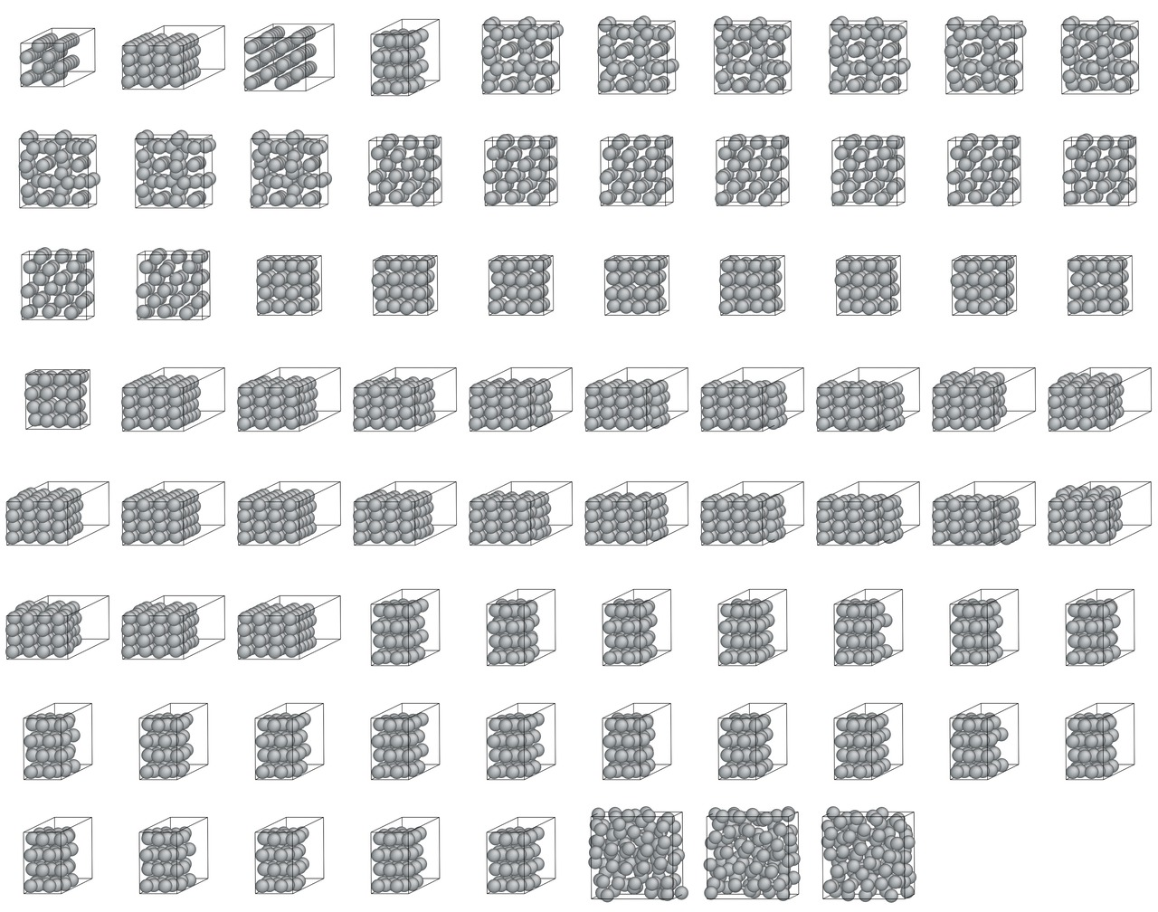
SNAP: Automated Machine-Learning Approach to Quantum-Accurate Potentials (with Laura Swiler, 1441)
Choose hyper-parameters:
QM group weights, bispectrum indices,
cutoff distance,
Python
LAMMPS files
QM
groups
DAKOTA
LAMMPS
bispectrum coeffs
pair potential
In: Cell Dimensions
Atom Coords
Atom Types
Out: Energy
Atom Forces
Stress Tensor
LAPACK
SNAP coeffs
Output responses:
Energy, force, stress errors per group, elastic constants,…

Slide 6
SNAP: Predictive Model for Tantalum
Objective: model the motion of dislocation cores and interaction with grain boundaries to understand microscopic failure mechanisms in BCC metals. Existing tantalum potentials do not reproduce key results from DFT calculations.
VASP DFT Training Data
363 DFT configurations
~100-atom supercells with perturbed atoms: BCC, FCC, A15, Liquid
Relaxed Surfaces
Generalized stacking faults, relaxed and unrelaxed
2-atom strained cells for BCC, FCC
No dislocation or defect structures
Notes:
Create training set data for BCC/FCC/BCT Tantalum (Foiles, Tucker)
Include both bulk and deformation properties
Automate the SNAP fitting procedures (Thompson, Swiler)
Evaluate accuracy relative to DFT
Iterate on training data to fix problems
Use best performers in large-scale simulations of dislocations interacting with grain boundaries.

Slide 7
Accuracy of SNAP Tantalum Potentials
Tantalum |F-F_{QM}| (eV/A)
BCC Lattice and Elastic Constants
0.52
0.087
 | a [A] | C11 [Gpa] | C12 [Gpa] | C44 [Gpa]
Expt | 3.303 | 266 | 158 | 87
ADP* | 3.305 | 265 | 163 | 85
DFT | 3.320 | 263 | 162 | 75
SNAP04 | 3.316 | 260 | 164 | 78
ADP*
SNAP04
*Gilbert, Queyreau, and Marian, PRB, (2011)
Radial Distribution Function, Molten Tantalum
T=3500 K, volume/atom = 20.9 Å³
QM
Jakse et al.(2004)
SNAP
Cand04
Notes:
Create training set data for BCC/FCC/BCT Tantalum (Foiles, Tucker)
Include both bulk and deformation properties
Automate the SNAP fitting procedures (Thompson, Swiler)
Evaluate accuracy relative to DFT
Iterate on training data to fix problems
Use best performers in large-scale simulations of dislocations interacting with grain boundaries.

Slide 8
Accuracy of SNAP Tantalum Potentials
 | SNAP candidate |  |  |  |  |  |  | EAM |  |  | ADP
 | 1 | 2 | 3 | 4 | 6 | 6A | DFT | Zhou | Li | ATFS | Mishin
Lattice Parameter (Angstroms) | 3.316 | 3.317 | 3.316 | 3.316 | 3.316 | 3.316 | 3.320 | 3.303 | 3.303 | 3.306 | 3.305
Equilibrium Atomic Energy (eV) | 11.759 | 11.843 | 11.781 | 11.787 | 11.859 | 11.852 | 11.85 | 8.090 | 8.089 | 8.100 | 8.100
Vacancy Formation Energy (eV) - Relaxed | -0.15 | 3.55 | -0.31 | 0.01 | 2.70 | 2.71 | 2.89 | 2.974 | 2.747 | 2.904 | 2.920
Vacancy Formation Energy (eV) - Unrelaxed | 0.43 | 3.68 | -0.08 | 0.19 | 3.03 | 3.03 | 3.36 | 3.078 | 2.936 | 3.133 | 3.014
100 Surface Energy (J/m2)- Relaxed | 0.02 | 2.44 | 0.62 | 0.87 | 2.73 | 2.68 | 2.40 | 2.342 | 2.034 | 2.329 | 2.243
110 Surface Energy (J/m2) - Relaxed | 0.14 | 2.28 | 0.56 | 0.79 | 2.40 | 2.34 | 2.25 | 1.984 | 1.757 | 1.982 | 2.126
111 Surface Energy (J/m2) - Relaxed | -0.18 | 2.57 | -0.09 | 0.78 | 2.65 | 2.58 | 2.66 | 2.563 | 2.197 | 2.498 | 2.574
112 Surface Energy (J/m2) - Relaxed |  | 2.47 |  | 0.90 | 2.35 | 2.49 | 2.60 | 2.361 | 2.018 | 2.302 | 2.455
C11 | 285.6 | 283.1 | 273.7 | 258.3 | 268.9 | 270.2 | 263.0 | 263.8 | 247.4 | 266.1 | 265.1
C12 | 155.1 | 147.5 | 155.3 | 169.0 | 152.8 | 151.1 | 161.6 | 157.3 | 147.0 | 164.5 | 163.1
C44 | 56.2 | 71.1 | 80.0 | 67.9 | 77.8 | 73.4 | 75.3 | 81.4 | 86.6 | 82.6 | 84.6
B | 198.6 | 192.7 | 194.7 | 198.8 | 191.5 | 190.8 | 195.4 | 192.8 | 180.4 | 198.3 | 197.1
110 Unstable SFE (J/m²) - Unrelaxed | 0.530 | 0.957 | 1.030 | 0.613 | 1.190 | 1.188 | 0.850 | 0.759 | 0.982 | 1.010 | 0.609
112 Unstable SFE (J/m²) - Unrelaxed | 0.410 | 1.056 | 0.946 | 0.537 | 1.330 | 1.346 | 1.000 | 0.876 | 1.136 | 1.167 | 0.771
110 Unstable SFE (J/m²) - Relaxed | 0.198 | 0.717 | 0.513 | 0.374 | 1.130 | 1.138 | 0.715 | 0.748 | 0.931 | 0.950 | 0.584
112 Unstable SFE (J/m²) - Relaxed | 0.135 | 0.803 | 0.303 | 0.340 | 1.230 | 1.252 | 0.841 | 0.866 | 1.079 | 1.100 | 0.739
SI - crowd ion (eV) - Relaxed |  | 4.35 |  | 1.99 | 5.87 | 5.46 | 4.45 | 5.062 | 6.536 | 7.121 | 7.481
SI - octahedral (eV) - Relaxed |  | 5.59 |  | 4.64 | 7.60 | 6.78 |  | 5.094 | 7.528 | 7.915 | 39.877
SI - <100> dumbbell (eV) - Relaxed |  | 5.00 |  | 3.18 | 7.12 | 6.58 | 5.58 | 5.243 | 8.031 | 8.029 | 26.470
SI - <110> dumbbell (eV) - Relaxed |  | 4.74 |  | 2.73 | 5.73 | 5.15 | 5.14 | 4.931 | 6.088 | 6.784 | 80.789
SNAP_1 and SNAP_3 have unrealistic behavior
SNAP_6A and SNAP_6 have give the best agreement with DFT
In general, SNAP_6 and SNAP_6A have better agreement with DFT than the EAM and ADP potentials.
Notes:
Create training set data for BCC/FCC/BCT Tantalum (Foiles, Tucker)
Include both bulk and deformation properties
Automate the SNAP fitting procedures (Thompson, Swiler)
Evaluate accuracy relative to DFT
Iterate on training data to fix problems
Use best performers in large-scale simulations of dislocations interacting with grain boundaries.

Slide 9
Testing SNAP against QM for Ta Screw Dislocation
Screw dislocation core structure
Weinberger, Tucker, and Foiles, PRB (2013)
QM
compact core
Energy barrier for screw dislocation dipole motion on {110}<112>
SNAP04
DFT
compact core
split core
ADP
SNAP potential superior to existing ADP and EAM potentials.
Correctly describes energy barrier for screw dislocation migration; no metastable intermediate (SNAP04).
SNAP potential also captures the correct core configurations.
Notes:
The basic point is that the SNAP potentials are outperforming common ADP and EAM potentials, in regard to the energy barrier for screw dislocation migration - especially cand04, which does not show the metastable configuration at the reaction coordinate of 0.5. In addition, the SNAP potentials seem to be capturing the correct core configurations as well during dislocation migration.

Slide 10
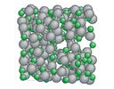
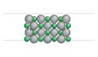
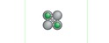
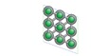
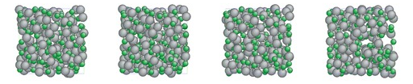
SNAP: Predictive Model for Indium Phosphide
468 configurations
Generated by Peter Schultz
1,066,738 lines of Quest output
131,796 data points
9 relaxed liquids
41 surfaces
11 cubic clusters
226 crystals
2x10xn = 181 liquid quenches

Slide 11
SNAP: Predictive Model for Indium Phosphide
Added neighbor weighting by type
Used different SNAP coefficients for each atom type
Used standard hyperparameters:
  Twojmax = 6
  Diag = 1
  Rcut = 4.2 A
  ZBL cutoffs = 4.0, 4.2 A

Slide 12
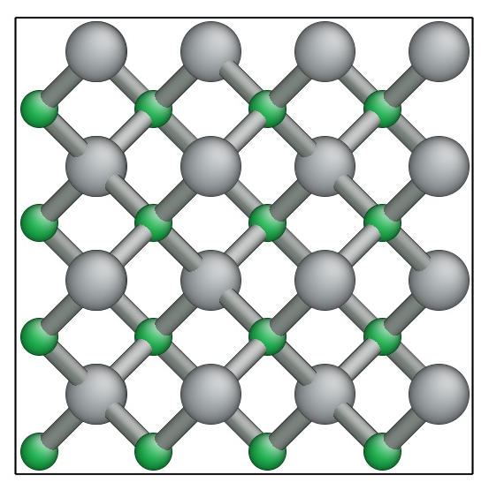
Initial Results for InP Zincblende Crystal
Balanced energy and force errors for entire training set
  Force error 0.019 eV/atom
  Energy error 0.17 eV/Å)
InP Zincblende Lattice
and Elastic Constants
 | a [A] | B[Gpa] | C11 [Gpa] | C12 [Gpa] | C44 [Gpa]
Expt | 5.87 | 71 | 101 | 56 | 47
Mod S-W* | 5.87 | 72 | 103 | 57 | 70
DFT | 5.84 | 69 | 98 | 54 | 45
InP_Cand04 | 5.82 | 88 | 111 | 77 | 47
*Branicio et al., J. Phys. (2008)

Slide 13
Computational Aspects of SNAP
FlOp count 10,000x greater than LJ
Communication cost unchanged
OMP Multithreading
Micro-load balancing (1 atom/node)
Excellent strong scaling
Max speed only 10x below LJ
GPU version shows similar result
SNAP strong-scaling on Sequoia
65,536 atom silicon benchmark
 |  | LJ | SNAP | SNAP/LJ
Data | kBytes/atom | 1 | 1 | 1
Computation | MFlOp/atom-step | 0.001 | 10 | 10,000
Min N/P | Atom/node | 100 | 1 | 1/100
Max Speed | Step/Sec | 10,000 | 1,000 | 1/10
Notes:
The SNAP potential also has some interesting computational characteristics. The FlOps/atom-step is about 10,000 that of Lennard-Jones. This means we can extend strong scaling to much larger node counts on a fixed size problem. This graph is a little busy, but it compares strong-scaling on three different platforms for the same fixed size problem: Chama(Intel Sandybridge), Sequoia (IBM BG/Q), and Titan (NVIDIA Kepler). Instead of node count on the x-axis, Christian has plotted Peak Performance for that number of nodes. On the y-axis is performance, proportional to speedup. We see that on the full Sequoia machine, there is no more speed-up, but on the full Titan, we are still getting good scaling. We see that on the Chama Intel Sandybridge nodes we are getting higher absolute performance for the same nominal peak performance. There are not enough nodes on Chama to see where strong-scaling breaks down.

Slide 14
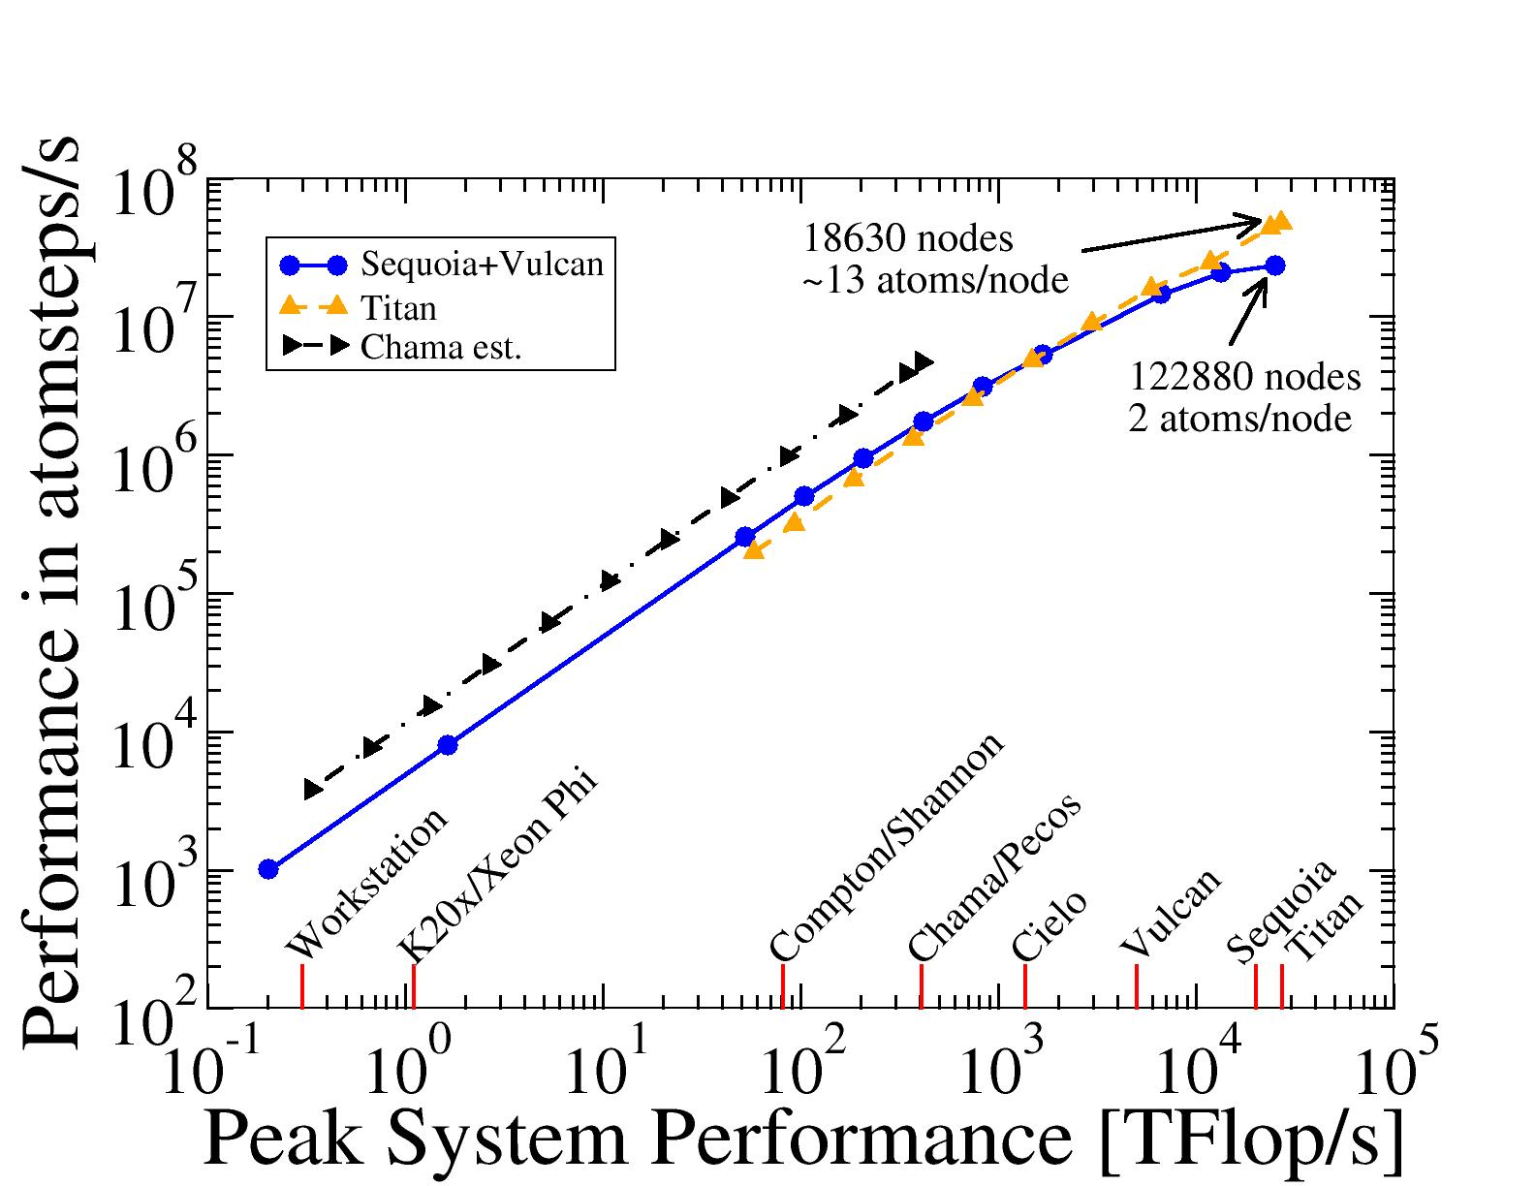
Computational Aspects of SNAP
SNAP strong-scaling on Sequoia, Titan, Chama
245,760 atom silicon benchmark
Titan
1230 nodes
~200 at/node
Sequoia
Chama
Notes:
The SNAP potential also has some interesting computational characteristics. The FlOps/atom-step is about 10,000 that of Lennard-Jones. This means we can extend strong scaling to much larger node counts on a fixed size problem. This graph is a little busy, but it compares strong-scaling on three different platforms for the same fixed size problem: Chama(Intel Sandybridge), Sequoia (IBM BG/Q), and Titan (NVIDIA Kepler). Instead of node count on the x-axis, Christian has plotted Peak Performance for that number of nodes. On the y-axis is performance, proportional to speedup. We see that on the full Sequoia machine, there is no more speed-up, but on the full Titan, we are still getting good scaling. We see that on the Chama Intel Sandybridge nodes we are getting higher absolute performance for the same nominal peak performance. There are not enough nodes on Chama to see where strong-scaling breaks down.

Slide 15
Conclusions
SNAP provides a powerful framework for automated generation of interatomic potentials fit to QM data
Uses the same underlying representation as GAP, and achieves similar accuracy, but uses a simpler regression scheme
For tantalum, reproduces many standard properties, and correctly predicts energy barrier for dislocation motion
We are now extending the approach to indium phosphide
Acknowledgements
Christian Trott
Laura Swiler
Stephen Foiles, Garritt Tucker, Chris Weinberger
Peter Schultz, Stephen Foiles

