Slide 1
General LAMMPS Overview
Aidan Thompson, Dept. 1426, Scalable Algorithms
Sandia National Laboratories
August 2013 LAMMPS Users' Workshop and Symposium
Notes:
It is a great pleasure to speak about our recent large-scale reactive MD simulations in this symposium. I am Ray Shan, post-doc from Sandia National Labs, and this work is in collaboration with Aidan Thompson, whom I have been working with for almost two years.
In this talk, I will speak about the shock-induced initiation processes in energetic materials ANFO and PETN using reactive MD simulations. For ANFO, we investigated the effects of orientation and fueling conditions on initiation, and for PETN, we introduced porosities, in the form of a spherical void, applied an explicit shock, then we observed void collapse, resulted formation of hotspots, and enhanced chemical reactivity.
Our MD simulations are reactive, which allow us to observe and examine chemical reactions.

Slide 2
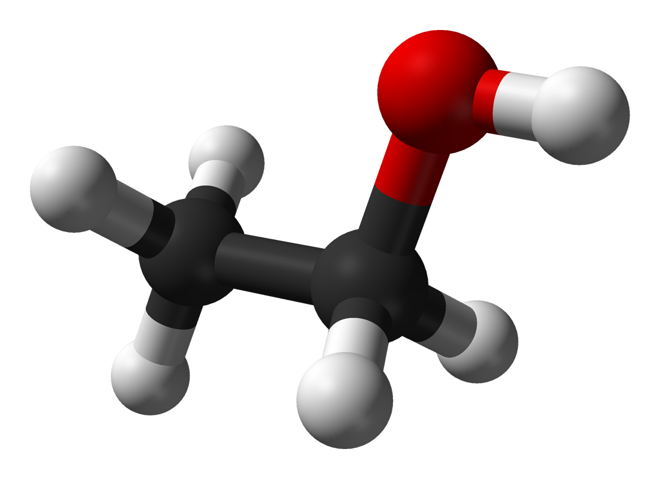


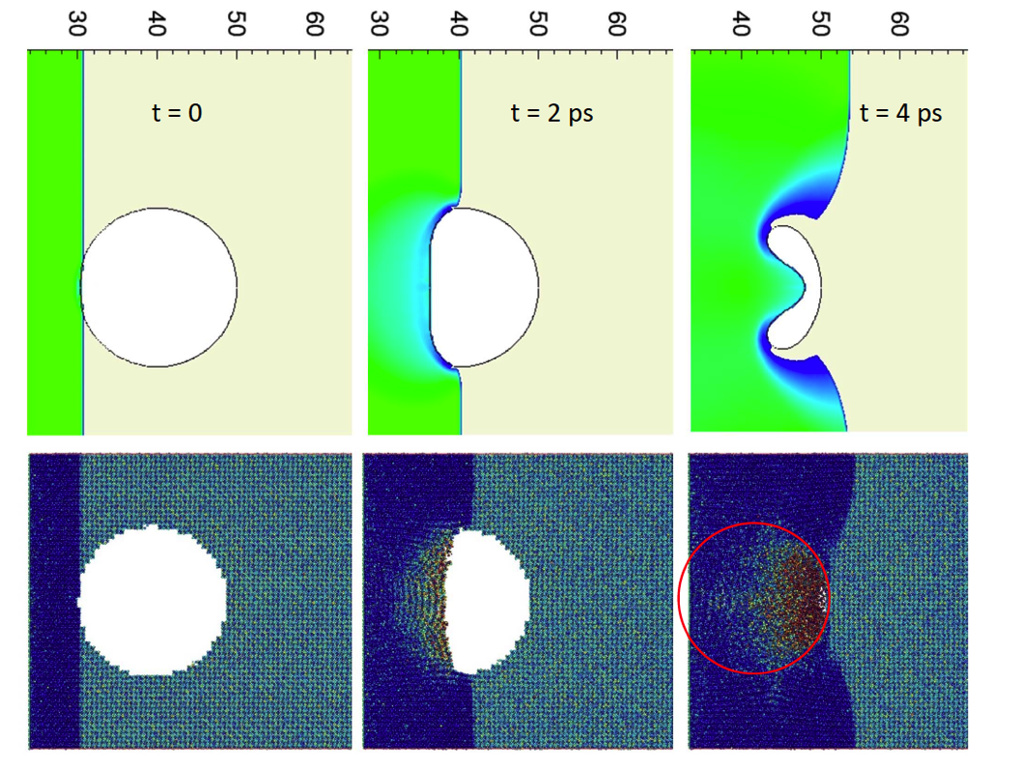
Introduction: What is large-scale MD good for?
Quantum mechanical electronic structure calculations (QM) provide accurate description of mechanical and chemical changes on the atom-scale: 10x10x10~1000 atoms
Atom-scale phenomena drive a lot of interesting physics, chemistry, materials science, mechanics, biology…but it usually plays out on a much larger scale
Mesoscale: much bigger than an atom, much smaller than a glass of beer.
QM and continuum/mesoscale models (CM) can not be directly compared.
10⁻⁶ s
Continuum
Mesoscale
Models
Time
Large-Scale MD simulation
QM
10⁻¹⁵ s
Å
Distance
mm
CM/
CTH
Small molecular dynamics (MD) simulations can be directly compared to QM results, and made to reproduce them
MD can also be scaled up to millions (billions) of atoms, overlapping the low-end of CM
Limitations of MD orthogonal to CM
Enables us to inform CM models with quantum-accurate results
MD/
LAMMPS
CTH images courtesy of David Damm, Sandia
Notes:
A brief introduction on reactive MD simulations. I know many of you may have seen this plot for a million times, but it serves as a great illustration to the capability of reactive MD.
Quantum mechanical methods provide accurate description of systems of roughly several thousand atoms. Continuum hydrodynamics models, in shock simulations particularly, describe propagation of shock and detonation fronts in real devices. However, these two methods can not be directly compared. ......
Provided here as an example, the top panel is a void collapse and void jetting process of a 20 nm void from a continuum hydrodynamics code CTH, and the bottom panel is the same process of a same system from LAMMPS reactive MD simulations. We see similarities and also disagreements between CH and RMD, and how to inform and calibrate CH with RMD is an ongoing investigation.
For the RMD simulations in this work, we used the reactive force field.

Slide 3
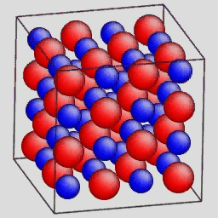
MD: What is it?
Initial Positions
and Velocities
MD Engine
Positions and
Velocities at
many later times
Interatomic
Potential
Mathematical Formulation
Classical Mechanics
Atoms are Point Masses: r₁, r₂, ..... r_{N}
Positions, Velocities, Forces: r_{i}, v_{i}, F_{i}
Potential Energy Function = V(r^{N})
6N coupled ODEs

Slide 4
MD Time Integration Algorithm
Most codes and applications use variations and extensions to the Størmer-Verlet explicit integrator:
Only second-order : δE = |<E>-E₀| ~ Δt², but….
….time-reversible, symplectic map: global stability trumps local accuracy of high-order schemes
More specifically, it can be shown that for Hamiltonian equations of motion, Størmer-Verlet exactly conserves a “shadow” Hamiltonian and E-E_{S} ~ O(Δt²)
For users: no energy drift over millions of timesteps
For developers: easy to decouple integration scheme from efficient algorithms for force evaluation, parallelization.
32 atom LJ cluster, 200 million MD steps, Δt=0.005, T=0.4
4

Slide 5
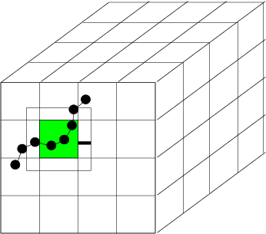
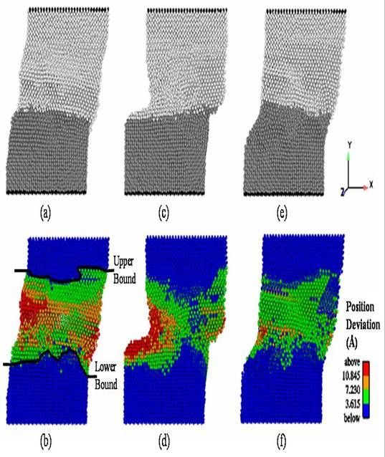
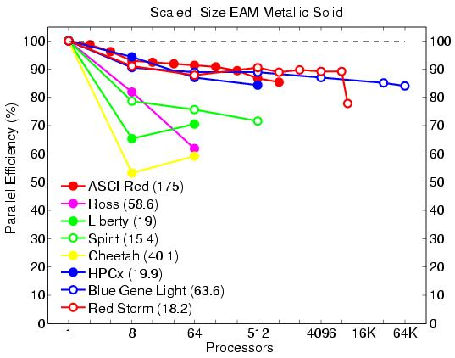
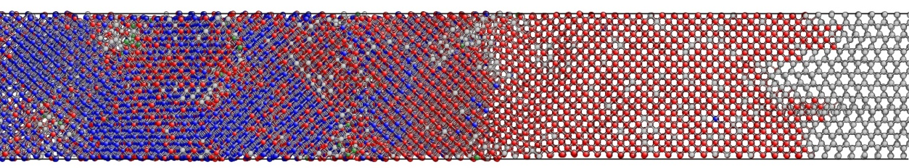
What is LAMMPS?
(Large-scale Atomic/Molecular Massively Parallel Simulator)
http://lammps.sandia.gov
Classical MD code.
Open source, highly portable C++.
Freely available for download under GPL.
Easy to download, install, and run.
Well documented.
Easy to modify or extend with new features and functionality.
Active users e-mail list with over 650 subscribers.
Users’ workshops: February 2010, August 2011, August 2013.
Spatial-decomposition of simulation domain for parallelism.
Energy minimization via conjugate-gradient relaxation.
Atomistic, mesoscale, and coarse-grain simulations.
Variety of potentials (including many-body and coarse-grain).
Variety of boundary conditions, constraints, etc.

Slide 6
Freely Available Parallel MD Codes
CHARMM, AMBER: grand-daddies of MD codes, lots of bio features
NAMD: bio, clever decomposition, very scalable
GROMACS: bio, fastest single processor performance, now scalable
DL-POLY: soft-materials
GULP: crystalline inorganic solids
HOOMD: GPU-based code, fastest on single GPUs
LAMMPS
  materials oriented, wide range of interatomic potentials
  many coarse-grained models for mesoscale to continuum
  scalable for large simulations (1000s of particles/processor)
  easy to extend
Notes:
17 years ago there weren’t many parallel MD codes, which is why we formed the initial CRADA to create LAMMPS
since that time, many good codes have been created, several of the most popular ones are listed here
want to give you some perspective on their focus and strong points and compare that to LAMMPS
C,A,N,G are focused on bio problems and N,G in particular are very scalable for the
hard problem of running a smallish bio problem on lots of processors, so few atoms per processors
due to clever decomposition algorithms developed in the past few years
some in fact by Marc Snir and the folks at DE Shaw
LAMMPS can do bio problems, but has more of a focus on materials problems, due to Sandia’s mission
this has translated to lots of interatomic potentials so a broad range of materials can be modeled,
including coarse-grained models that allow you to extend the length and timescales that can be simulated
I’ll tell you about some of that in the next few slides
while LAMMPS is not as scalable as NAMD & GROMACS for small problems, it performs quite well on large problems
on lots of processors, the kind more typical of materials modeling,
so long as you have at least a few thousand atoms per processor

Slide 7
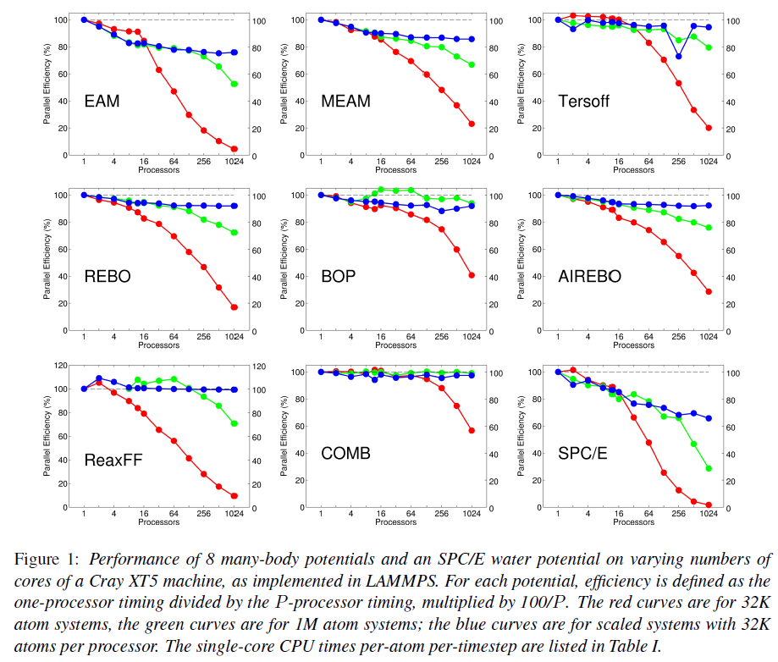
Why Use LAMMPS?
Answer 1: Good parallel performance
Red = 32k atoms
small fixed-size
strong scaling
Green = 1M atoms
large fixed-size
strong scaling
Blue = 32k atoms/proc
scaled size
weak scaling
MRS Bulletin,
May 2012,
37, 513-521.

Slide 8
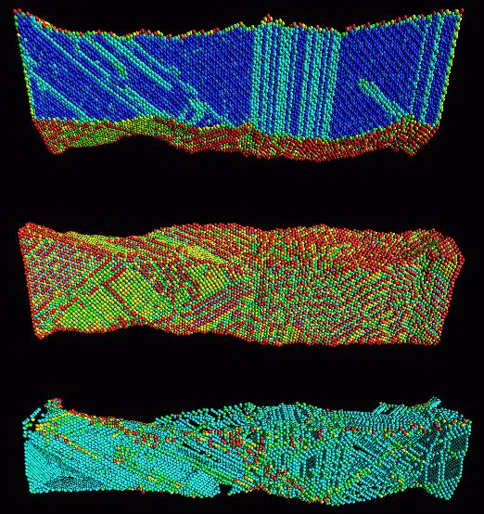
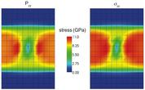
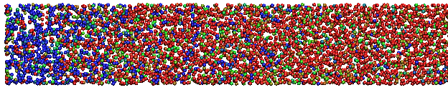
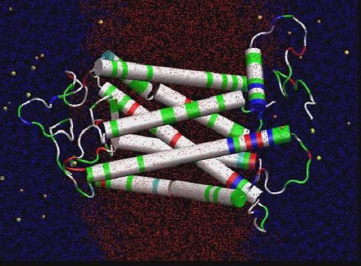
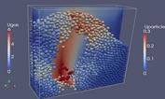
Why Use LAMMPS?
Answer 2: Versatility
Materials Science
Solid Mechanics
Chemistry
Biophysics
Granular Flow

Slide 9
Why Use LAMMPS?
Answer 3: Modularity
LAMMPS Objects
atom styles: atom, charge, colloid, ellipsoid, point dipole
pair styles: LJ, Coulomb, Tersoff, ReaxFF, AI-REBO, COMB, MEAM, EAM, Stillinger-Weber,
fix styles: NVE dynamics, Nose-Hoover, Berendsen, Langevin, SLLOD, Indentation,...
compute styles: temperatures, pressures, per-atom energy, pair correlation function, mean square displacements, spatial and time averages
Goal: All computes works with all fixes work with all pair styles work with all atom styles

Slide 10
Why Use LAMMPS?
Answer 4: Potential Coverage
LAMMPS Potentials by Material
Biomolecules: CHARMM, AMBER, OPLS, COMPASS (class 2),
long-range Coulombics via PPPM, point dipoles, ...
Polymers: all-atom, united-atom, coarse-grain (bead-spring FENE),
bond-breaking, …
Materials: EAM and MEAM for metals, Buckingham, Morse, Yukawa,
Stillinger-Weber, Tersoff, COMB, SNAP, ...
Chemistry: AI-REBO, REBO, ReaxFF, eFF
Mesoscale: granular, DPD, Gay-Berne, colloidal, peri-dynamics, DSMC...
Hybrid: can use combinations of potentials for hybrid systems:
water on metal, polymers/semiconductor interface,
colloids in solution, …

Slide 11
Why Use LAMMPS?
Answer 4: Potential Coverage (contd.)
LAMMPS Potentials by Functional Form
pairwise potentials: Lennard-Jones, Buckingham, ...
charged pairwise potentials: Coulombic, point-dipole
manybody potentials: EAM, Finnis/Sinclair, modified EAM (MEAM), embedded ion (EIM), Stillinger-Weber, Tersoff, AI-REBO, ReaxFF, COMB
coarse-grained potentials: DPD, GayBerne, ...
mesoscopic potentials: granular, peridynamics
long-range electrostatics: Ewald, PPPM, MSM
implicit solvent potentials: hydrodynamic lubrication, Debye
force-field compatibility with common CHARMM, AMBER, OPLS, GROMACS options

Slide 12
Why Use LAMMPS?
Answer 5: Easily extensible
One of the best features of LAMMPS
  90% of code is “extensions” via styles
  only ~35K of 474K lines is core of LAMMPS
Easy to add new features via 14 “styles”
  new particle types = atom style
  new force fields = pair style, bond style, angle style, dihedral style, improper style
  new long range = kspace style
  new minimizer = min style
  new geometric region = region style
  new output = dump style
  new integrator = integrate style
  new computations = compute style (global, per-atom, local)
  new fix = fix style = BC, constraint, time integration, ...
  new input command = command style = read_data, velocity, run, …
Enabled by C++
  virtual parent class for all styles, e.g. pair potentials
  defines interface the feature must provide
  compute(), init(), coeff(), restart(), etc

Slide 13
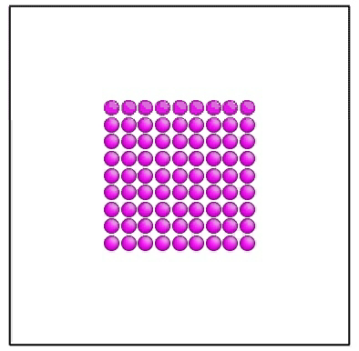
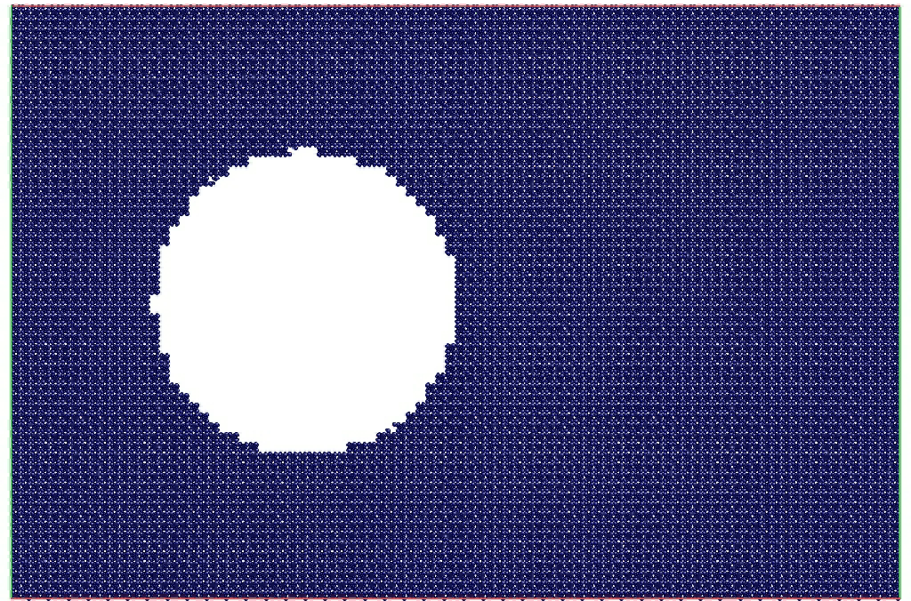
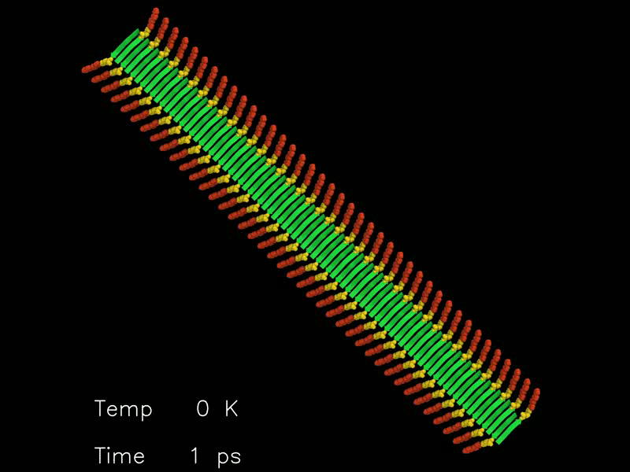
Why Use LAMMPS?
Answer 6: Movies
This is work by Aidan Thompson at home on his couch. It demonstrates an ordered solid cluster undergoing a melting transition to form a liquid droplet in equilibrium with a confined vapor phase. It provides a very direct demonstration of why there are three “states of matter.”
This is work by Ray Shan and Aidan Thompson at Sandia National Laboratories showing a 2 km/s shockwave passing through a spherical void in a molecular crystal of PETN. The shockwave produces a jet at the void surface which collides with the opposite surface. The collision creates a local hotspot, elevated temperature, chemical reaction, leading to initiation of detonation.
This is work by Alexey Shaytan et al. at the Dept of Energy-Related Nanomaterials (University of Ulm, Germany) on a large-scale fully atomistic MD simulation of the amyloid-like nanofibers formed by the conjugates of oligothiophenes and oligopeptides. Such compounds are very promising for applications in organic electronics (conductive organic nanowires).

