Slide 1

A new method for calculating the pressure profile by LAMMPS
August 2013
LAMMPS Users' Workshop and Symposium
Tohoku University
Advanced Institute for Material Research(WPI-AIMR)
Takenobu Nakamura

Slide 2
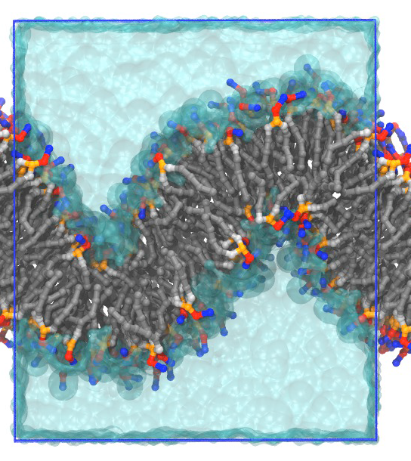
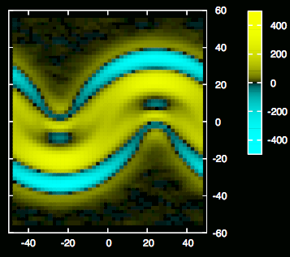
What kind of quantity we calculate?
Pxx
mechanical response in nano scale
Notes:
This is an example we calculate. The left figure shows a snapshot of MD simulation in LAMMPS.
The right figure shows a xx component of pressure tensor obtained by our implementation in LAMMPS.

Slide 3
MD mechanical property
Mapping from MD to continuous description
  Mechanical property stress distribution
  Resolution : Angstrom
    Fracture, dislocation, buckled membrane, etc.
  Accuracy, Convergence
    Virial poor convergence
    Time evolution of field variables
precise calculation is necessary!

Slide 4
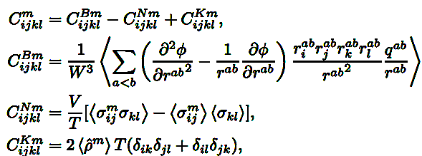
Relationship between stress tensor and mechanical properties
Stress tensor → elastic compliance
Saddle splay modulus
Surface tension
Solid
Soft Material
(Molecular liquid)

Slide 5
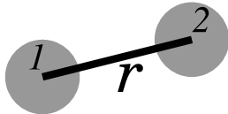
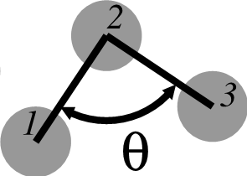
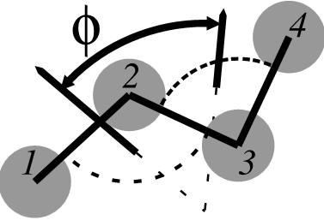


Rigorous definition of local stress field
m-body potential
Irving-Kirkwood contour
Notes:
More explicitely, stress tensor is represented like this.
Stress or pressure tensor field is introduced as a something whose divergence describe time evolution of momentum flux

Slide 6






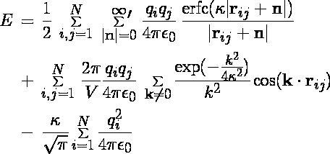
Force field in Soft Material
(package MOLECULE)
pair/vdw, bond(m=2)
pair/coul without Ewald
angle(m=3)
dihedral/improper (m=4)
kspace (m=∞)

Slide 7
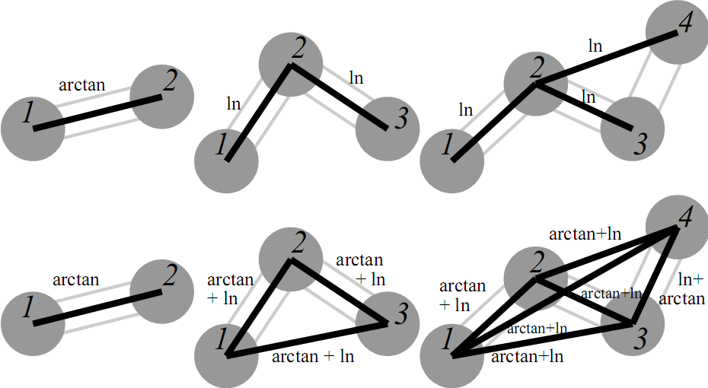
Choice of contours in cluster
Choose one node
Connect every nodes

Slide 8
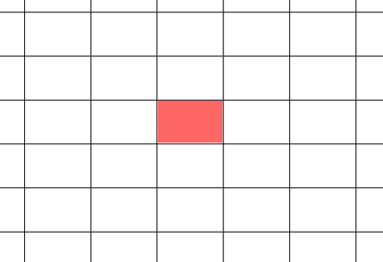
bin averaged stress
Volume (bin) average in
Irving-Kirkwood Contour
Its Contribution
in
3d volume data
1d data

Slide 9
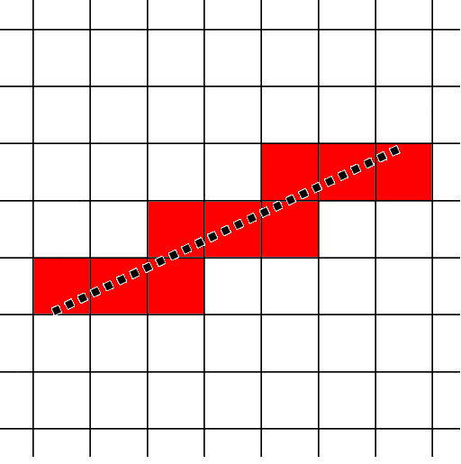
3d contour integration
Calculate the length of segment in each cuboidal bin
→few # of calculation
→accurate
Pioneering work by
Ollila et al. PRL (2009)
Count the number of point in cuboidal bin
→numerical discretized integration
c.f. ATC package
Notes:
They represent the line segment as a collection of points.
They count the number of the points in each bin and evaluate the

Slide 10
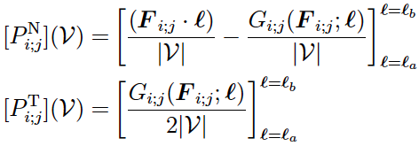
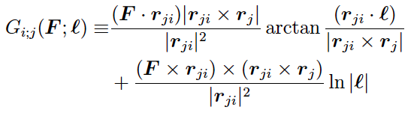
Pressure profile of spherical geometry
Notes:
Have to consider the direction of the basis vector for each position in the contour

Slide 11

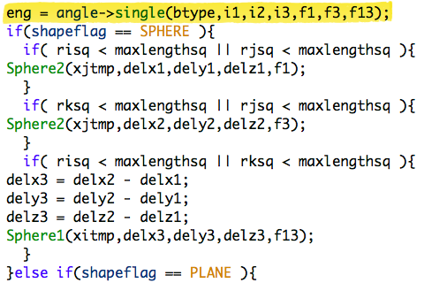
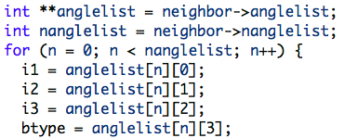
Implementing in LAMMPS
modify angle_*.cpp
modify dihedral_*.cpp and improper_*.cpp
Create new compute
  extraction

Slide 12
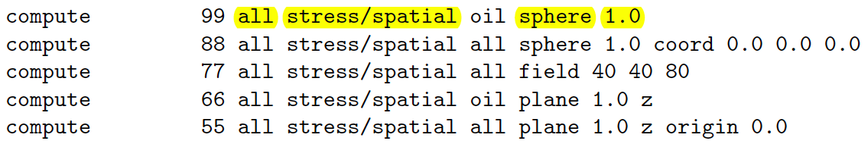
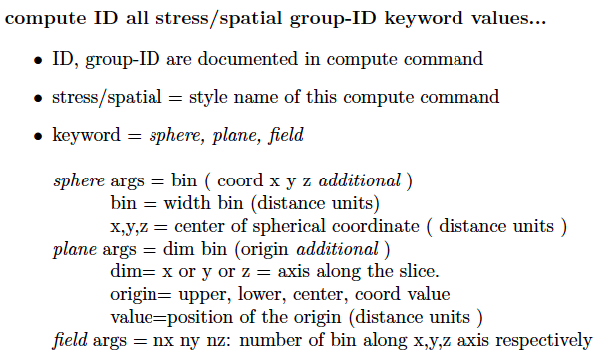
Preparing input script in LAMMPS .
C.O.M.→
oil group
Examples
Syntax

Slide 13
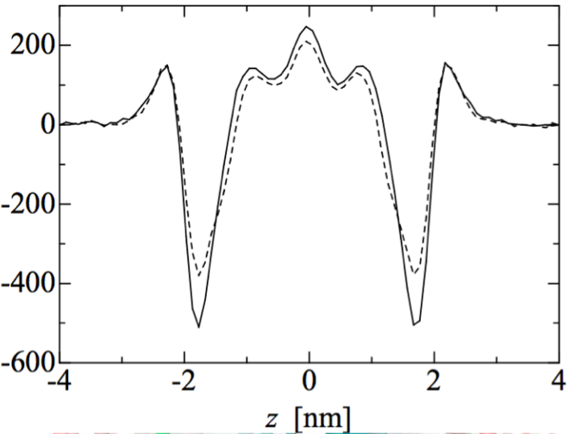
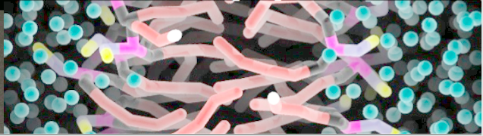
Example 1
Lateral pressure profile for planar membrane
P ^{T} (z) - P ^{N} [bar]
compute ID all stress/spatial lipids plane “width_of_bin” z
Notes:
Normal component is constant

Slide 14
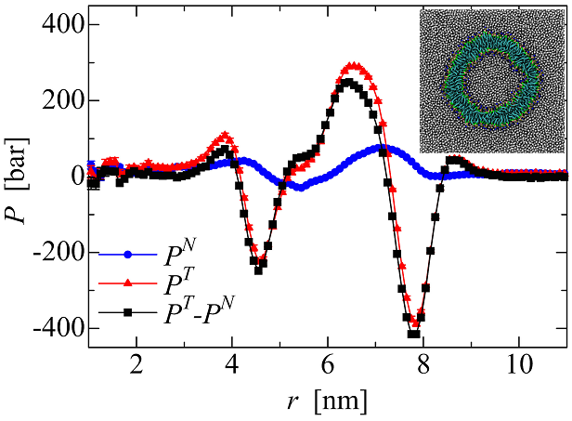
Example 2
Pressure profile for SUV along radial axis
T.N. et.al., J. Chem. Phys. 135, 094106 (2011)
r
compute ID all stress/spatial lipids sphere “width_of_bin”
Notes:
Normal component

Slide 15
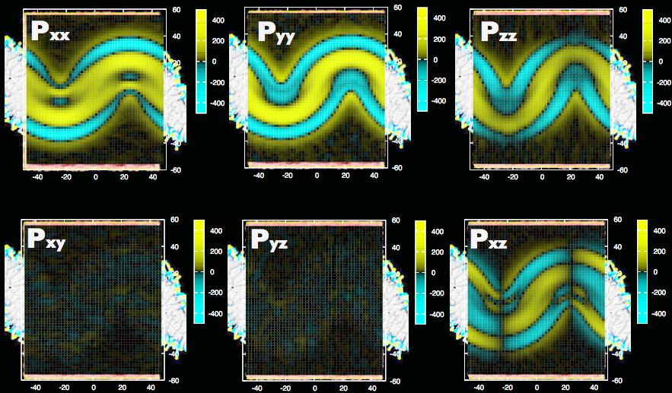
Example 3 pressure distribution of buckled membrane

Slide 16
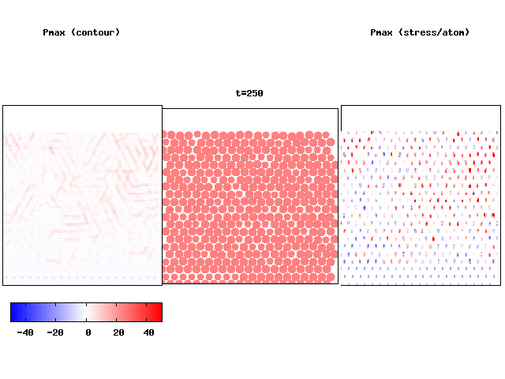
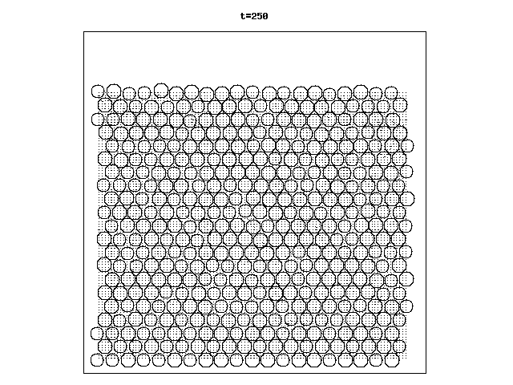

Example 4 time evolution of stress for indentation
(lammps/examples/indent/)
Maximum principal stress Pmax and particles
  Length=magnitude
  Direction principal axis
Comparison with stress/atom
compute stress/spatial
and fix ave/time
compute stress/atom
and fix ave/spatial
Pmax
Pmax
c.f. AtC package

Slide 17
Conclusions
Using the Irvin-Kirkwood contour integration, we implemented stress tensor field calculation algorithm in LAMMPS.
The algorithm enables us to precisely compute a clearly-defined local stress even at angstrom resolution.
The algorithm is useful for the standard force field for bio and soft systems.
Still need some works : SHAKE, Ewald force field, setting window of calculation
The program will be available through my webpage(?) soon!!

Slide 18
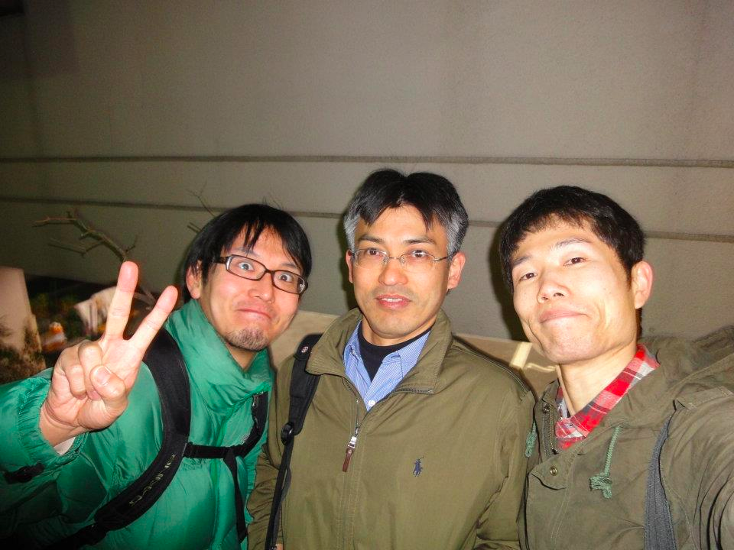
Thank you for your attention!
Collaborators,
  Wataru Shinoda (AIST)
  Shuhei Kawamoto (AIST)
Special thanks
    Tamio Ikeshoji (Tohoku Univ)

