Slide 1
Molecular Simulations of Repellant Surfaces for Chemical Biological Defense
LAMMPS Users' Workshop and Symposium
Craig K. Knox, Jerry B. Cabalo, Gary K. Kilper, Stephanie Ihejirika
August 8, 2013
Approved for public release
Notes:
Abstract
Contamination of surfaces by deposition of aerosol particles is a process that affects a broad array of application areas, including pharmaceutical and food production, as well as chemical and biological defense. The deposition of particles is driven by particle-surface adhesion. Using atomistic simulations, we examined the role of nanostructures in minimizing the interaction energy between nanoparticles and surfaces. Using molecular mechanics and molecular dynamics simulations, we calculated the interaction of nanoscale rigid protein particles with nanostructured silicon surfaces of various sizes consisting of arrays of cones to mimic sharp, rough surface features inspired by the Lotus leaf. Liquid water nanodroplets interacting with a similar set of surfaces were used to investigate the interaction for deformable particles. Binding energy, solvent-accessible surface area in contact between particle and surface, and wetting and repellency behavior were investigated. This work may help guide the design of future coatings and materials for detection, protection, and decontamination applications.

Slide 2

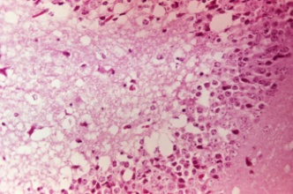
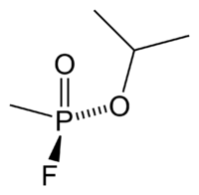
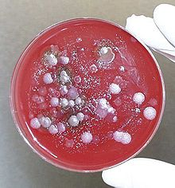
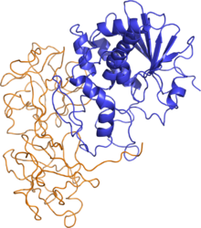
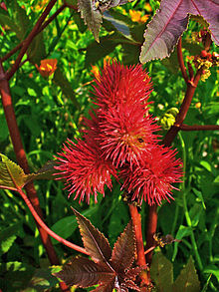

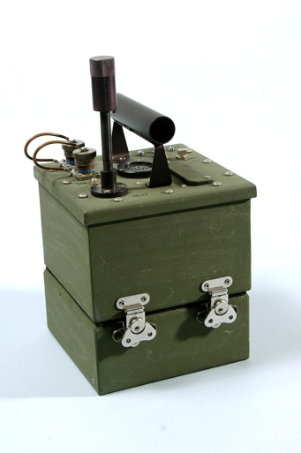
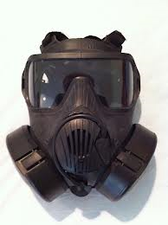
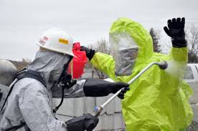
CB Defense
The CB in CBRNe (Chemical, Biological, Radiological, Nuclear, and explosives)
Chem Agents
Bio Agents
bacterium, virus, protozoan, parasite, fungus, or toxin
HD (Mustard)
Venezuelan equine encephalitis virus
Anthrax (Bacillus anthracis)
GB (Sarin)
VX
Ricin
Detection
Protection
Decontamination
Wikipedia and www.ecbc.army.mil
Approved for public release

Slide 3
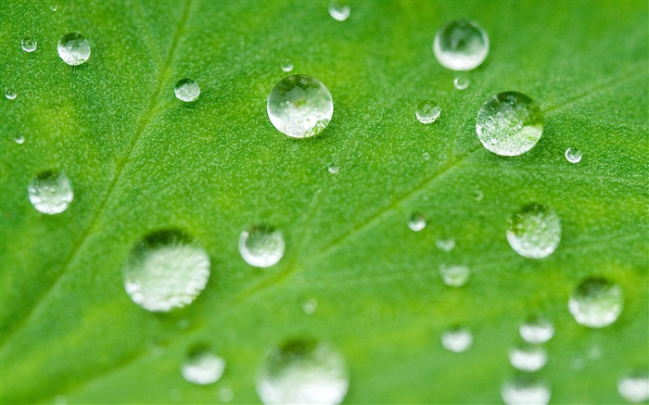


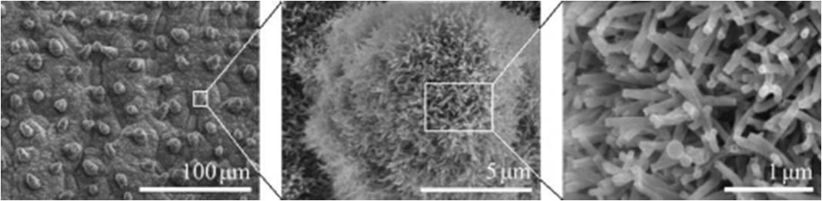
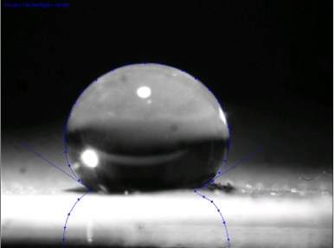
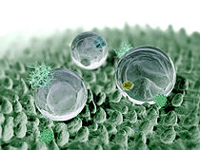
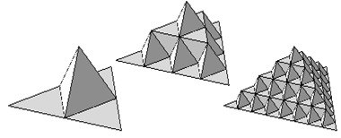
The Lotus Leaf
very clean because superhydrophobic, very low binding energy to particles
covered in forest of ~100nm pillars on ~10µm knobs, 30µm spacing
design similar synthetic surfaces?
contact angle > 150°
thanks Wikipedia and web
Approved for public release

Slide 4
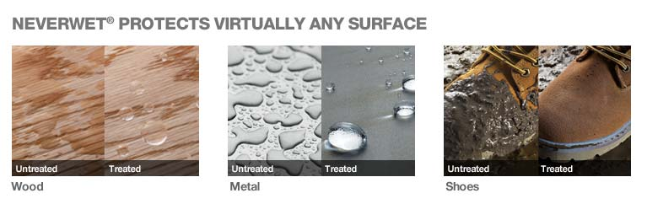
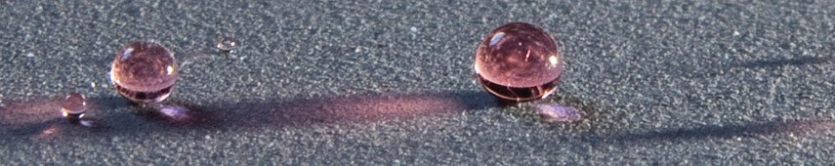
Rust-Oleum® NeverWet
NeverWet™ has “designed a coating that repels dirty water and thick oils, and that remains clean and virtually bacteria-free. When dust, dirt or other molecules accumulate on our surfaces, a light spray of water grabs the dust. Because the water is repelled by our superhydrophobic surface, it then simply rolls away.” http://www.neverwet.com
Approved for public release

Slide 5
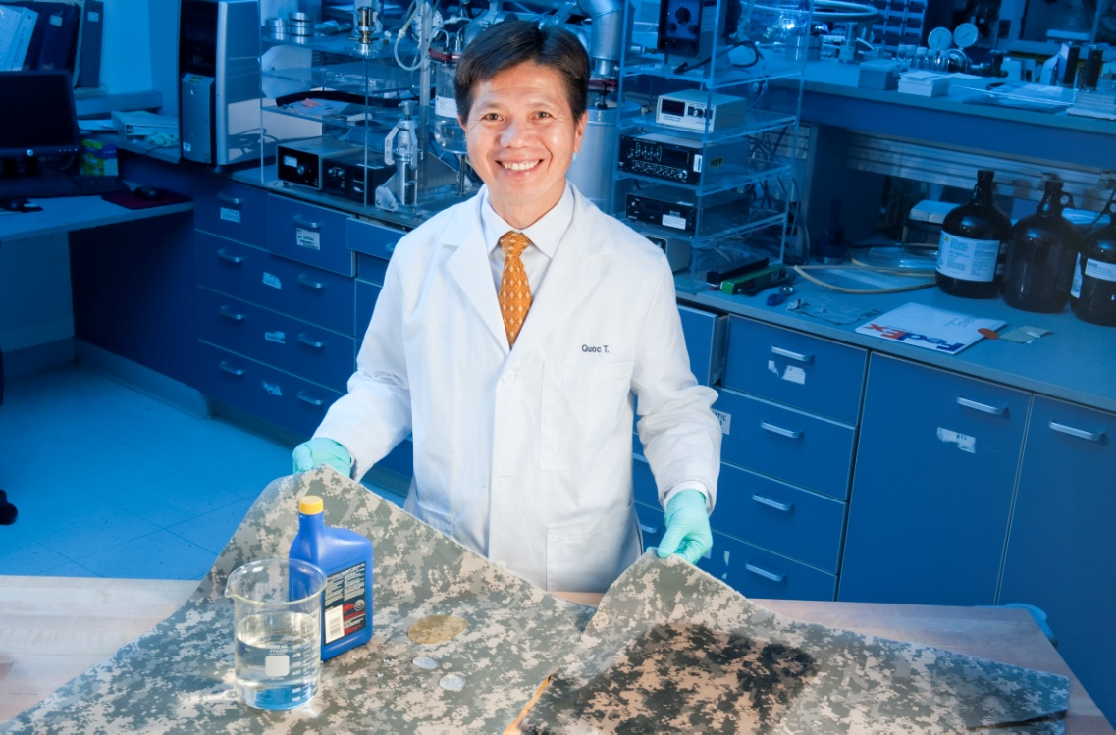
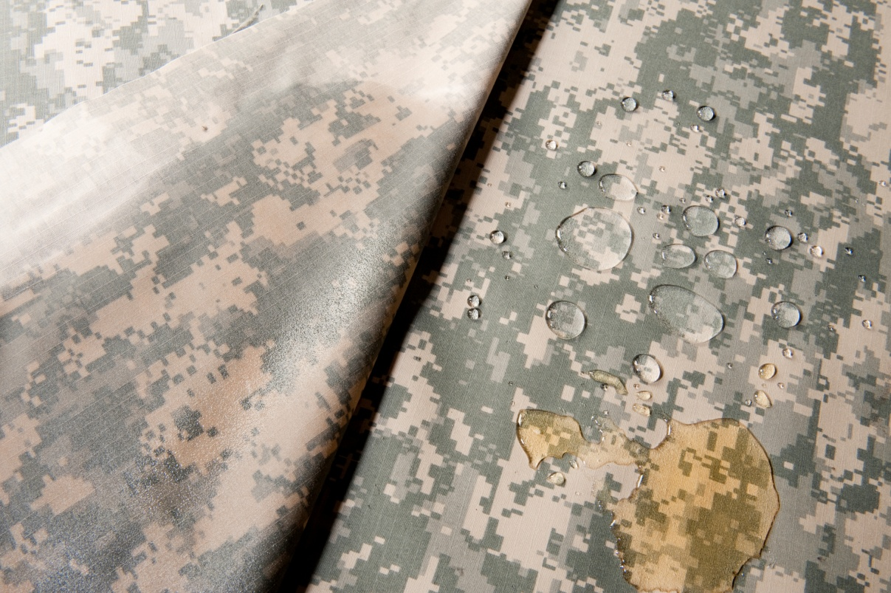
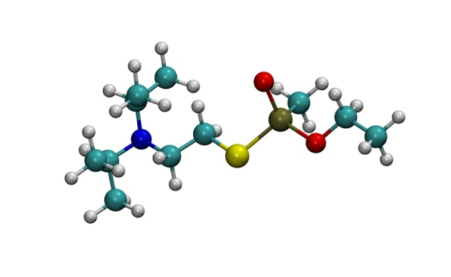
Self-Cleaning Clothes
omni = hydro (water) + oleo (oil)
What?
superomniphobic fabric coatings with nano and micro-structures (repeating ‘pimples’ pattern) inspired from Lotus leaf
Requires:
high contact angle, moisture/vapor permeability, laundering, wash durability, abrasion resistance, tensile strength, air permeability, and flexibility
Dr. Quoc Truong (Natick, in collab. w/ MIT & Luna Innovations, Inc.)
in addition to dirt/dust/mud, solvents/oils, water…
Wish List:
flame-resistance
odor-free
antimicrobial
multifunctional
VX
What about chem/bio agents and toxic industrial chemicals?
http://www.army.mil/article/95276/
Approved for public release

Slide 6
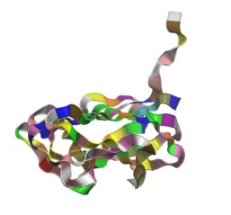
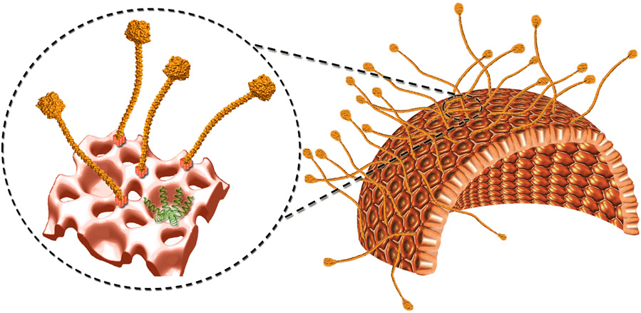
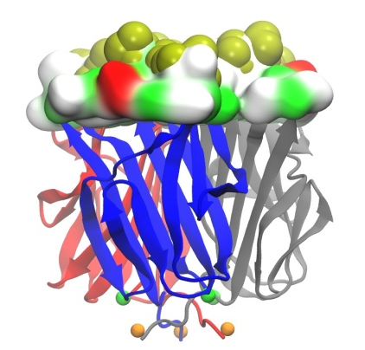
Exosporium Hairs
“[exosporium] may be the basis of the hydrophobicity of spores and, thereby, play a role in adhesion both in the environment and in vivo.”
P. Turnbull, Ed., Anthrax in humans and animals - 4th ed., World Health Organization, Geneva, Switzerland, 2008, p.60
BclA glycoprotein of exosporium
BclA monomer
EM of B. anthracis spore showing exosporium
BclA trimer
BJ Moberly, et al., J Bacteriol. 1966 July; 92(1): 220–228
bacterial spore
~2 μm spore
~70 nm hairs
schematic of exosporium basal layer and hairy-nap (hirsute layer)
PA. Bullough et al., “Surface architecture of endospores of the Bacillus cereus/anthracis/thuringiensis family at the subnanometer scale,” PNAS,108:16014-16019 (2011)
Approved for public release

Slide 7
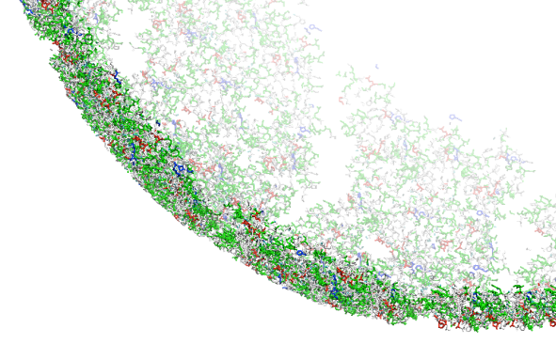
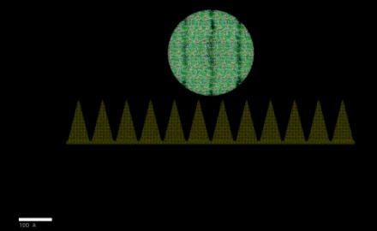
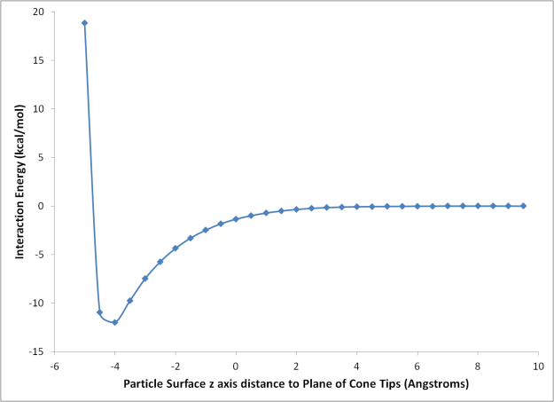
Solid Protein Aerosol
used classical molecular mechanics (LAMMPS) with LJ but no Coulomb (because of uncharged surface) and large cutoff
modeled a 26nm rigid BclA protein ball (hollow)
above silicon surface with cones of different sizes
moved ball over surface (in xy-plane) and up/down (z-axis) and calc. binding energy
at each location (single-point energy calc)
weakest binding energies occurred when contact area was minimized
Strongest binding occurs when particle slips between cones
10 nm
Approved for public release

Slide 8
LAMMPS Binding Energy Calc.
E_{bind} = E_{sys} – (E_{surf} + E_{part})
Normally requires 3 separate simulations to calculate the energy of the entire system, the surface in isolation, and the particle in isolation.
LAMMPS’ “compute group/group” allows quick calculation of E_{bind} from only 1 sim by directly calculating interaction energy between surface and particle groups of atoms.
NOTE: this is potential not free energy.
Approved for public release

Slide 9
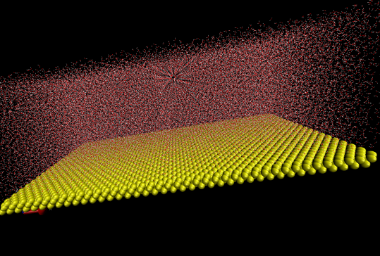
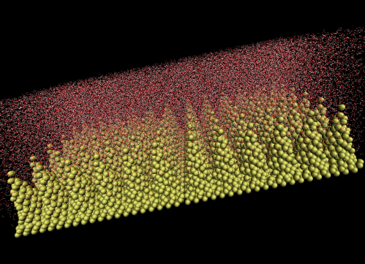
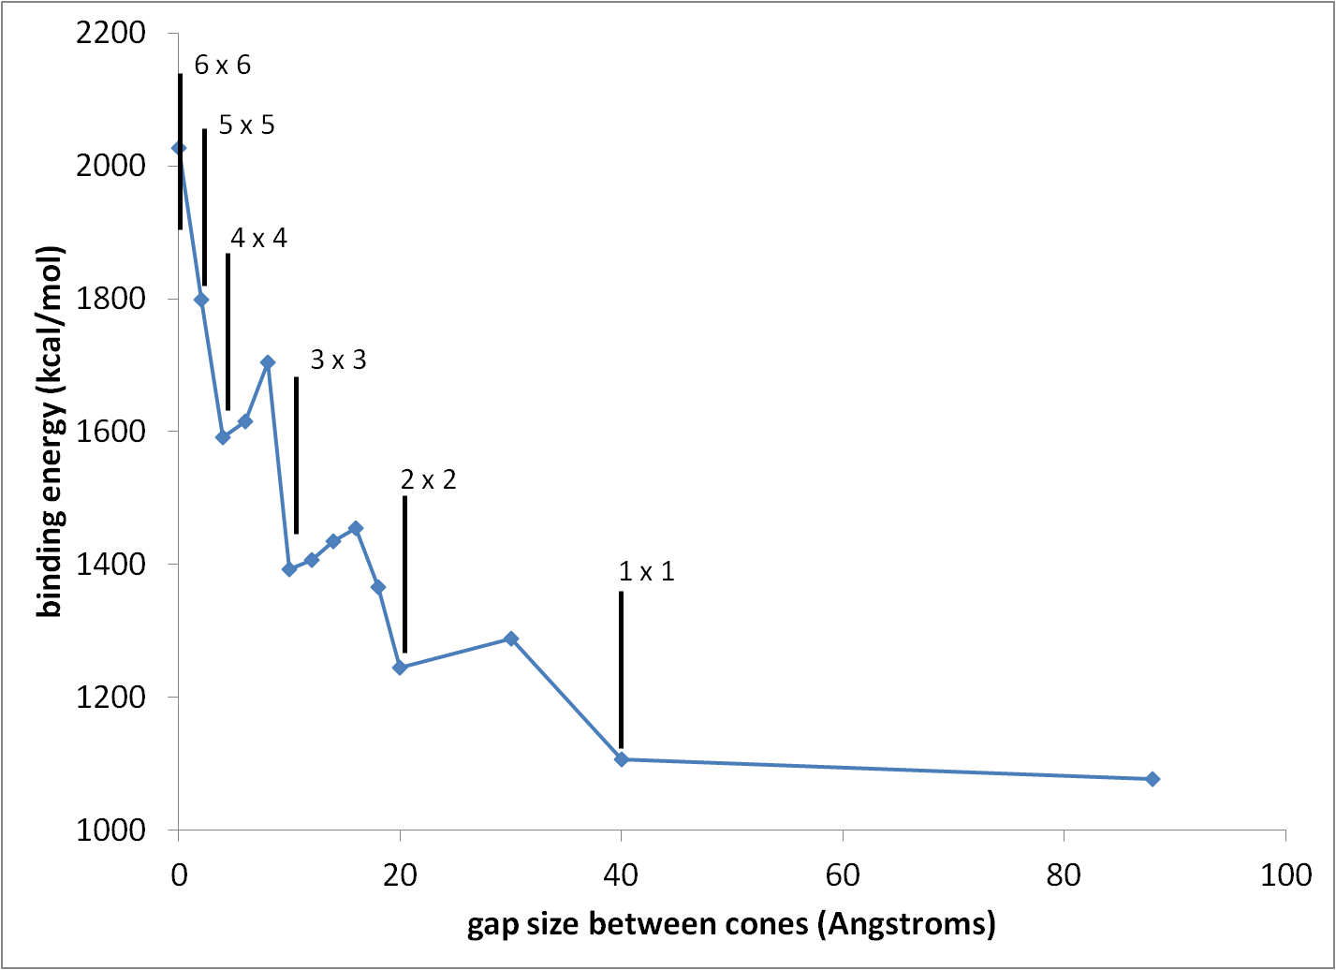
Liquid Dynamics
Switched to a much more difficult problem: water, which loves binding to silicon.
Used different amounts and spacings of Si cones.
Filled the volume above the surface with water (rigid SPC/E model)
Found that the binding energy increased with the silicon surface’s area, but decreased when the cones were more tightly packed.
Used PPPM long-range electrostatics and performed MD NVT
More cones increases surface area.
Packing the cones tighter decreases BE
Approved for public release

Slide 10
Results
solvent accessible surface area (SASA), wettability (water surface coverage), and binding energy vs. cone density (gap spacing)
Approved for public release

Slide 11
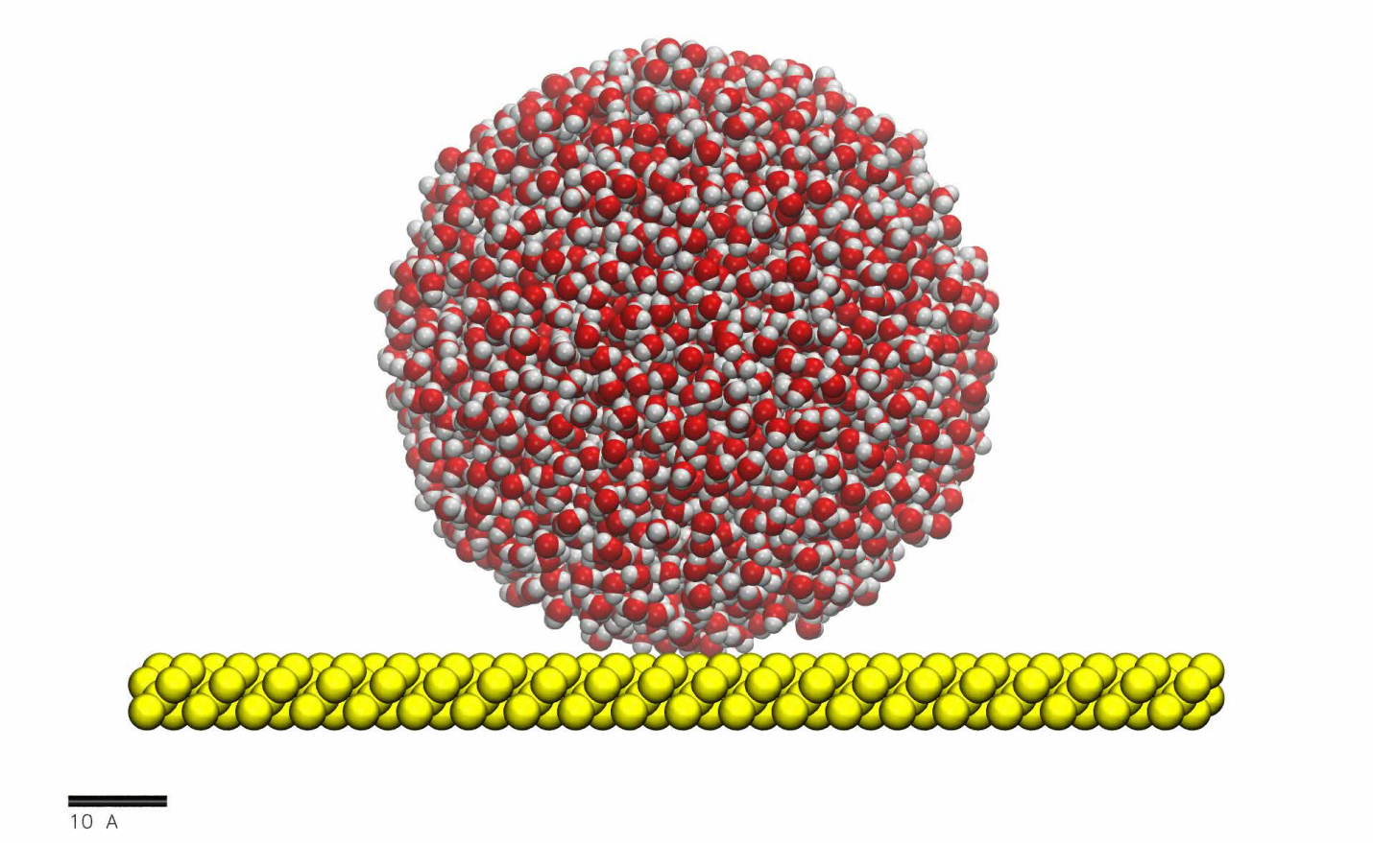
Liquid Droplets
more difficult problem:
water, which loves binding to silicon
6nm droplet
silicon surface in vacuum
flat surface
1 ns duration
High wetting
High binding E
Approved for public release

Slide 12
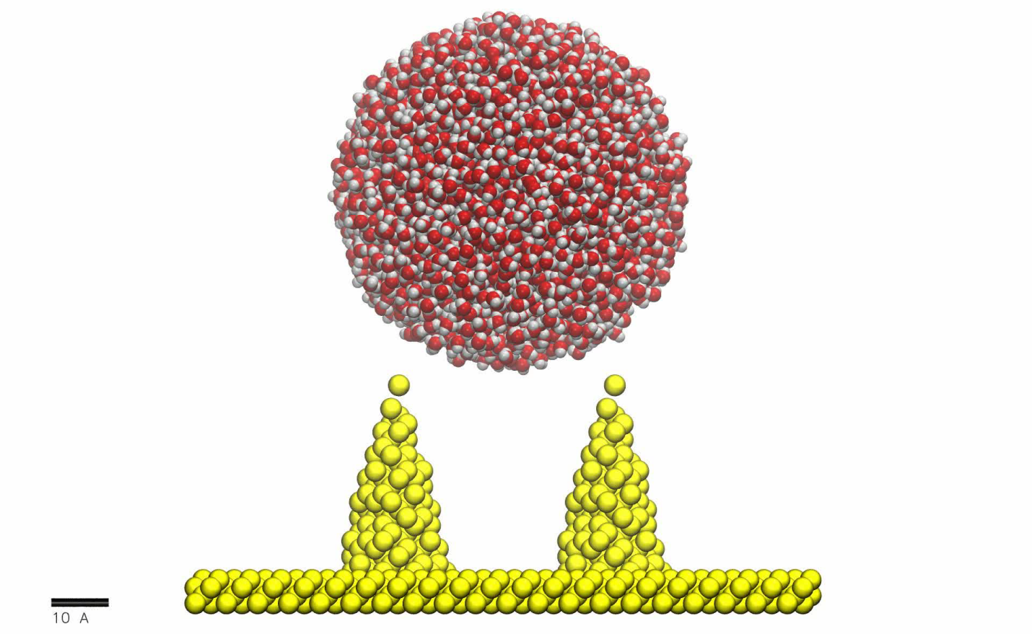
Slower Wetting
2 x 2 cones, 4 nm tall and 4 nm apart
cones spaced farther apart
Slower and milder wetting
Approved for public release

Slide 13
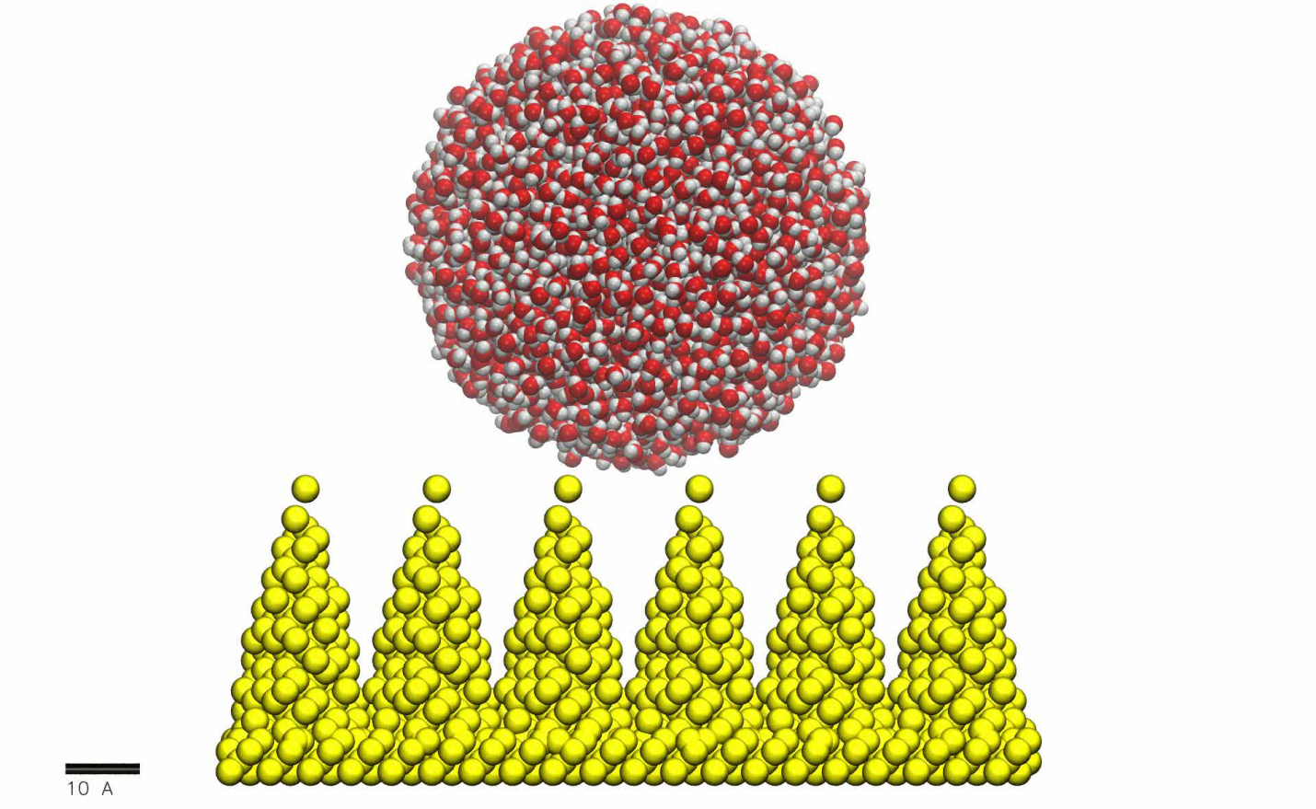
Slower Still…
6 x 6 cones, 4 nm tall and 2 nm apart
many cones
1000 ps duration
Little wetting
Low binding E
next try VX
also try fractal surface to repel broad size range
Approved for public release

Slide 14
Summary and Future Directions
key to a broadly repellant surface: minimization of contact area
Future Work:
  make fractal surface pattern
  vary particle size
  model VX droplets and other surface chemistries
Approved for public release

Slide 15
Thanks

