Slide 1
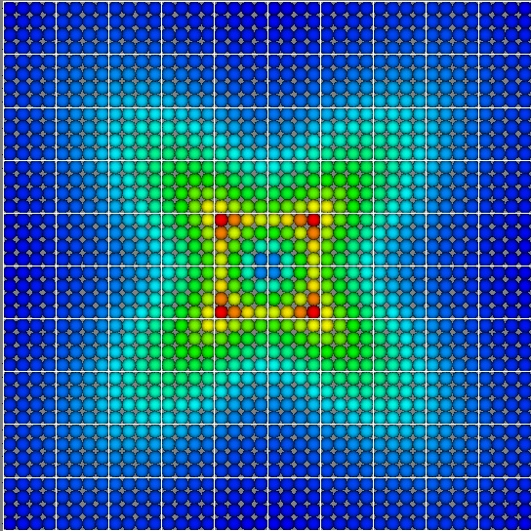
Atom-to-Continuum (AtC) package for LAMMPS aka paid advertising
LAMMPS Workshop, Albuquerque, CA August 7-8, 2013
Reese Jones,
Jeremy Templeton,
Jonathan Zimmerman
Sandia National Laboratories is a multi-program laboratory managed and operated by Sandia Corporation, a wholly owned subsidiary of Lockheed Martin Corporation, for the U.S. Department of Energy's National Nuclear Security Administration under contract DE-AC04-94AL85000.

Slide 2
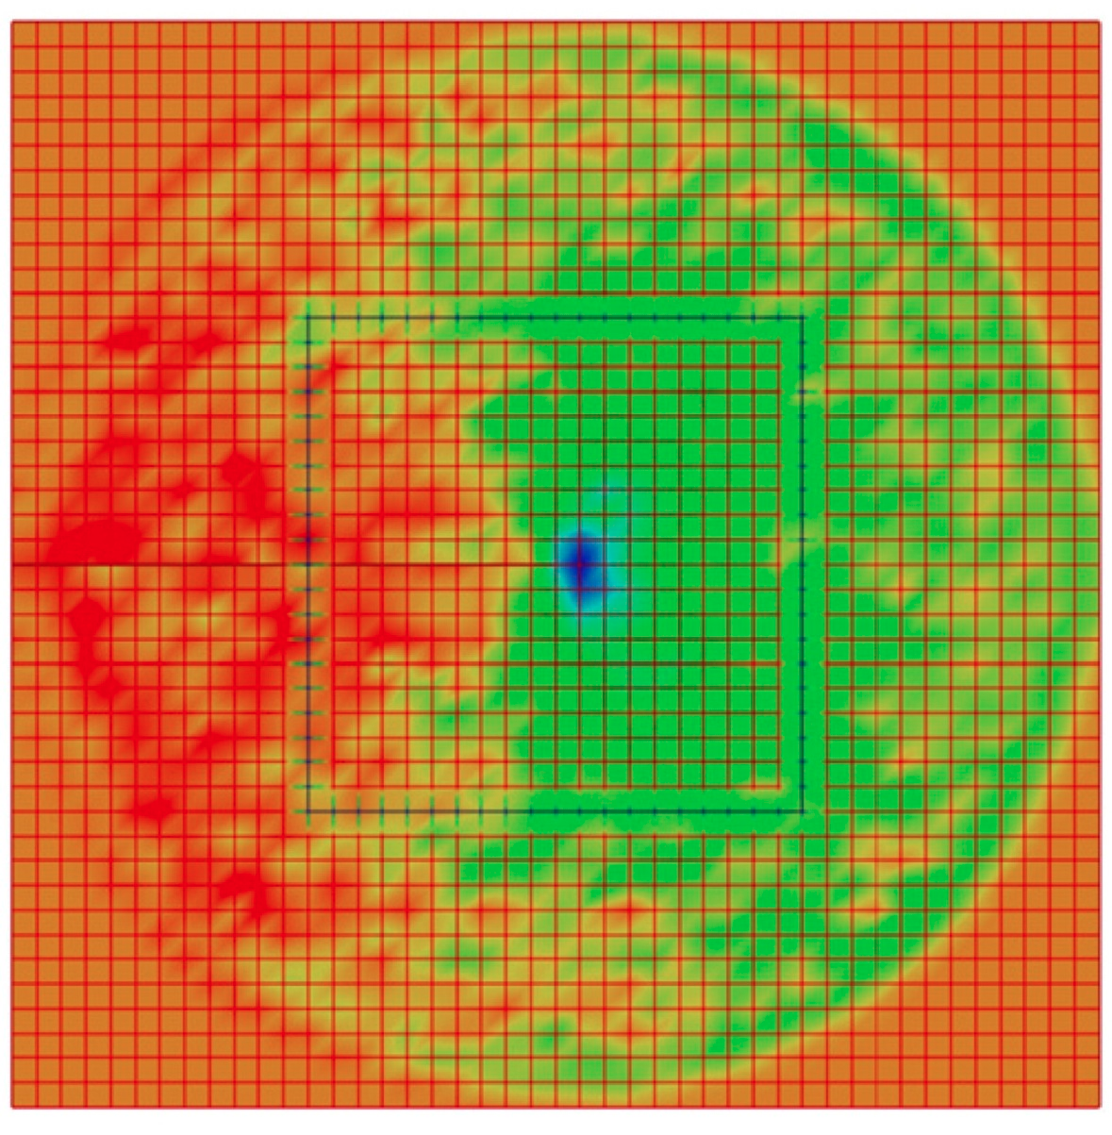
Overview
Objectives
History
Capabilities
Examples
Software
Contacts
Publications
Please ask questions
Stress field around crack at finite temperature

Slide 3
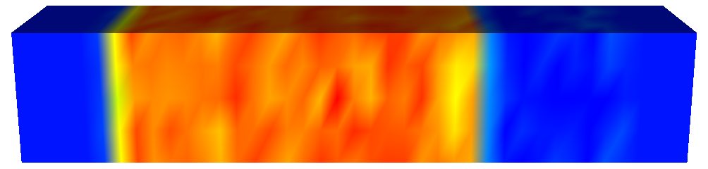
Objectives
Estimation of continuum fields from atomistic simulation data using the consistent coarse-graining techniques. A → C i.e. dots to rainbows
Coupling of static and dynamic atomistic and finite element regions for rigorous thermal, mechanical, electrostatic & charge and mass transport simulations. A ←→ C … and back again
Compressive stress field for an atomic simulation of shock loading

Slide 4
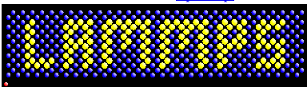

History
To put current capabilities in context
LeHoucq LDRD, Greg Wagner, Reese Jones, and later Jeremy Templeton: Thermal coupling in WARP
Transition to LAMMPS
Decisions about Matrix/Lin. Alg., FE library
Expanding to have a Hardy capability (transition from Paradyn & Jon from Fortran → C++)
Electron transport LDRD (Jones)
J-integral ESRF (Jones)
Ionic Fluids LDRD (Templeton)
Dislocation/Plasticity ESRF (Zimmerman)

Slide 5
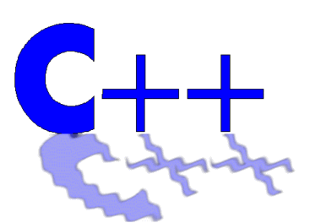
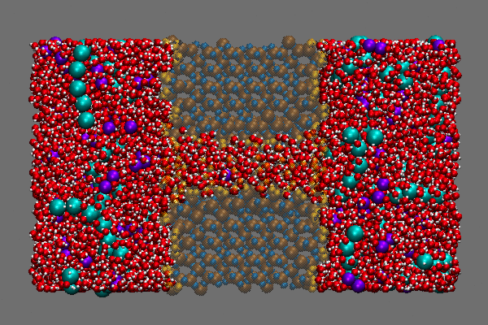
Capabilities
Transfer/Coarse graining fields: mass & charge density, displacement, velocity, stress, concentration, Eshelby stress, Cauchy-Born stress, temperature, potential energy, heat flux, electric potential, dipole moment, dislocation density, gradients, rates, contour & boundary integrals, filtered time averages, ….
Coupling: mass, charge, diffusion, mechanical/momentum, energy/thermal, thermo-mechanical, two temperature, drift diffusion, Schrodinger-Poisson, …
Arbitrary hex & tet meshes, library of
kernel estimators and time filters
Parallel, object oriented, extensible,
benchmarked nightly with ~100 benchmarks,
80k+ lines of code

Slide 6
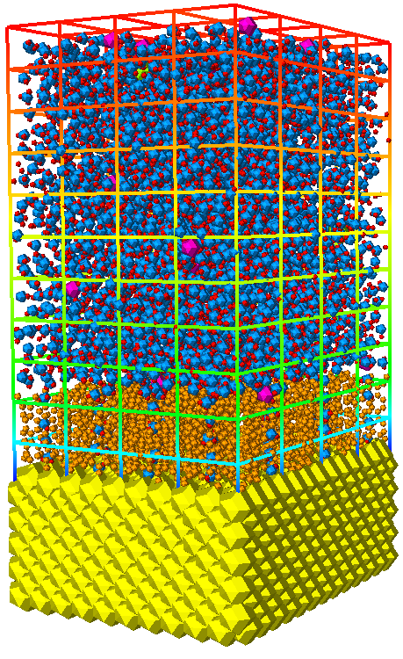
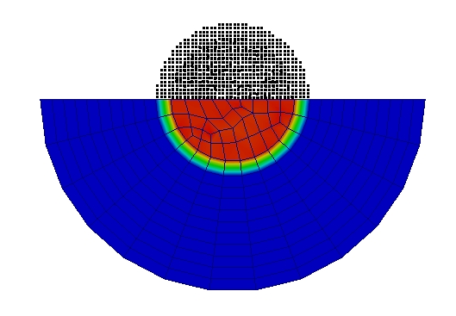
Examples
Ingredients:
Atoms, lattices, interatomic potentials
Mesh, elements, constitutive surrogates
Extrinsic fields & physics, e.g. electrons, electric field
Filters: spatial estimators and temporal filters
Saltwater-electrode-CNT system: mesh overlaps exactly with water-CNT atom region

Slide 7
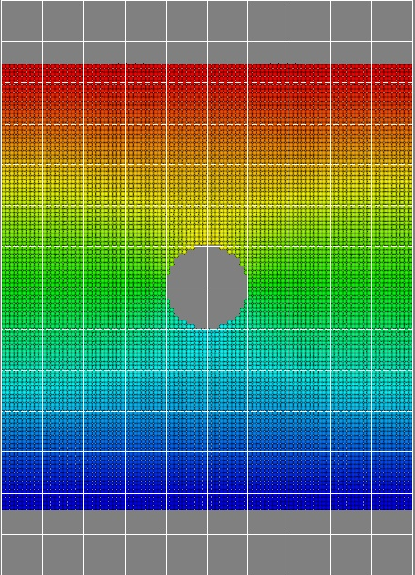
Example: Stress estimation
Near various defects:
Circular hole in plate: mesh overlaps exactly with box, but atom region is subset
Stress around an atomistic edge dislocation
Eshelby stress around a finite crack

Slide 8
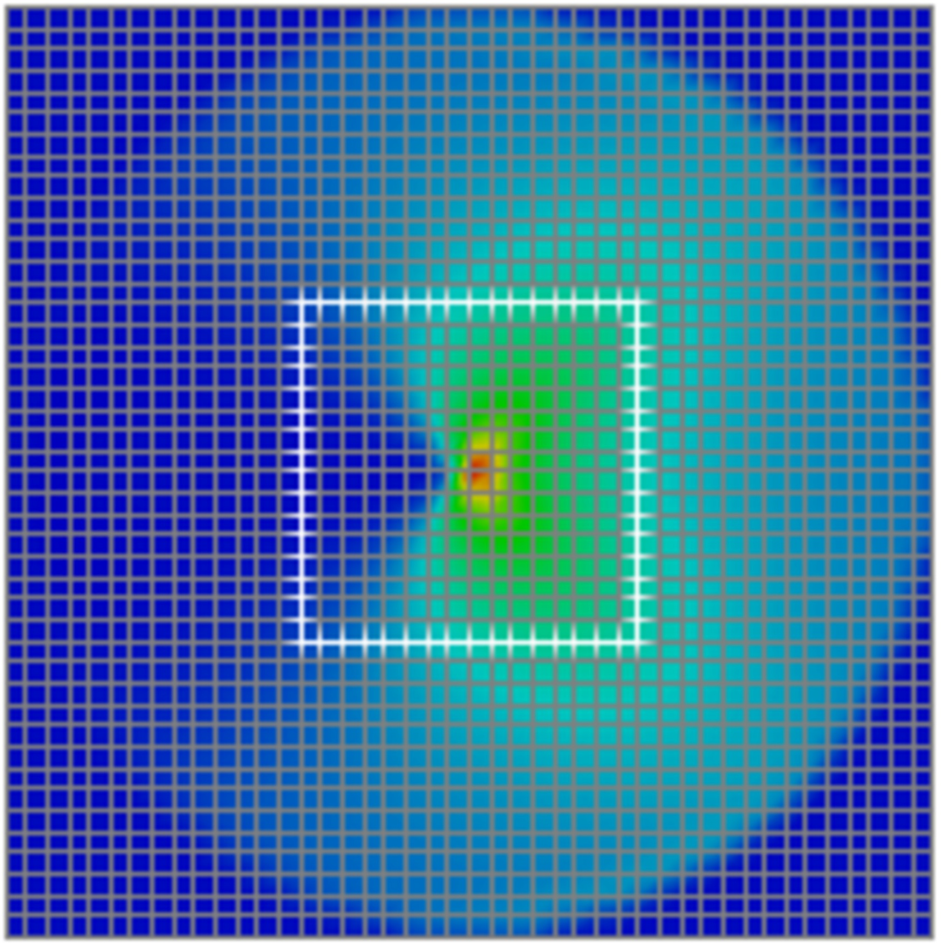
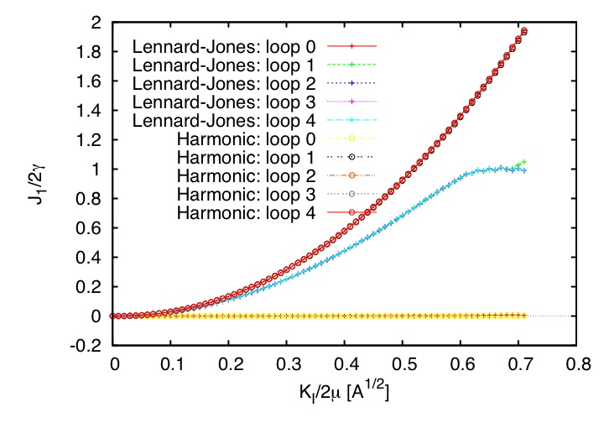
Example: J-integral calculation
Zero temperature
Finite temperature
Comparison with theory

Slide 9
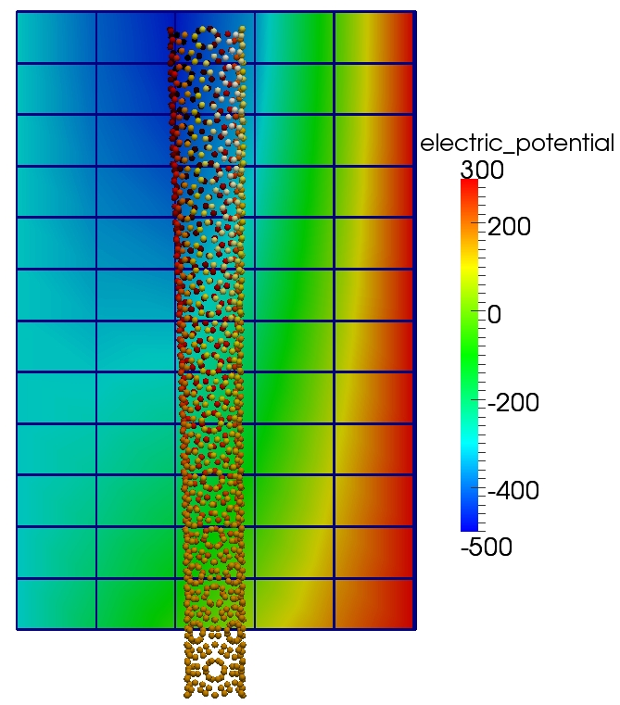
Example: Electrostatics
Source-drain-gate electrodes
Surrogate model of electron density
Electrons segregate to tip
Potential drop across short axis
Mutual repulsion opens tip
Net charge causes net tip displacement
CNT anchored in a warm substrate

Slide 10
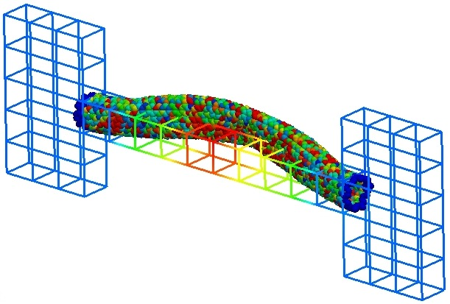
Example: Electron transport
Two reservoirs of heat,
Direct shaped source to electrons
Raises temperatures and excites long wavelength modes
Electron-transport enhanced simulation of heating and deformation of a metallic CNT

Slide 11
Dislocations & Plasticity
Hard Inclusions
3D view of the dislocations and stacking faults for system at a strain of 9.5%
Pinning
Top view of the dislocations and pinning joints
Exploring the relation:
dislocations -> dislocation density -> plastic strain
By coarse graining dislocations to tensor density field using a Hardy-like formula
3D view of many dislocations and stacking faults for system at a strain of 12.5%

Slide 12
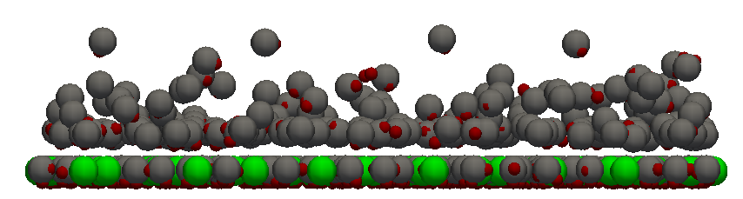
Electrical double layers
V
z
Compact
Diffuse
Computing the polarization field
Polarization across the channel width for averaging length of 0.05 Angstroms.

Slide 13
Syntax examples
Setup:
fix AtC ATOMS atc hardy
fix AtC ATOMS atc thermal Ar_thermal.dat
fix_modify AtC fem create mesh
Control and time filtering:
fix_modify AtC filter
fix_modify AtC filter scale
fix_modify AtC atom_element_map
fix_modify AtC neighbor_reset_frequency
fix_modify AtC kernel
Output: text and EnSight
fix_modify AtC output 10 binary
fix_modify AtC mesh output

Slide 14
Publications
K. K. Mandadapu, R. E. Jones, J. A. Zimmerman, On the microscopic definitions of the dislocation density tensor. Mathematics and Mechanics of Solids, 2013
F. Rizzi, R. E. Jones, B. J. Debusschere, O. M. Knio. Uncertainty quantification in MD simulations of concentration driven ionic flow through a silica nanopore. Part I: sensitivity to physical parameters of the pore. J. Chem. Phys., 2013
J. A. Zimmerman, and R. E. Jones. The application of an atomistic J-integral to a ductile crack. J. Phys.-Cond.Mat., 25(15):155402, 2013
R. E. Jones, J. A. Templeton, and T. W. Rebold. Simulated real-time detection of a small molecule on a carbon nanotube cantilever. J. Comp. Theo. NanoSci., 8:1364–1384, 2011.
J. A. Templeton, R. E. Jones, J. W. Lee, J. A. Zimmerman, and B. M. Wong. A long-range electric field solver for molecular dynamics based on atomistic-to-continuum modeling. J. Chem. Theo. Comp., 7(6):1736–1749, 2011.
R. E. Jones, J. A. Zimmerman, J. Oswald, and T. Belytschko. An atomistic J- integral at finite temperature based on Hardy estimates of continuum fields. J. Phys. Cond. Mat., 23:015002, 2010.
J. A. Templeton, R. E. Jones, and G. J. Wagner. Application of a field-based method to spatially varying thermal transport problems in molecular dynamics. Mod. Sim. Mat. Sci. Eng., 18:085007, 2010.
R. E. Jones and J. A. Zimmerman. The construction and application of an atomistic J-integral via Hardy estimates of continuum fields. J. Mech. Phys. Solids, 58:1318–1337, 2010.
R. E. Jones, J. A. Templeton, G. J. Wagner, D. Olmsted, and Nomand A. Modine. Electron transport enhanced molecular dynamics for metals and semi-metals. Int. J. Num. Meth. Engin., 83(8-9):940–967, 2010.
R. E. Jones and C. J. Kimmer. Efficient non-reflecting boundary condition constructed via optimization of damped layers. Phys. Rev. B, 81(9):094301, 2010.
J. A. Zimmerman, R. E. Jones, and J. A. Templeton. A material frame approach for evaluating continuum variables in atomistic simulations. J. Comp. Phys., 229:2364–2389, 2010.
G. J. Wagner, R. E. Jones, J. A. Templeton, and M. L. Parks. An atomistic-to-continuum coupling method for heat transfer in solids. Comp. Meth. Appl. Mech. Eng., 197(41-42):3351–3365, 2008

Slide 15
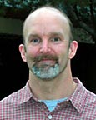


Software & Contacts
Publically available at:
http://lammps.sandia.gov/download.html
S.J. Plimpton, A. Thompson, P. Crozier
Development version available through:
Reese Jones rjones@sandia.gov
Jeremy Templeton jatempl@sandia.gov
Jon Zimmerman jzimmer@sandia.gov
Careful what you put on the web

Slide 16
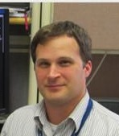
Software & Contacts
Publically available at:
http://lammps.sandia.gov/download.html
S.J. Plimpton, A. Thompson, P. Crozier
Development version available through:
Reese Jones rjones@sandia.gov
Jeremy Templeton jatempl@sandia.gov
Jon Zimmerman jzimmer@sandia.gov
Coarse-graining
coupling
Coupling
Coarse-graining

Slide 17
Public release of new version this week with regular updates following
New capabilities and applications will be added as we have confidence in them (we are looking for beta users/testers).
Coupling:
Coarse graining
Also: I am teaching a class on molecular simulation ESP900 at SNL this Fall
diffusion/mass/species
momentum/forces,
energy/temperature
electrostatics/dynamics
densities: energy, mass, charge, dislocation, . . .
stresses: Cauchy, 1st Piola, Eshelby,atom/molecule . . .
fluxes: heat, charge, mass, . . .
gradients
rates, filtered averages
coarse-graining of generic data, & more ...

