Slide 1
Model-free test of
local-density mean-field behavior in
Electric Double Layers
Published last week as a Rapid Communicaiton in PRE
Brian Giera^{[1, 2]}
Special thanks to:
Neil Henson^{[2]}, Ed Kober^{[2]}, Scott Shell^{[1]} , Todd Squires^{[1]}
and to everyone at:
^{[1]} Department of Chemical Engineering, University of California Santa Barbara
^{[2]} Institute for Multiscale Materials Studies, Los Alamos National Laboratory
Notes:
In my talk, I will discuss the MD model we have developed to explore and improve electric double layer theory that is useful for innovation of electric double layer capacitors.

Slide 2
What are Electric Double Layers (EDLs)?
How can we model planar EDLs?
When can we use the simplest of models: local-density approximations?

Slide 3
Ions make up Electric Double Layers
Example: Charge plate in a buffer
EDLs form at interfaces between charged surfaces and ionic fluids.

Slide 4
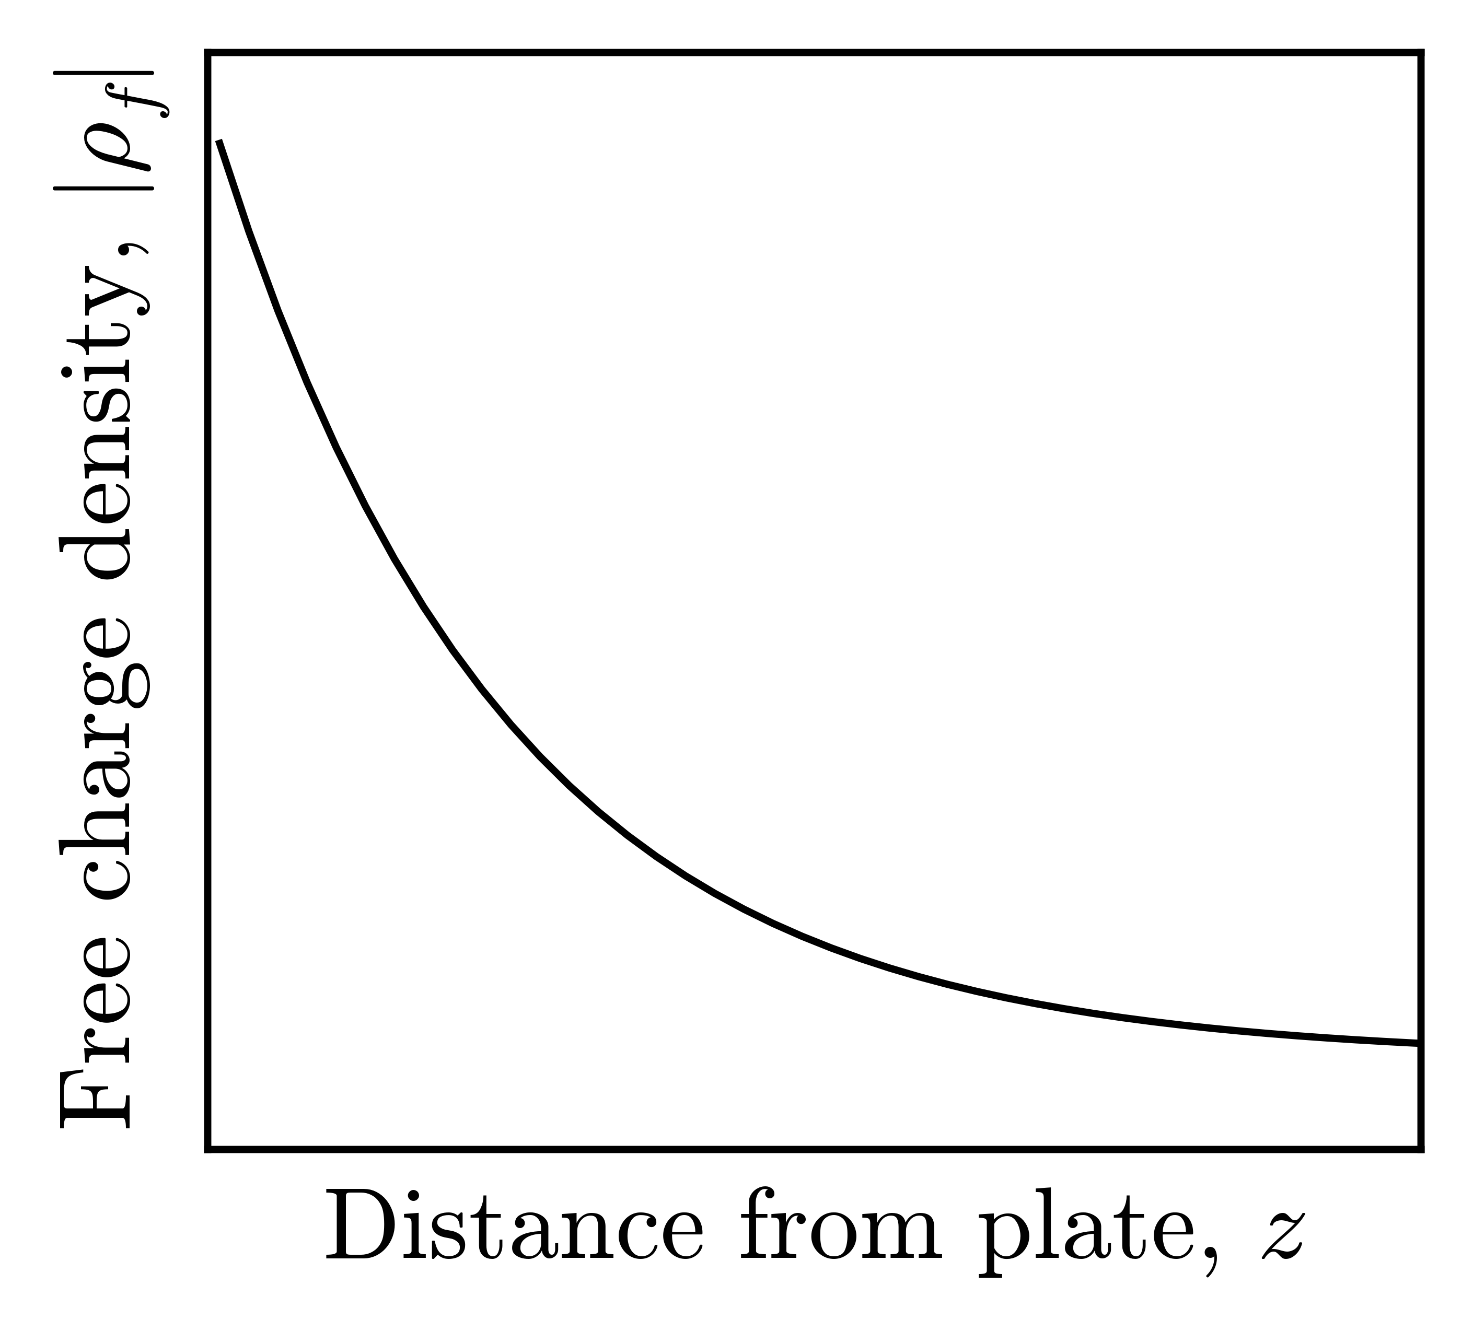
Ions make up Electric Double Layers
Example: Charge plate in a buffer
EDLs form at interfaces between charged surfaces and ionic fluids.

Slide 5
Ions make up Electric Double Layers
Example: Charge plate in a buffer
Ions screen surface charges across 1 – 100s nanometers
EDLs form at interfaces between charged surfaces and ionic fluids.

Slide 6
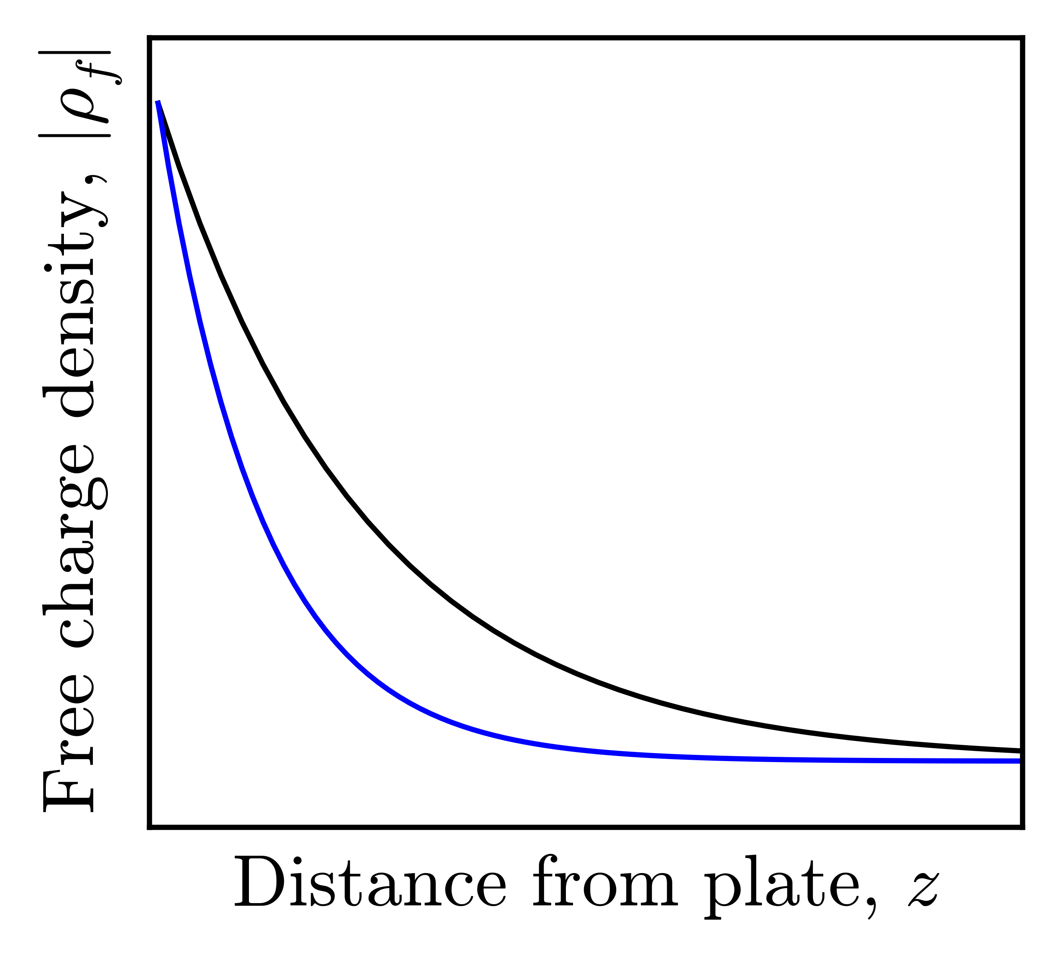
Ions make up Electric Double Layers
Example: Charge plate in a buffer
Ions screen surface charges across 1 – 100s nanometers
EDL width decreases with ion valence and concentration
EDLs form at interfaces between charged surfaces and ionic fluids.

Slide 7
EDLs store energy electrochemically
Ions screen surface charges across 1 – 100s nanometers
EDL width decreases with ion valence and concentration
EDLs act like capacitors
EDL
Capacitor
Parallel Plate
Capacitor
Name | Variable
Screening length

Slide 8
Why are EDLs important?
EDL
Capacitor
surface area×dielectric
Capacitance =
charge separation
Parallel Plate
Capacitor

Slide 9
Why are EDLs important?
High surface area electrodes
(1000+ meters²/gram)
EDL
Capacitor
Nanoscale charge separation
surface area×dielectric
Capacitance =
charge separation
Parallel Plate
Capacitor

Slide 10
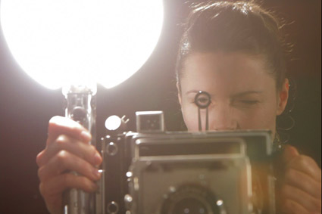
Why are EDLs important?
High surface area electrodes
(1000+ meters²/gram)
EDL
Capacitor
Nanoscale charge separation
surface area×dielectric
Capacitance =
charge separation
Parallel Plate
Capacitor
High Power Density

Slide 11
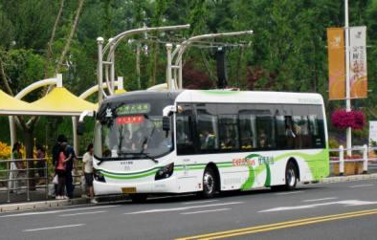
EDLC energy densities are almost comparable to batteries
“Supercapacitor”
Parallel Plate
Capacitor
High Power Density

Slide 12
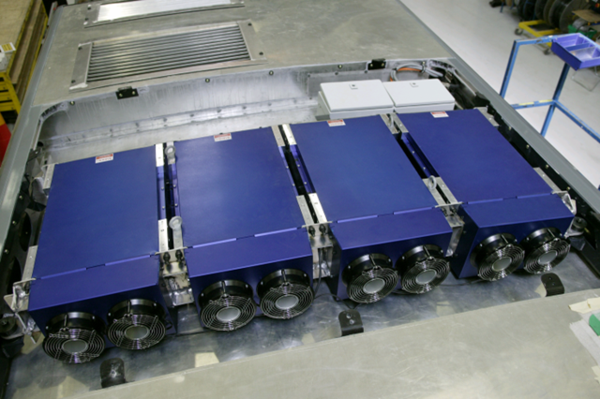
EDLC energy densities are almost comparable to batteries
“Supercapacitors”
*This requires more than one EDLC…
Parallel Plate
Capacitor
High Power Density

Slide 13
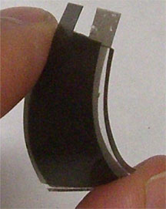
Experiments show specific chemistry determines EDL behavior
“Supercapacitors”
Porous Electrode
Solvated Anion
Current Collector
Separator
Cation
EDLC

Slide 14
Experiments show specific chemistry determines EDL behavior
Capacitance increases:
with voltage, until ions pack at interface
when ions & pores are same size [1]
“Supercapacitors”
Porous Electrode
Solvated Anion
Current Collector
Separator
Cation
EDLC
[1] Chmiola, Science, ’06
Notes:
SIZE EFFECTS ARE NOT ALWAYS DETRIMENTAL!

Slide 15
Experiments show specific chemistry determines EDL behavior
Capacitance increases:
with voltage, until ions pack at interface
when ions & pores are same size [1]
Voltage and charge density depend on
interactions between ions, solvent, and the surface [2]
equilibrium fluctuations
“Supercapacitors”
Porous Electrode
Solvated Anion
Current Collector
Separator
Cation
[1] Chmiola, Science, ’06
[2] Israelachvili, ‘92

Slide 16
How can we model planar EDLs?
Theoretical modeling
Mean-field local-density approximations (LDAs)
Integral equation theories
Compuational modeling
Molecular dynamics
Monte Carlo
Density functional theory
Porous Electrode
Solvated Anion
Current Collector
Separator
Cation

Slide 17
How can we model planar EDLs?
Theoretical modeling
Mean-field local-density approximations (LDAs)
Integral equation theories
Compuational modeling
Molecular dynamics
Monte Carlo
Density functional theory
Porous Electrode
Solvated Anion
Current Collector
Separator
Cation

Slide 18
“Local-density approximations” are easy to use & physically insightful
Mean-field LDAs model many-body interactions with simple effective fields
LDAs neglect structuring effects due to ion-surface, ion-ion, and ion-solvent correlations
LDAs are prone to fail near highly charged electrodes

Slide 19
Simplest LDA: Gouy-Chapman theory
GC assumes:
Continuum solvent
Uniform surface charge density,
Point-sized ions
GC works for:
Negligible volume fractions,
Weakly charged electrodes,
Mean-field LDAs model many-body interactions with simple effective fields
LDAs neglect structuring effects due to ion-surface, ion-ion, and ion-solvent correlations
LDAs are prone to fail near highly charged electrodes

Slide 20
Gouy-Chapman predicts divergent free charge densities
GC assumes:
Continuum solvent
Uniform surface charge density,
Point-sized ions
GC works for:
Negligible volume fractions,
Weakly charged electrodes,
Mean-field LDAs model many-body interactions with simple effective fields
LDAs neglect structuring effects due to ion-surface, ion-ion, and ion-solvent correlations
LDAs are prone to fail near highly charged electrodes
Notes:
GC predicts divergent free charge densities for Sigma >> 0.04 e/nm^2

Slide 21
Should we derive improved LDAs…
Mean-field LDAs model many-body interactions with simple effective fields
Primitive Model explicitly calculate many-body interactions with pairwise potentials
EDL with tunable ion size, valence, and concentration
or try more sophisticated models?

Slide 22
Model-free test of LDA behavior in planar EDLs
We derived a test to systematically determine whether LDAs can possibly describe an EDL that:
exploits the “similarity” of LDAs
only requires measured or simulated EDLs
Mean-field models modified to account for non-GC behavior.
PM with tunable characteristic scales.

Slide 23
Weakly-charged EDLs with low volume fractions:
Primitive Model LAMMPS simulation that treats 0.01 M [NaCl]:
as repulsive WCA ions
with long-range electrostatics
in an implicit Langevin solvent
Notes:
The entire video is 0.72 microseconds
The simulation time step is 1.6 picoseconds
Snapshots are taken every 1.6 nanoseconds

Slide 24
Weakly-charged EDLs with low volume fractions:
Notes:
The entire video is 0.72 microseconds
The simulation timestep is 1.6 picoseconds
Snapshots are taken every 1.6 nanoseconds

Slide 25
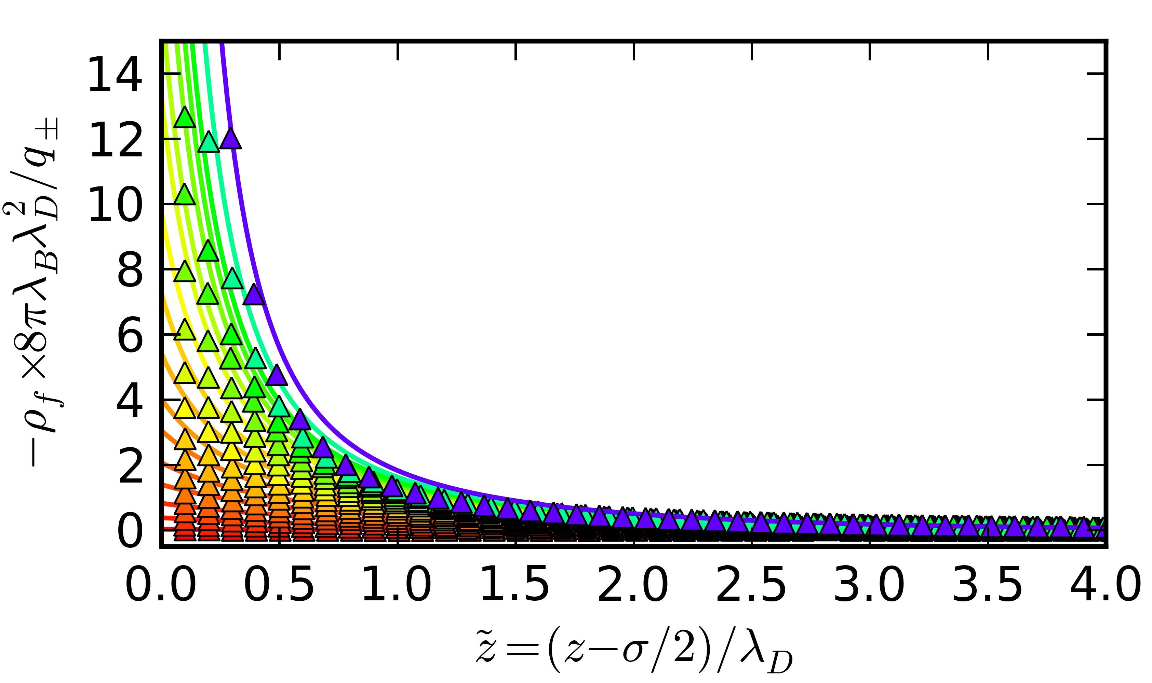
GC accurately predicts low volume fraction EDLs
Notes:
The entire video is 0.72 microseconds
The simulation timestep is 1.6 picoseconds
Snapshots are taken every 1.6 nanoseconds

Slide 26
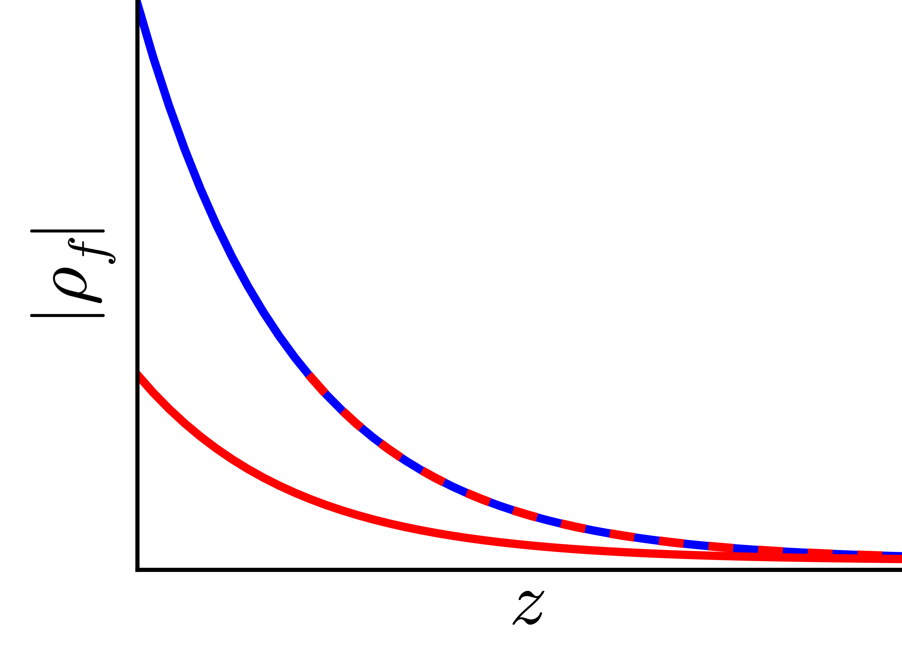
GC theory exhibits “similarity”
from
lower
can be shifted bulkwards onto
higher
Notes:
The entire video is 0.72 microseconds
The simulation timestep is 1.6 picoseconds
Snapshots are taken every 1.6 nanoseconds

Slide 27
If measured EDL profiles are similar, then there exists a suitable LDA.
from
lower
can be shifted bulkwards onto
higher
Notes:
The entire video is 0.72 microseconds
The simulation timestep is 1.6 picoseconds
Snapshots are taken every 1.6 nanoseconds

Slide 28
All mean-field LDAs exhibit similarity

Slide 29
All mean-field LDAs exhibit similarity
LDA ions do not “know” where the wall is:
Effective charge density:

Slide 30
All mean-field LDAs exhibit similarity
LDA ions do not “know” where the wall is:
Effective charge density:
Combining these expressions:
Notes:
Solving this PDE using method of characteristics reveals a “similarity coordinate” S
Use S to determine LDA feasibility space

Slide 31
Solving with Method of Characteristics
Given the free charge density at contact, dddddddd can be solved explicitly
then collapses LDA EDLs in a given electrolyte onto a single master curve
If not, the LDA approach itself is bound to fail.
Notes:
Solving this PDE using method of characteristics reveals a “similarity coordinate” S
Use S to determine LDA feasibility space
i.e. no point of derviving a better LDA.

Slide 32
Solving with Method of Characteristics
Given the free charge density at contact, dddddddd can be solved explicitly
then collapses LDA EDLs in a given electrolyte onto a single master curve
If not, the LDA approach itself is bound to fail.
Notes:
Solving this PDE using method of characteristics reveals a “similarity coordinate” S
Use S to determine LDA feasibility space
i.e. no point of derviving a better LDA.

Slide 33
Gouy-Chapman theory permits an analytical solution
Known from GC theory
(or simulated profiles)

Slide 34
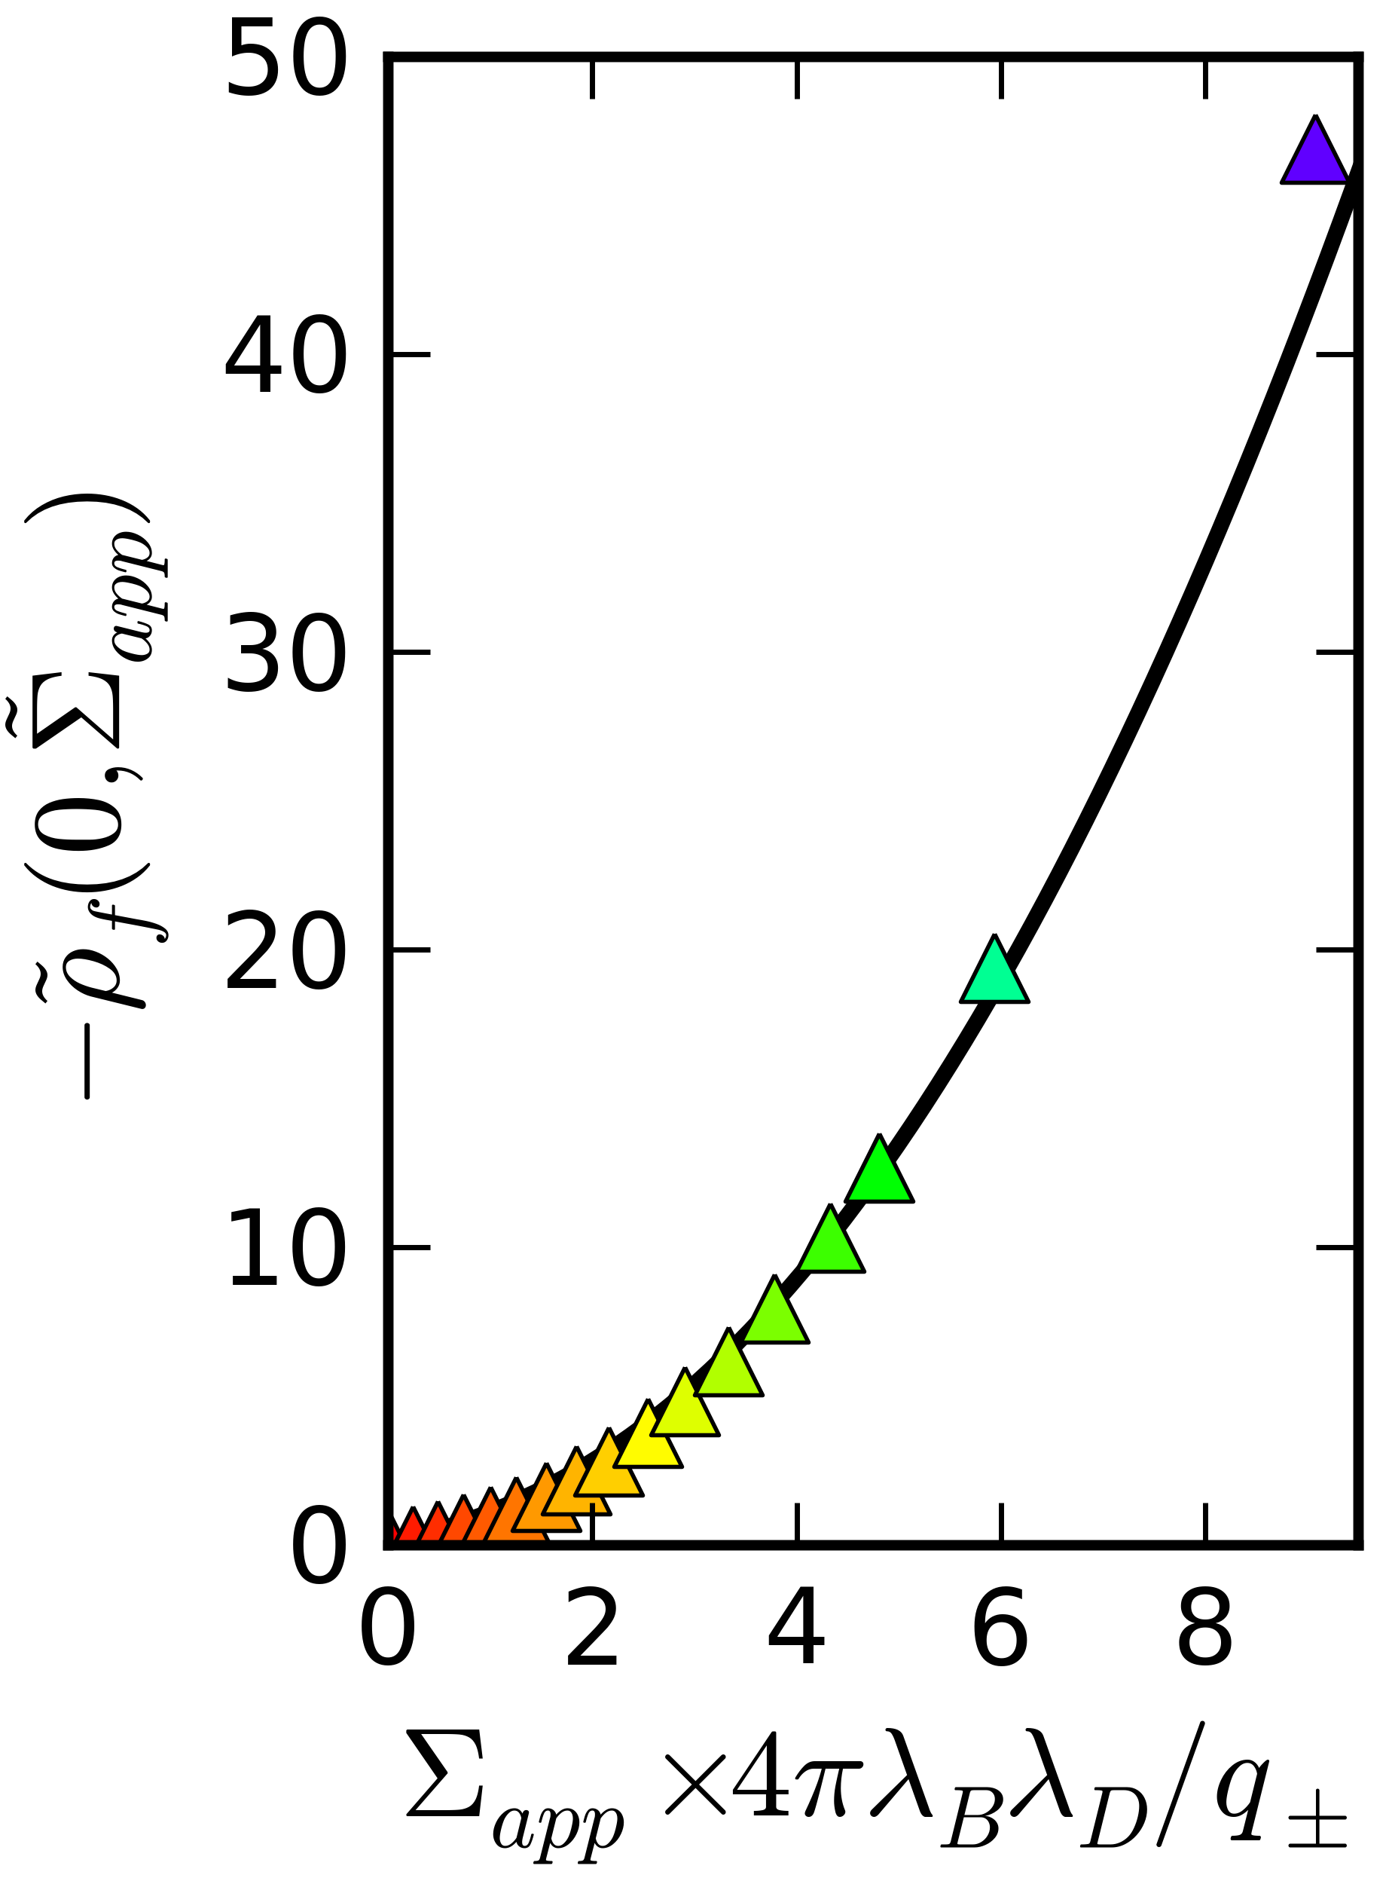
Gouy-Chapman theory permits an analytical solution
Known from GC theory
(or simulated profiles)

Slide 35
SGC collapses point-like EDL regimes

Slide 36
Solution yields a similarity coordinate that characterizes the GC model
Dilute limit:
Strong-coupling limit:

Slide 37
Solution yields a similarity coordinate that characterizes the GC model
Dilute limit:
Strong-coupling limit:
GC works near
the bulk.
GC fails near
the interface.

Slide 38
SCS collapses 100 Gouy-Chapman like simulations
Notes:
The entire video is 0.72 microseconds
The simulation timestep is 1.6 picoseconds
Snapshots are taken every 1.6 nanoseconds

Slide 39
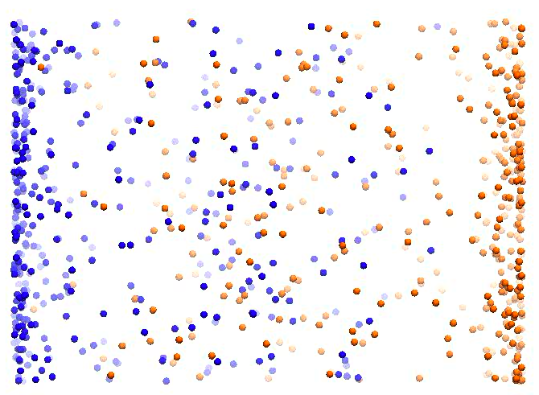
SCS collapses 100 Gouy-Chapman like simulations
Notes:
The entire video is 0.72 microseconds
The simulation timestep is 1.6 picoseconds
Snapshots are taken every 1.6 nanoseconds

Slide 40
SCS collapses 100 Gouy-Chapman like simulations
Strong-coupling limit:
Dilute limit:
Notes:
The entire video is 0.72 microseconds
The simulation timestep is 1.6 picoseconds
Snapshots are taken every 1.6 nanoseconds

Slide 41
Without assumptions, we can test if an arbitrary LDA will ever work
LDA models restrict electric double layer profiles to be “similar”
This may not be true for actual EDLs
“Similarity variables” S can be derived from LDAs that characterize the system
Our approach will reveal whether measured or computed profiles exhibit LDA behavior
Or where more complicated modeling methods are required
Strong-coupling limit:
Dilute limit:
Notes:
The entire video is 0.72 microseconds
The simulation timestep is 1.6 picoseconds
Snapshots are taken every 1.6 nanoseconds

Slide 42
Improved LDAs have better models for the excess chemical potential,
Gouy-Chapman
Notes:
The entire video is 0.72 microseconds
The simulation timestep is 1.6 picoseconds
Snapshots are taken every 1.6 nanoseconds

Slide 43
Easiest improvement to GC requires a better approximation of the excluded volume
Gouy-Chapman
Carnahan-Starling chemical potential for hard spheres:
Notes:
The entire video is 0.72 microseconds
The simulation timestep is 1.6 picoseconds
Snapshots are taken every 1.6 nanoseconds

Slide 44
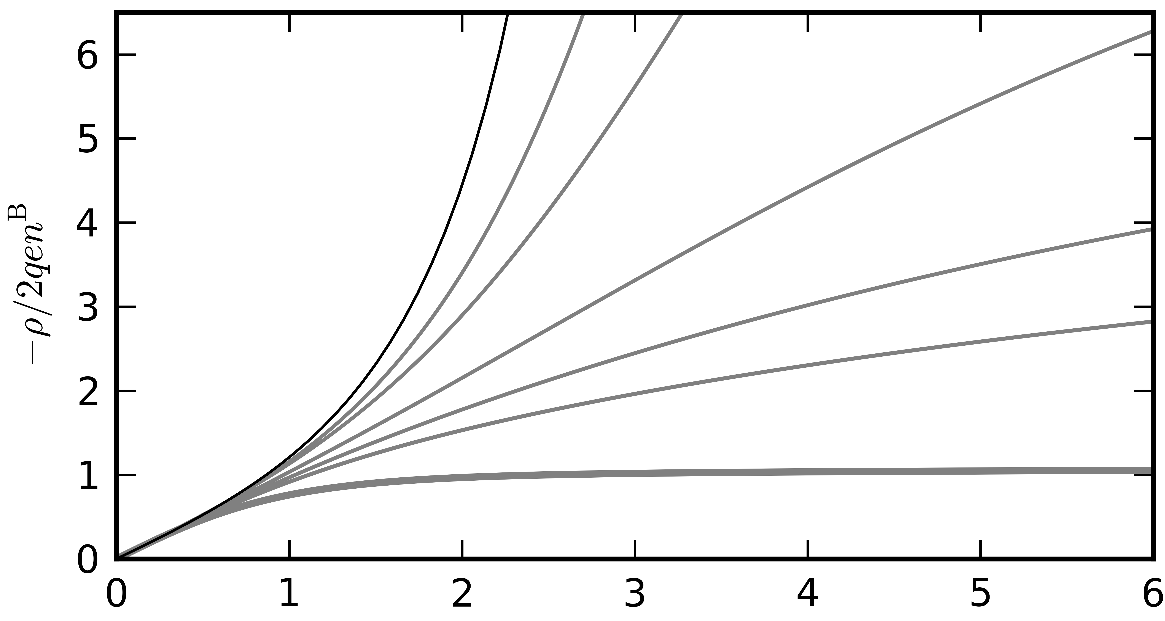
Carnahan-Staling LDA that uses hard-sphere equation of state

Slide 45
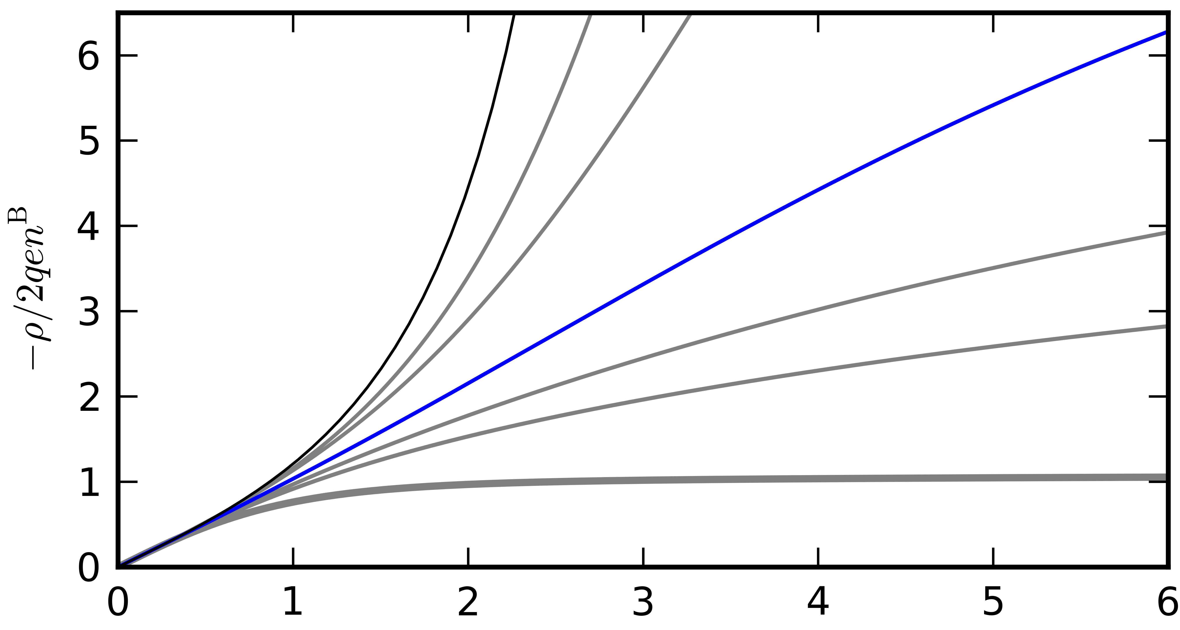
Carnahan-Staling LDA that uses hard-sphere equation of state
Increasing

Slide 46
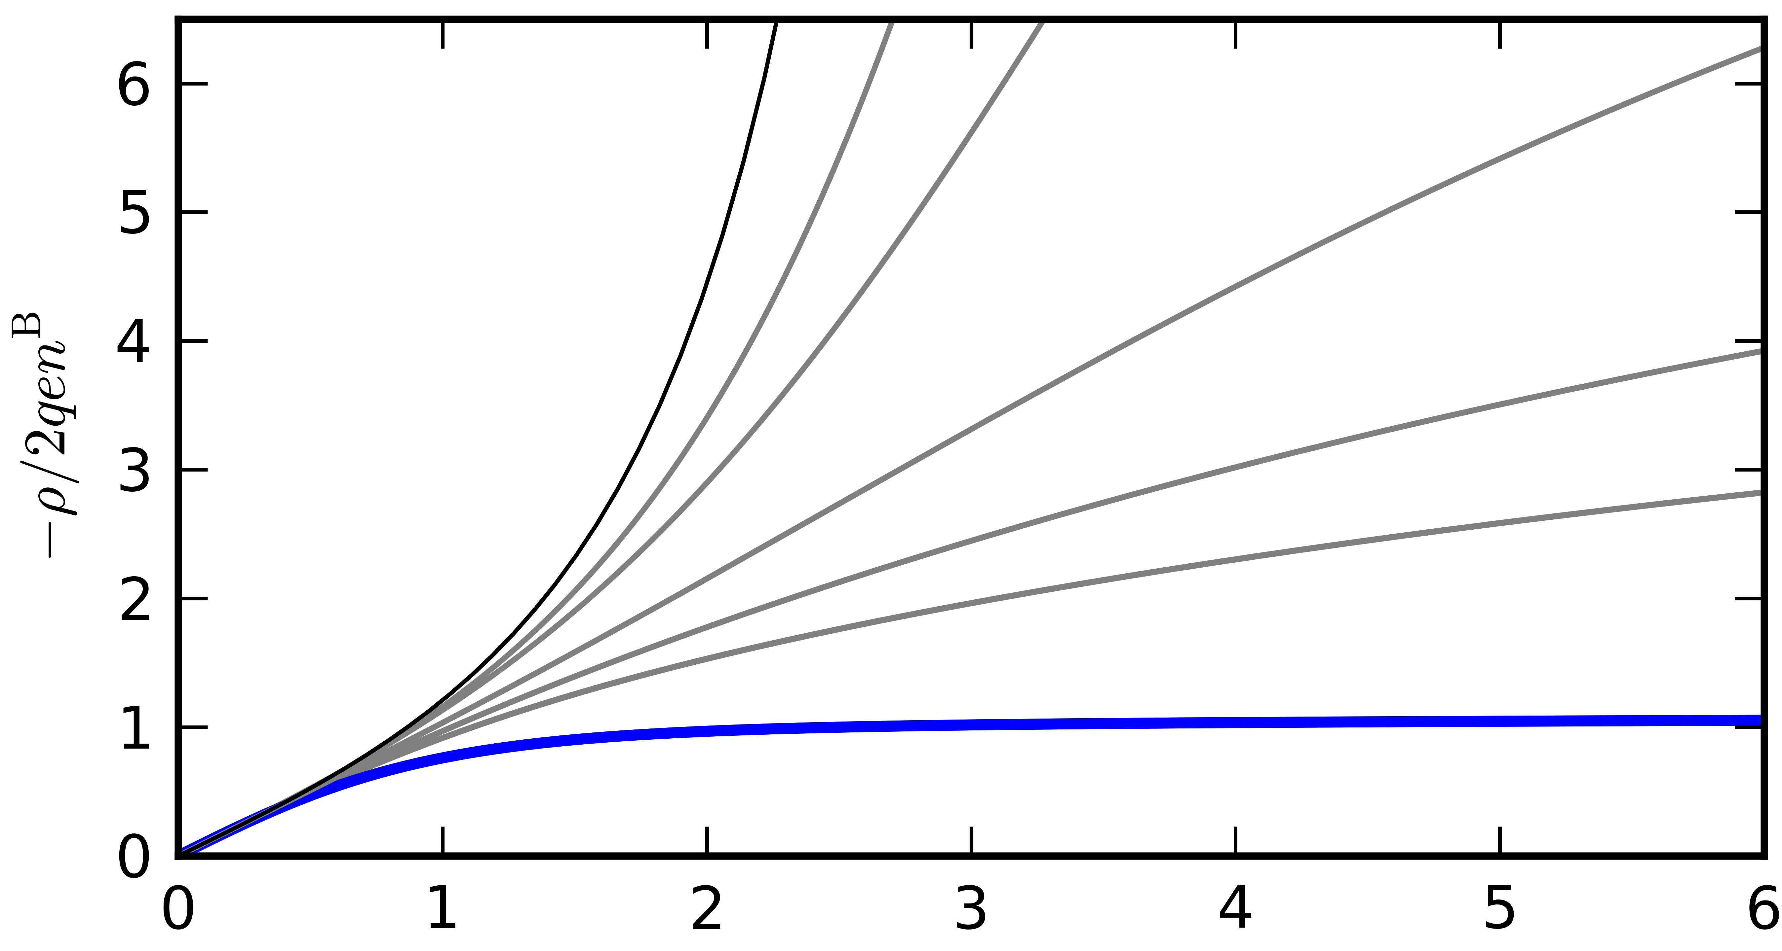
Carnahan-Staling LDA that uses hard-sphere equation of state
Increasing

Slide 47
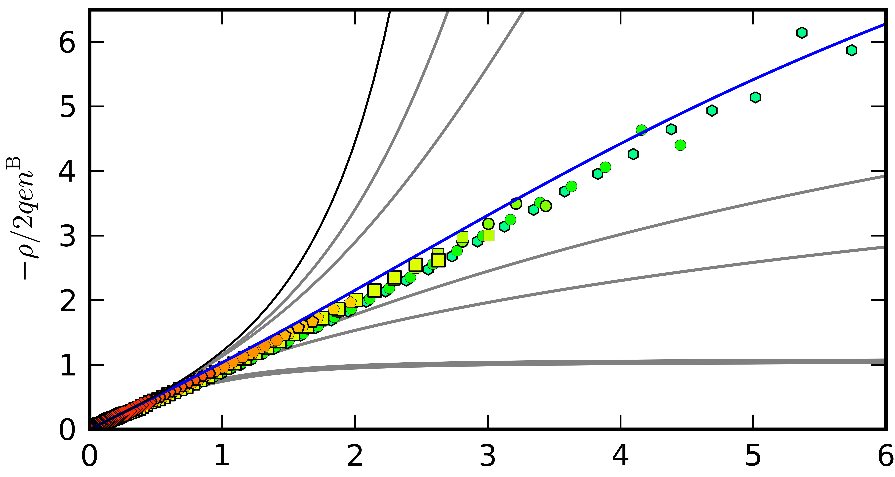
SCS collapses 10 moderate volume fraction EDLs

Slide 48
Model-free test of LDA behavior in planar EDLs
Similarity variables from distinct LDAs have distinct functional forms
S_{GC} is bounded and collapses pointlike EDL profiles
S_{CS} is unbounded and collapses semidilute EDL profiles
Differences in S between anodic and cathodic EDLs immediately reveal anions and cations to have different size and/or valency
The general LDA mean-field approach will fail when EDL profiles deviate from collapse along S
C

Slide 49
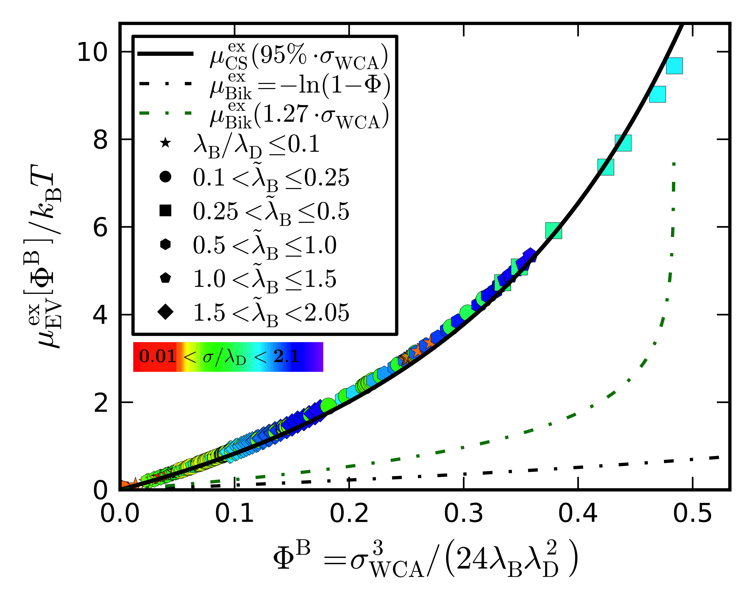
Measured excluded volume chemical potential: in the bulk

Slide 50
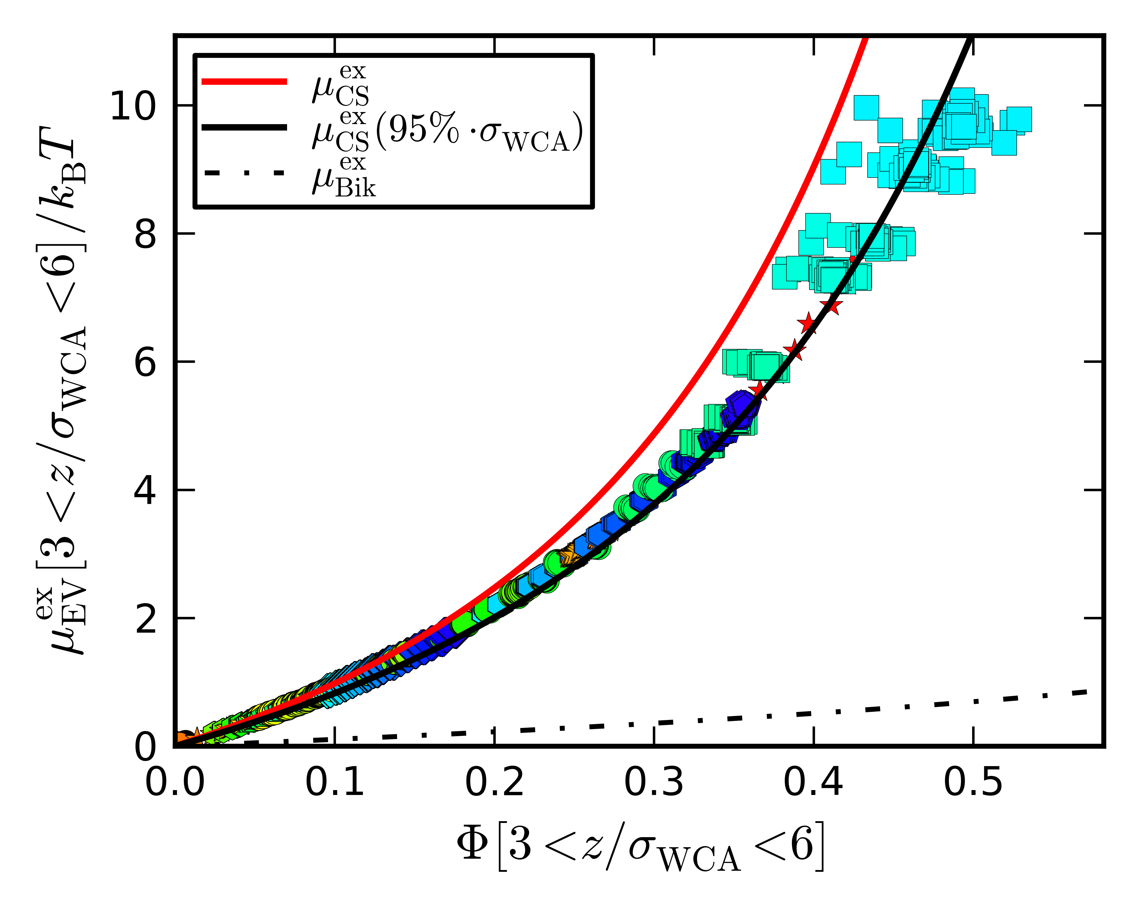
Measured excluded volume chemical potential: near the bulk

Slide 51
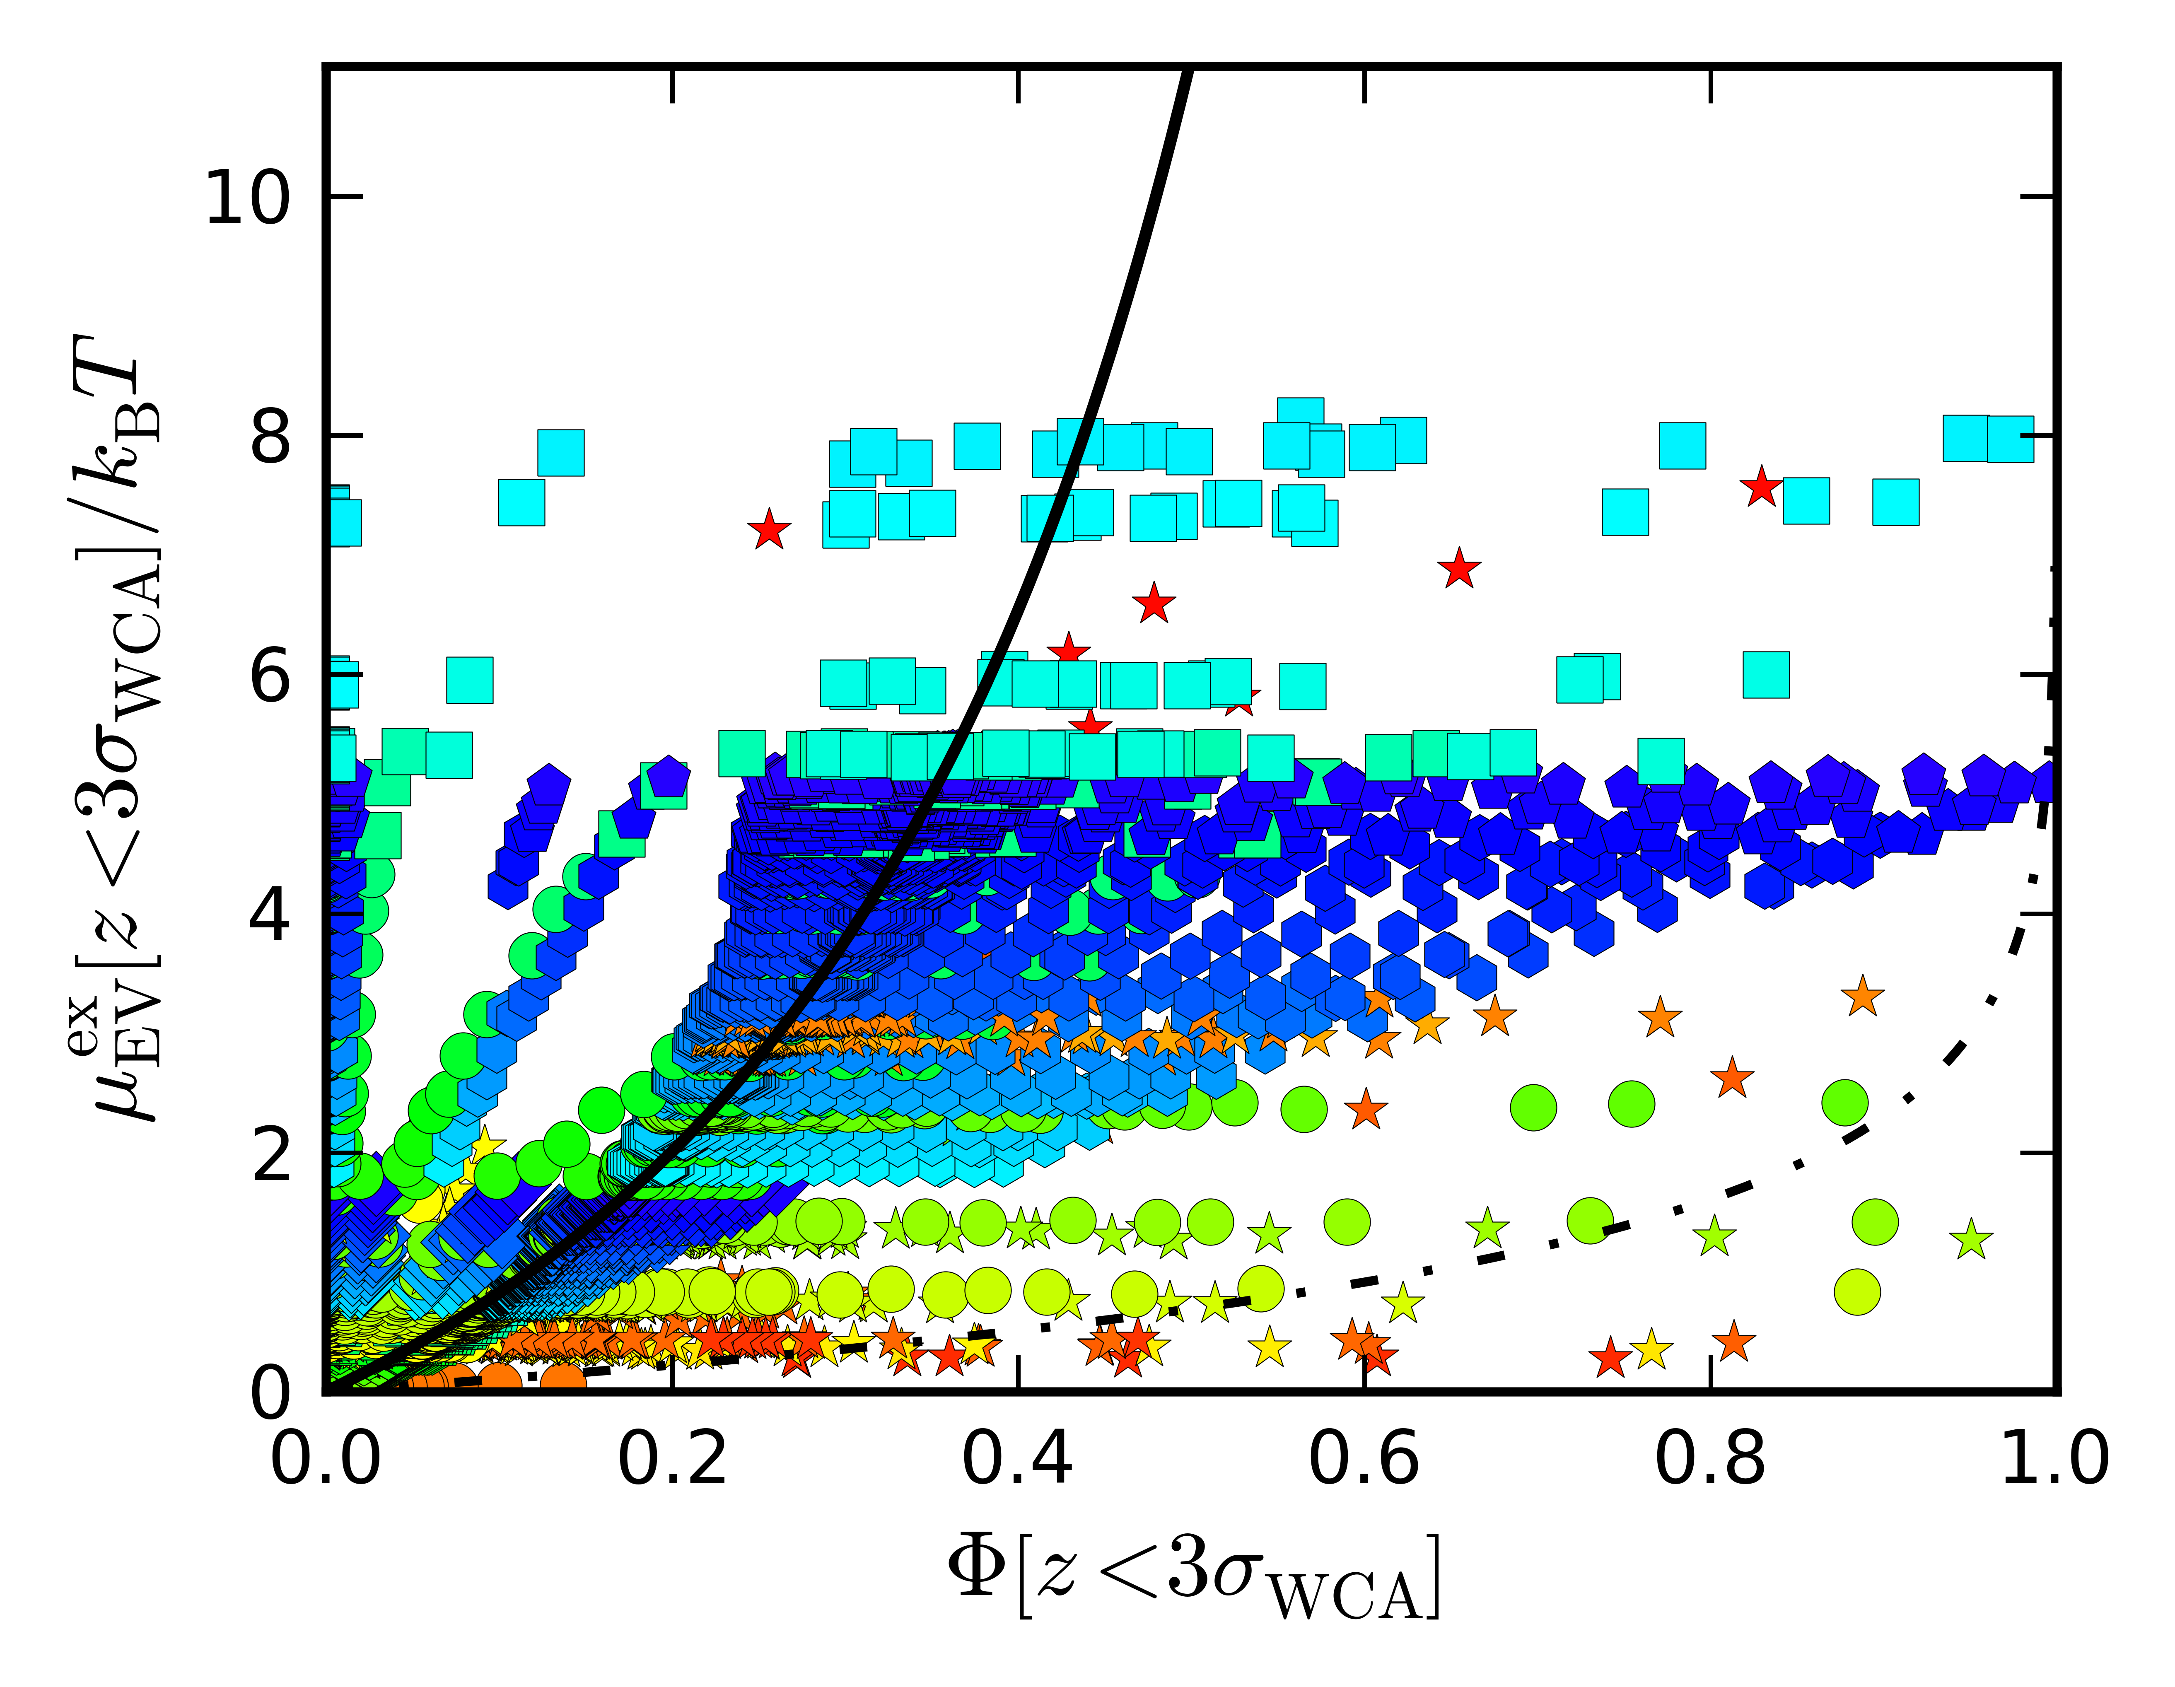
Measured excluded volume chemical potential: near the wall

Slide 52
The chemical potential determines the distribution of ions
Differential change in energy upon adding one more neutral particle
Notes:
The entire video is 0.72 microseconds
The simulation timestep is 1.6 picoseconds
Snapshots are taken every 1.6 nanoseconds

Slide 53
Bikerman theory replaces point-size ions with lattices that saturate at the surface
Gouy-Chapman:
Lattice ions [5]:
[5] Bikerman, 1942
Notes:
The entire video is 0.72 microseconds
The simulation timestep is 1.6 picoseconds
Snapshots are taken every 1.6 nanoseconds

