Slide 1
Charge Optimized Many Body (COMB) Potential in LAMMPS
Ray Shan, Simon R. Phillpot, Susan B. Sinnott
Department of Materials Science and Engineering
University of Florida
LAMMPS Users’ Workshop
August 9th 2011
Supported by: NSF-DMR, DOE EFRC, NSF-CHE, DOE
Notes:
Good afternoon, ladies and gentlemen. I am Ray Shan, from the University of Florida and I work with Profs. Simon Phillpot and Susan Sinnott. My talk for the next 15 minutes is to introduce a recently implemented pair style: the Charge optimized many body potential. Before I start, I would like to acknowledge Steve and Aidan for their kind assistance when we were implementing the potential into LAMMPS.

Slide 2
Outline
Introduction to the COMB potentials
Comparisons to other empirical potentials
Applications of the COMB potentials
  Adhesion of Cu/SiO₂ interfaces
  Nanoindentation and nanoscratch of Si/a-HfO₂
  Modeling Cu/Cu₂O interface
  C/H/O and Zr/ZrO₂ potential development
  Cu ad-atom on ZnO surface via adaptive kinetic Monte Carlo
Conclusions
Notes:
This is a brief outline of my talk. I will start with an introduction to the COMB potential, and then provide a comparison of COMB to other potentials that are available in LAMMPS with some examples. Then I will go through several applications with the COMB potentials

Slide 3
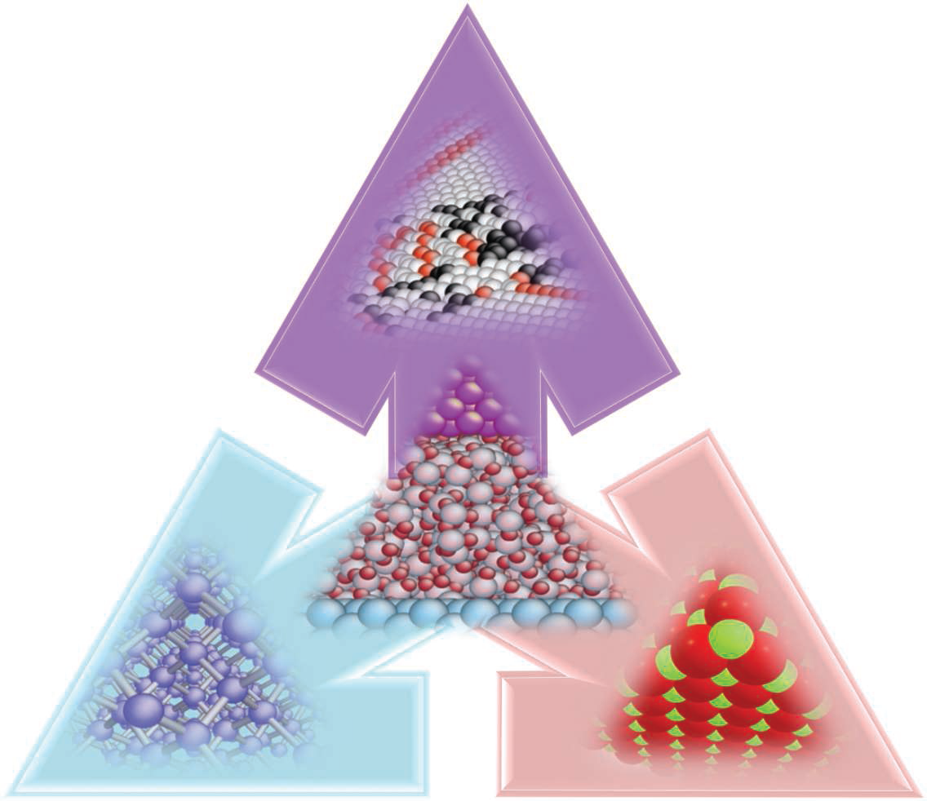
Visual presentation of COMB potentials
Metallic
Cu, Al, Hf, Ti, Zr, U, Zn
Interconnects
Corrosion/Oxidation
Thermal barrier coatings
Catalysts
SiO₂, Cu₂O, Al₂O₃,
HfO₂, TiO₂, ZrO₂,
UO₂, ZnO, AlN, TiN
Si, C/H/O/N
Covalent
Bone/biocomposites
Aqueous biological systems
Ionic
S. R. Phillpot, S. B. Sinnott, Science 325, 1634 (2009).
Notes:
This figure visually presents the capabilities of COMB. COMB is a variable charge empirical potential that is designed to model nanostructures composed of heterogeneous interfaces. Such interfaces consist of discrete bonding types and it has been a challenge to model these interfaces with empirical potentials. For example, catalysts includes interfaces between covalent and metallic bonding types, interconnects include metallic and ionic bonds, and microelectronic devices are composed of all three types of bonding types.

Slide 4
Functional form of COMB potential
General formalism:
  Self energy: fit to atomic ionization energies and electron affinities
  Interatomic potential: Charge dependent Tersoff + Coulomb
  Spherical charge distribution: 1s-type Slater orbital
  ¹ J. Yu, et. al., Phys. Rev. B 75 085311 (2007)
² T.-R. Shan, et al., Phys. Rev. B 81, 125328 (2010)
Notes:
Self energy, which is a fourth order polynomial, is fit to ..
… in the COMB formalism, charges are treated as spherical charge densities centered around each atom, for which we use 1s-type Slater orbital to describe the charge densities.

Slide 5
Overview of COMB potentials
1st generation ª
  Si/SiO₂, Cu
  Tersoff + Coulomb (point charge model with cutoff) + QEq
  In-house HELL code
2nd generation ^{b}
  Si/SiO₂, Cu/Cu₂O, Hf/HfO₂, Ti/TiO₂
  Tersoff + Coulomb (spherical charge density with Wolf Sum) + Qeq
  In-house HELL code, implemented into LAMMPS
3rd generation ^{c}
  C/H/O/N, Zr/ZrO₂, Zn/ZnO, U/UO₂, Al/AlN/Al₂O₃, Ti/TiN/TiO₂
  Improved bond-order term
  Implementation into LAMMPS undergoing
  ª J. Yu, et. al., Phys. Rev. B 75 085311 (2007)
^{b} T.-R. Shan, et al., Phys. Rev. B 81, 125328 (2010)
^{c} T. Liang, et al., in preparation

Slide 6
Use COMB potentials in LAMMPS
2nd Generation COMB
  atom_style charge
  pair_style comb
  pair_coeff * * ffield.comb Si O Cu
  fix ID group-ID qeq/comb 1 1e-4 file fq.out
3rd Generation COMB
  atom_style charge
  pair_style comb3
  pair_coeff * * ffield.comb3 Cu C H O
  fix ID group-ID qeq/comb 1 1e-4 file fq.out
Notes:
To use COMB in LAMMPS, first you have to enable the manybody package since it is implemented as a pair style.

Slide 7
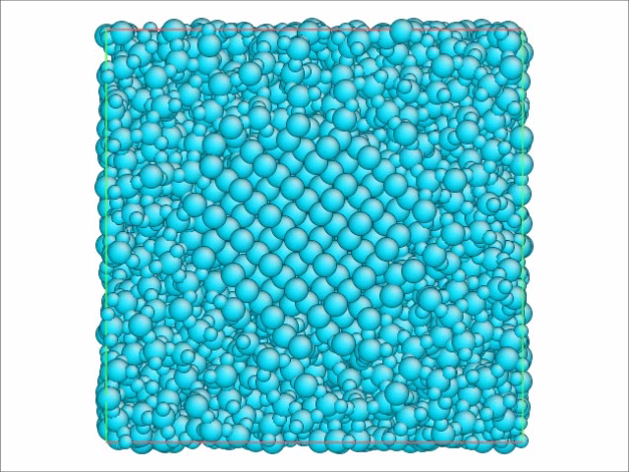
Variable Charge Equilibration
Electronegativity equalization principle
Extended Lagrangian method
  Si-NC
  a-SiO₂

Slide 8
Outline
Introduction to the COMB potential
Comparisons to other empirical potentials
Applications of the developed potentials
  Adhesion of Cu/SiO₂ interfaces
  Nanoindentation and nanoscratch of Si/a-HfO₂
  Modeling Cu/Cu₂O interface
  C/H/O and Zr/ZrO₂ potential development
  Cu ad-atom on ZnO surface via adaptive kinetic Monte Carlo
Conclusions

Slide 9
Cost of Potentials in LAMMPS
Potential | System | # Atoms | Memory | LJ Ratio
Lennard-Jones | LJ liquid | 32000 | 12 Mb | 1.0x
EAM | bulk Cu | 32000 | 13 Mb | 2.4x
Tersoff | bulk Si | 32000 | 9.2 Mb | 4.1x
Stillinger-Weber | bulk Si | 32000 | 11 Mb | 4.1x
EIM | crystalline NaCl | 32000 | 14 Mb | 6.5x
CHARMM + PPPM | solvated protein | 32000 | 124 Mb | 13.6x
MEAM | bulk Ni | 32000 | 54 Mb | 15.6x
AIREBO | polyethylene | 32640 | 101 Mb | 54.7x
ReaxFF/C | PETN crystal | 32480 | 976 Mb | 185x
COMB2 (fixed q) QEq | Ti crystalline SiO₂ | 32400 32400 | 31 Mb 85 Mb | 55x 284x
eFF | H plasma | 32000 | 365 Mb | 306x
ReaxFF | PETN crystal | 16240 | 425 Mb | 337x
VASP/small | water | 192 (512e⁻) | 320 procs | 17.7×10⁶
http://lammps.sandia.gov/bench.html

Slide 10
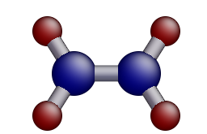
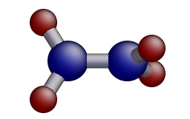
Modeling C₂H₄ molecule
C₂H₄
C₂H₄p
△E from QC: 0.75 eV/atom
 | REBO * | AIREBO | ReaxFF/C | COMB fix | COMB qeq
Energy of C₂H₄ (eV/atom) | -4.05 | -4.05 | -106.92 | -3.83 | -3.88
Relative energy, △E (eV/atom) | + 0.69 | + 0.7 | + 7.51 | + 0.65 | + 0.7
CPU time (sec/10⁵ step) | 3.7 | 10.0 | 43.5 | 7.2 | 35.3
Charge on C | -- | -- | -0.11 | 0.0 | -0.15
* With in-house serial REBO code
REBO, AIREBO, ReaxFF and COMB capable of modeling torsionals
COMB and ReaxFF capable of variable charges

Slide 11
Modeling Cu crystal
Scaling of COMB and EAM in LAMMPS
  System sizes vary from 500 to 64,000 atoms
  8 CPUs, Intel Xeon 2.27 GHz
  COMB costs ~25 times more than EAM
 | EAM ¹ | COMB ²
a₀ (Å) | 3.615 | 3.615
Ecoh (eV) | -3.54 | -3.51
C₁₁ (Gpa) | 170 | 169
C₁₂ (Gpa) | 123 | 119
C₄₄ (Gpa) | 76 | 52
MD Time (seconds． 10³ atom⁻¹．10³ steps⁻¹) | 2.1 | 44.8
¹ Y. Mishin, JM Mehl, DA Papaconstantopoulos, AF Voter, JD Kress, Phys. Rev. B 63, 224106 (2001).
² J Yu, SR Phillpot, SB Sinnott, Phys. Rev. B 75, 233203 (2007).

Slide 12
Outline
Introduction to the COMB potential
Comparisons to other empirical potentials
Applications of the developed potentials
  Adhesion of Cu/SiO₂ interfaces
  Nanoindentation and nanoscratch of Si/a-HfO₂
  Modeling Cu/Cu₂O interface
  C/H/O, Zr/ZrO₂ and U/UO₂ potential development
  Cu ad-atom on ZnO surface via adaptive kinetic Monte Carlo
Conclusions

Slide 13
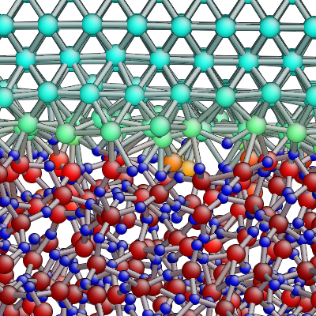
Cu (001)/a-SiO₂ Interfaces
Structural properties of the interface
  Oxidation of Cu is limited to the first two Cu layers; formation of Cu₂O
Introduced O vacancies at the interface
  0, 10 and 20 V_{O}
Type of interface | W (J/m²) |  | Cu-O (%)
 | Exp | COMB
Cu/a-SiO₂ + 0 V_{O} | 0.5 - 1.2 ^{b} 0.6 - 1.4 ^{c} | 1.810 | 22
Cu/a-SiO₂ + 10 V_{O} |  | 0.629 | 13
Cu/a-SiO₂ + 20 V_{O} |  | 0.289 | 11
  Cu-O bonds play crucial roles in adhesion of the interface
Adhesion of Cu/dielectric layer decreases with O defects
ª T.-R. Shan, B. D. Devine, S. R. Phillpot, and S. B. Sinnott, Phys. Rev. B 83 115327 (2011).
^{b} T. S. Oh, R. M. Cannon, and R. O. Ritchie, J. Am. Ceram. Soc. 70, C352 (1987).
^{c} M. Z. Pang and S. P. Baker, J. Mater. Res. 20, 2420 (2005).

Slide 14
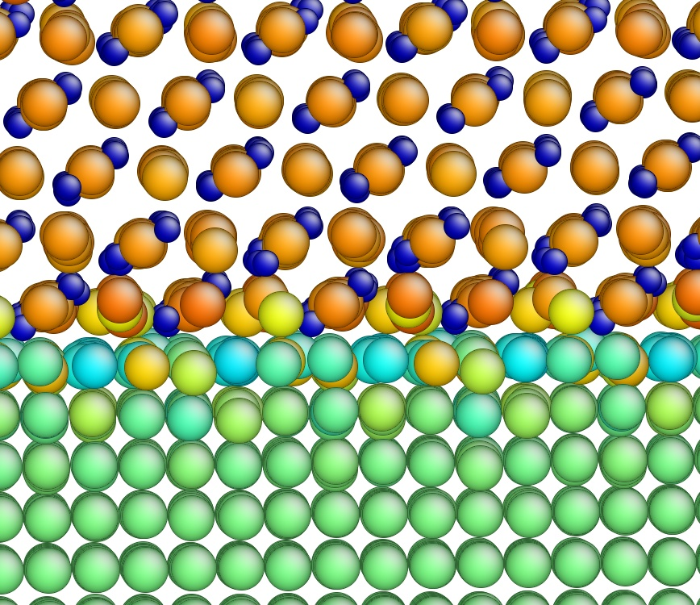
Cu(100) [001]∥Cu₂O(111)[112] Interface
Electrochemically deposited Cu₂O film grows in (111) direction on Cu(100)
  Atomically sharp, semi-coherent
Modelled with COMB potential
  Coherent, 3.6% lattice mismatch
  Negligible charge transfer between phases
  No unphysical charge leaks
  May be applied to study Cu₂O growth on Cu surfaces
Interface adhesion strength:
DFT: 1.96 J/m²
COMB: 2.77 J/m²
B. D. Devine, T.-R. Shan, Y.-T. Cheng, M.-Y. Lee, A. J. McGaughey, S. R. Phillpot, and S. B. Sinnott, Phys. Rev. B, in press

Slide 15
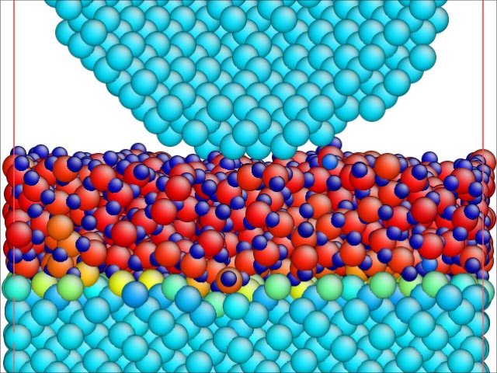
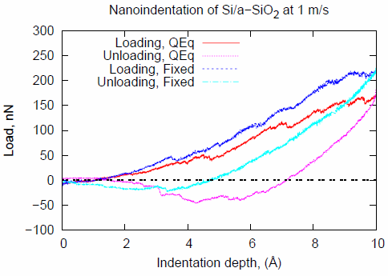
Nanoindentation of Si/a-SiO₂
Load-displacement curves
Snapshot of the system
Simulation set ups
  Rigid Si indenter, 1 m/s indentation rate at 300K
  Movie: 10 ps/frame, 2 ns MD time
Interface stronger and stiffer with variable charge
1.2 nm
T.-R. Shan, X. Sun, S. R. Phillpot, and S. B. Sinnott, in preparation

Slide 16
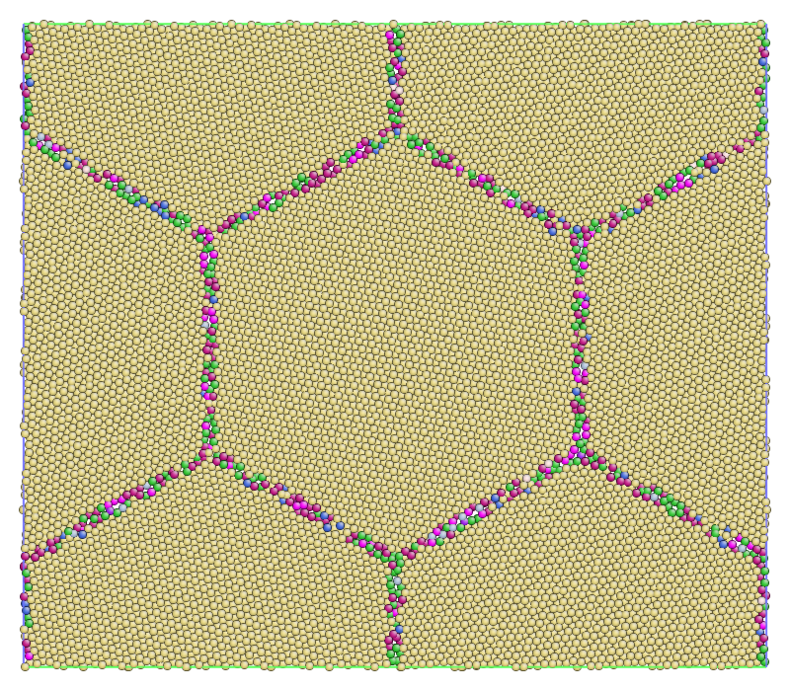
Modeling Polycrystalline Zr with COMB
On-going mechanical testing on polycrystalline Zr metal
  2D columnar grains, 17 nm in diameter
Color coded by coordination,
courtesy of Dong-Hyun Kim and Zizhe Lu

Slide 17
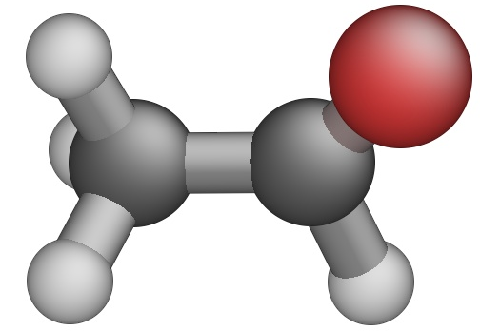
COMB Potentials for CHO Systems
CH₃CHO (acetaldehyde)
Development ongoing, considering more CH and CHO molecules
Combining with COMB potentials for metals and oxides
  Able to model complex organic/inorganic systems
B3LYP COMB
En (eV) -4.14 -4.26
q_{C1} (e) -0.68 -0.56
q_{C2} (e) 0.12 -0.01
q_{O1} (e) -0.27 -0.21
R1 (Å) 1.09 1.15
R2 (Å) 1.51 1.49
R3 (Å) 1.20 1.17
R3
R1
O1
R2
C1
C2
T. Liang, et al., in preparation

Slide 18
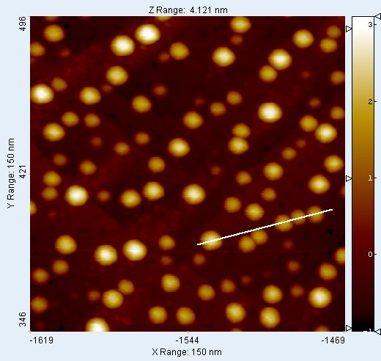
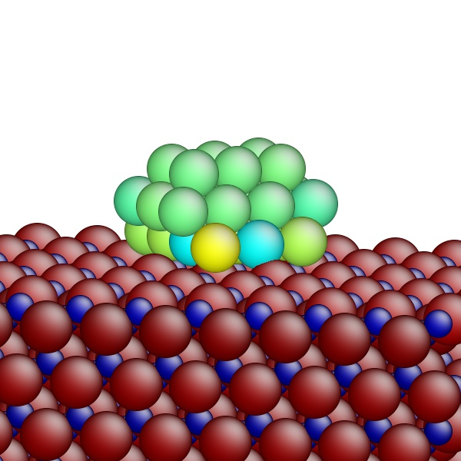
Charge Transfer at Cu/ZnO Interfaces as Predicted by the COMB Potential
0.4587
-0.4581
STM image of Cu clusters on
ZnO(10-10) surface
Charge of Cu cluster on ZnO(10-10) predicted by COMB
Diameter: ~ 15 Å
Height: ~ 6 Å
Courtesy of Yu-Ting Cheng

Slide 19
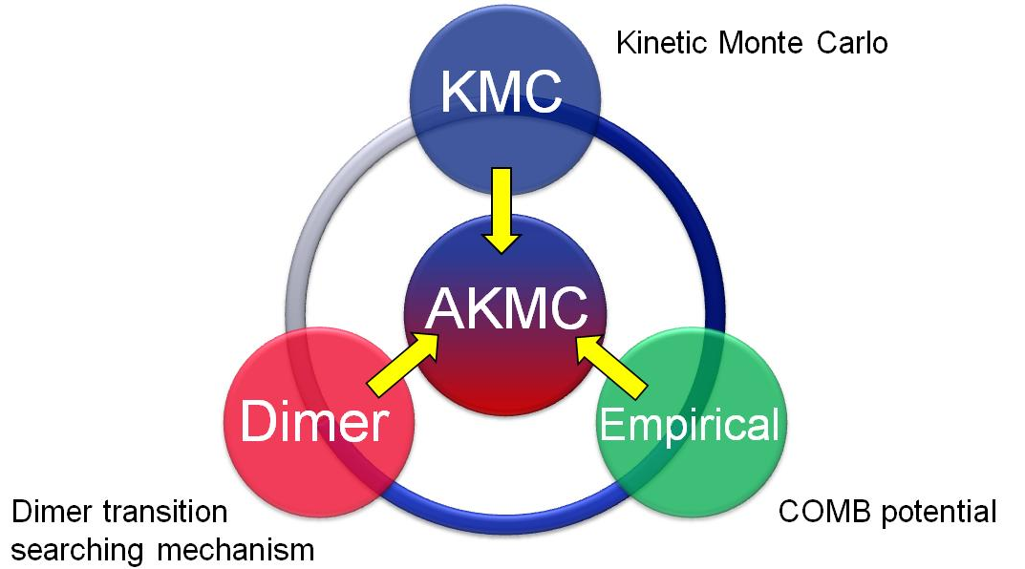

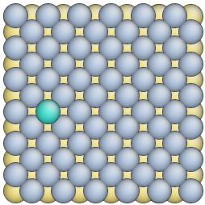
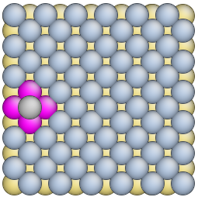
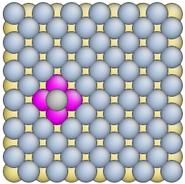
Adaptive Kinetic Monte Carlo
Pathway for single Cu atom diffusion on Cu(100) from the aKMC calculations
(eV)
0.88
 | Activation energy (eV)
COMB | 0.88
Adaptive KMC | 0.88
E_{a}
Courtesy of Yu-Ting Cheng
0
(displacement)

Slide 20
Conclusions
An empirical, variable charge many body (COMB) potential developed for modeling heterogeneous interfaces
  COMB2 Parameterized for Si/SiO₂, Cu/Cu₂O, Hf/HfO₂ and Ti/TiO₂
  COMB3 being developed for C/H/O/N, Zr/ZrO₂, Zn/ZnO, U/UO₂, Al/Al₂O₃, Ti/TiN/TiO₂
  Implemented in community popular MD software LAMMPS
Enables large scale MD simulations of complex, real device-size multifunctional nanostructures with technological significance
Modified formalism with improved flexibility is currently being parameterized for more systems

