Slide 1

Dislocation-Interface Interactions in Silicon
August 10th, 2011 3PM
Lucas Hale
Post Doc
Sandia National Laboratories, CA
Jonathan Zimmerman, Xiaowang Zhou, Neville Moody
Sandia National Laboratories, CA
William Gerberich, Roberto Ballarini
University of Minnesota
Funding: NSF NIRT, NSF CMS, AOARD Air Force, Hysitron Inc., ADMIRE
Sandia National Laboratories is a multi-program laboratory managed and operated by Sandia Corporation, a wholly owned subsidiary of Lockheed Martin Corporation, for the U.S. Department of Energy’s National Nuclear Security Administration under contract DE-AC04-94AL85000.

Slide 2
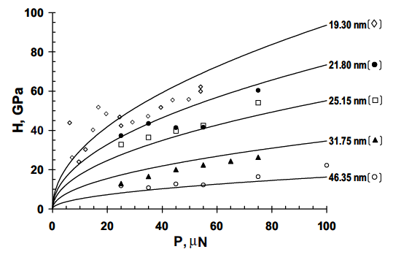
Super Hard Silicon Nanoparticles
Compressed Si nanoparticles harder than bulk silicon
W.W. Gerberich, et. al, Int. J. of Plasticity 21 (2005) 2391
W.W. Gerberich, et al. Journal of the Mechanics and Physics of Solids 51 (2003) 979.

Slide 3
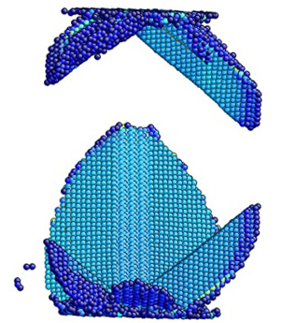
Increasing Number of Dislocations
Hardening at low strain with increasing dislocations
Softening at high strains – dislocations reach surfaces

Slide 4
Simulation Design
Perfect edge dislocations
Systems of 37920, 85648, 152640, and 238784 atoms used
Stillinger-Weber silicon
Two testing methods
  All atoms unconstrained
  Rigid y boundaries

Slide 5
Dislocation Interaction Simulations
Can mechanically realistic Si-SiO₂ systems be easily simulated?
Will dislocation interactions in MD match elasticity based models?
Will oxide retain dislocations for hardness increase?

Slide 6
Si/SiO₂ Potential
Watanabe et al.^{[1]} modification of the Stillinger-Weber is able to model both Si and SiO₂
Introduces bond softening function to 2-body term based on Si-O binding energy with coordination
Cutoffs and preferred bond angles less restricted in three-body term
Stable and correct polymorphs
[1] T Watanabe, H Fujiwara, H Noguchi, T Hoshino, and I Ohdomari, Jpn. J. Appl. Phys. 38 (1999) L366

Slide 7
LAMMPS Implementation
Stillinger-Weber code modified
2 parameter sets in literature, both included
~2X slower than Stillinger-Weber (coordination dependent)
Tested values consistent with report
  Si behaves exactly like Stillinger-Weber
  Si-O dimer energy and bond length
  α-Quartz lattice energy and Si-O length

Slide 8
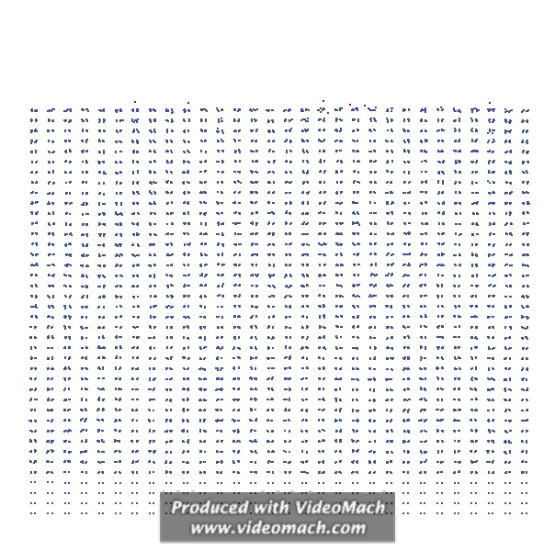
Oxide Growth
Use growth routine by Dalla Torre, et al.^{[1]}
Add O atoms at surface
Run LAMMPS
Add new O atoms in leap-frog method
Repeat 2 and 3 until desired thickness
[1] J. Dalla Torre, J.-L. Bocquet, Y. Limoge, J.-P. Crocombette, E. Adam, G. Martin, T. Baron, P. Rivallin, and P. Mur, J. Appl. Phys. 92 (2002) 1084

Slide 9
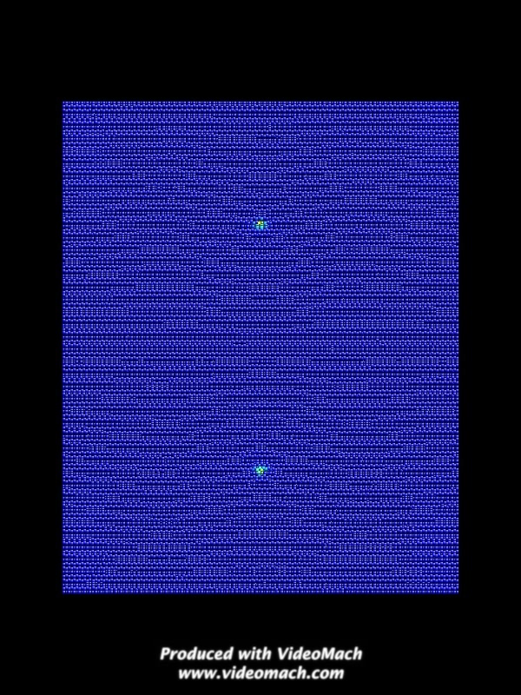
Free Surface: No Shear Applied

Slide 10
Attraction to Interface
Incremental straining with holds
Attraction during last straining
C is 1/4 -1/5 free surface value

Slide 11
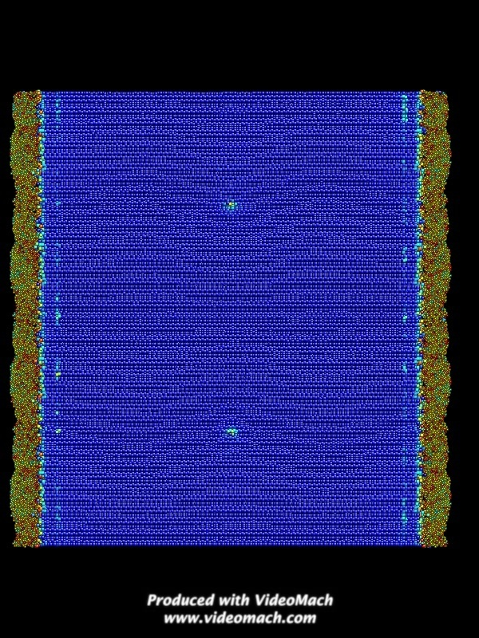
Long Range Repulsion
Dislocation positions remain fixed in unconstrained systems
No dislocation-dislocation repulsion seen
Oxide is repulsive

Slide 12
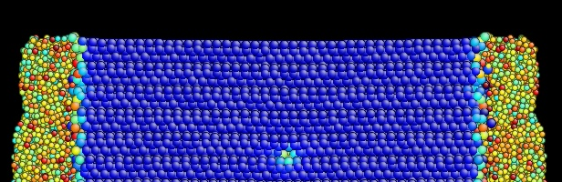
Stress State
Oxide places surfaces in tension
Stress gradient results in shear stresses
Long range repulsion

Slide 13
Summary/Conclusions
Watanabe, et. al Si-SiO₂ implemented in LAMMPS
Free surface and short range oxide attraction consistent with dislocation theory
Presence of oxide is repulsive at long range due to stress state of system
Repulsion can lead to dislocation buildup depending on stress state due to oxide

