Slide 1

Molecular Simulations of
Metal-Organic Frameworks
Jeffery A. Greathouse
Sandia National Laboratories
9 August 2011
Sandia National Laboratories is a multi-program laboratory managed and operated by Sandia Corporation, a wholly owned subsidiary of Lockheed Martin Corporation, for the U.S. Department of Energy’s National Nuclear Security Administration under contract DE-AC04-94AL85000.

Slide 2
Outline
Metal-organic frameworks (MOFs)
MD simulation
  Mechanical properties
  Vibrational properties
  Framework stability
GCMC simulation
  Code development (Paul Crozier)
  Adsorption of I₂ by ZIF-8
IRMOF-1

Slide 3
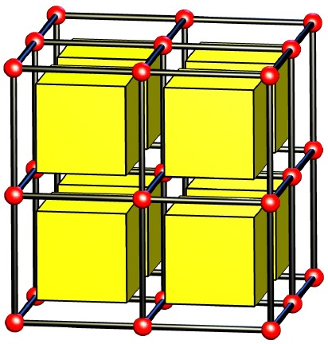
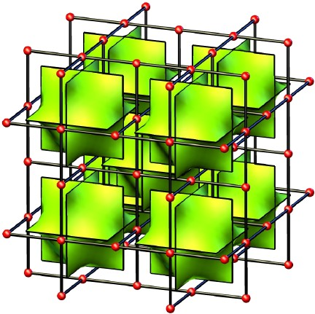
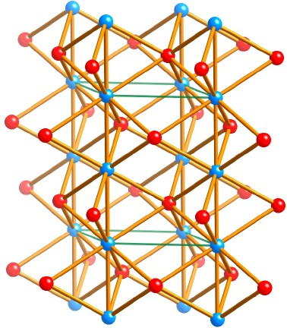
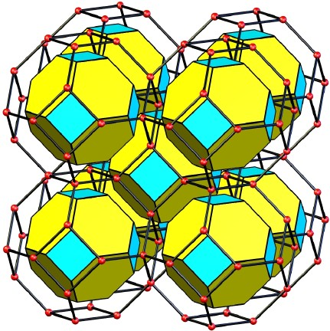
Metal-Organic Frameworks (MOFs)
Crystalline, highly ordered solids
Metal cations linked by organic linkers
Tunable pore chemistry
Nanoporous (5-30 Å)
Huge variety of structures
Ultrahigh surface areas
    (as high as 6000 m²/g)
Structurally flexible
pcu
IRMOF series
Zn₄O cluster
nbo
NOTT-10x, PCN-14
Cu₂ cluster
seh
MIL-53(Al)
Al(OH) cluster
sod
ZIF-8
Zn cluster

Slide 4
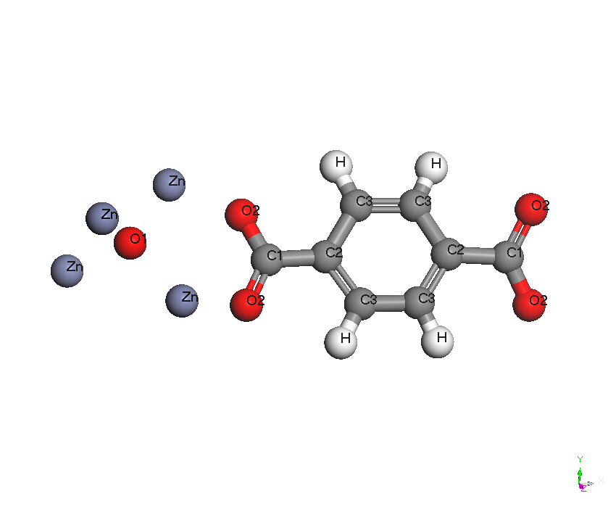
MD Simulation
Potential energy expression:
  All atoms: VDW and electrostatic
  Linkers and adsorbates: CVFF intramolecular parameters (bond, angle, dihedral, out-of-plane
Constant pressure (NPT) ensemble to calculate volume and lattice parameters (with and without adsorbate).
Constant volume (NVT) ensemble for elastic and vibrational properties.
Nonbonded force field approach for IRMOF-1 validated by: T and P effects, elastic properties, vibrational properties, volume changes associated with adsorption (water)

Slide 5
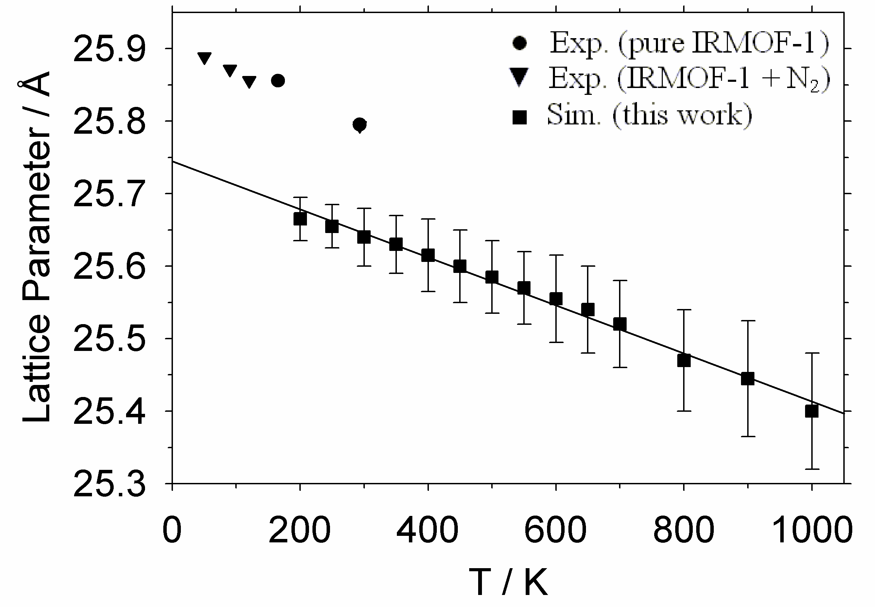
Mechanical Properties of IRMOF-1
Trend of negative thermal expansion agrees with experiment.
1.0% increase in volume between 30 K – 293 K (0.1 Å in lattice parameter).
Significant decrease in bulk modulus between 0 K and 300 K
 | Energy Min (0 K) |  | MD Sim (300 K)
 | FF | DFT | FF
Bulk Modulus (GPa) | 20.0 | 16.3 | 4.0
Greathouse and Allendorf, J. Phys. Chem. C 2008.

Slide 6
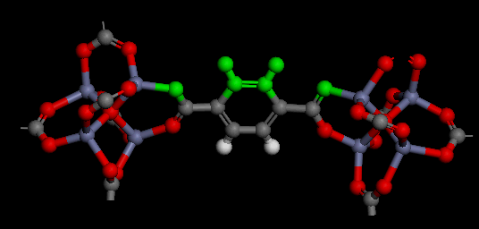
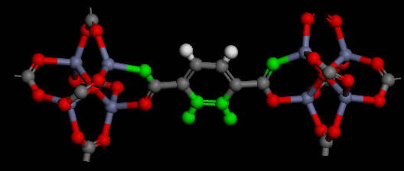
Vibrational Properties of IRMOF-1
Power spectra for select atom types. Frequencies for ZnO₄ modes are in agreement with experiment.
Librational modes due to internal rotation of phenyl groups.
Greathouse and Allendorf, J. Phys. Chem. C 2008.

Slide 7
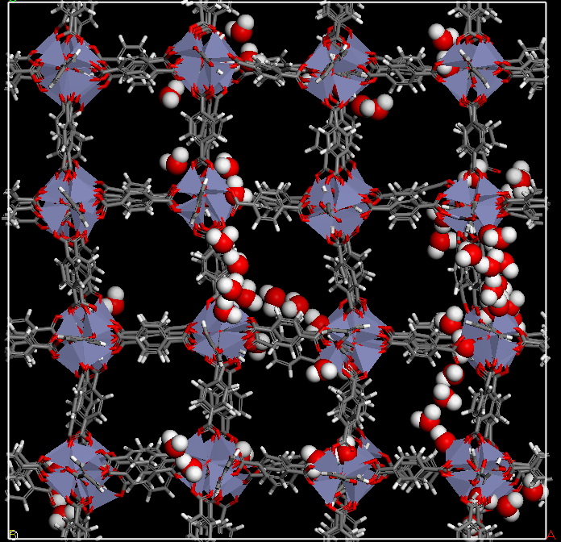
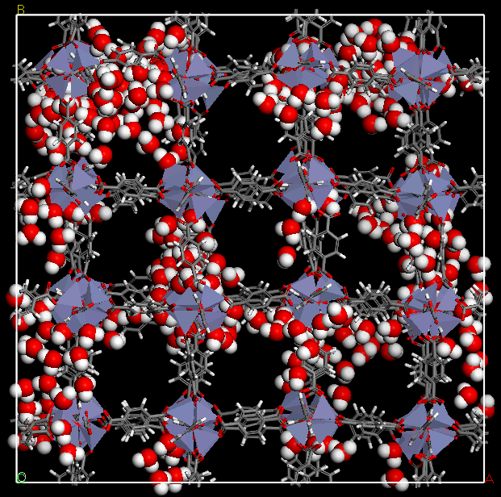
Interaction of IRMOF-1 with Water
Framework distortion at low water content
Framework unstable at higher water content
Greathouse and Allendorf, J. Am. Chem. Soc 2006.

Slide 8
Adsorption in LAMMPS: “fix GCMC”
Grand canonical Monte Carlo (μVT ensemble)
Standard GCMC features:
  Particle creation/destruction.
  Work efficiently, and in parallel on multiple processors.
  Compatible with other LAMMPS features (MD, ensembles, force fields, computes, etc).
  Reports relevant statistics.
Currently limited to monatomic adsorbates and short-range interactions (no electrostatics).

Slide 9
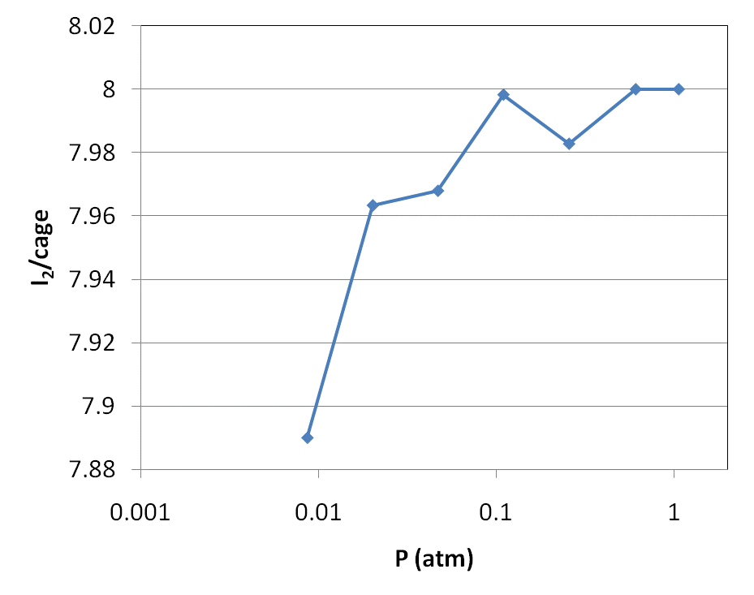
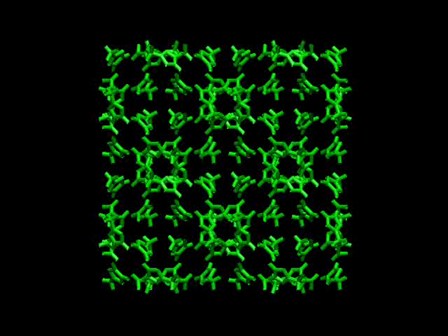
Adsorption of I₂ in ZIF-8
Spherical model for I₂.
Predicted I₂ loading in good agreement with x-ray diffraction.
Sava et al, J. Am. Chem. Soc. 2011, in press.

Slide 10
More on “fix GCMC”
Likely to be done soon:
More verification testing vs MCCCS Towhee code.
Fix code problems identified by beta testers.
Improve the documentation in preparation for release.
Send updated code & docs out to beta testers and Steve.
Release code & docs on main LAMMPS website.
Maybe later if there’s time:
Add molecule capability, including MC exchanges, moves, and rotations of molecules.
Add ability to measure and report chemical potential.
Make it work with long-range electrostatics.
Make it scale: better parallel simulation.
Add fancier MC moves (configurational bias, etc.).

Slide 11
Acknowledgements
Sandia National Laboratories
  Mark Allendorf
  Paul Crozier
  Tina Nenoff
  Dorina Sava

