Slide 1
Inelastic Deformation in Shock Loaded PETN
Reilly Eason and Thomas D. Sewell
Department of Chemistry
University of Missouri-Columbia
Funded by Defense Threat Reduction Agency

Slide 2
Background
Jerry Dick observed an initiation anisotropy in PETN
sensitive – [110] and [001]
insensitive – all other directions studied
Steric hindrance model¹⁻³
We seek to characterize the mechanisms of inelastic deformation on the atomic level by using molecular dynamics
Used the non-polarizable force field for alkyl nitrates developed by Borodin et al.⁴
1. Dick, J. J. Appl. Phys. Lett. 1984, 44, 859
2. Dick, J. J.; Mulford, R. N.; Spencer, W. J.; Pettit, D. R.; Garcia, E.; Shaw, D. C. J. Appl. Phys. 1991, 70, 3572
Dick, J. J.; Ritchie, J. P. J. Appl. Phys. 1994, 76, 2726
Borodin, O.; Smith, G. D.; Sewell, T. D.; Bedrov, D. J. Phys. Chem. B 2008, 112, 734

Slide 3
Simulation Details
Two orientations
normal to (001) – sensitive, 20a × 20b × 120c
normal to (100) –insensitive, 120a × 20b × 20c and 120a × 120b × 6c
Equilibration
NVE – 5 ps
full velocity scaling to T = 298 K every 10 fs with velocities randomly re-selected from a Maxwell distribution every 1 ps
NVT – 20 ps, T = 298 K
Shock
NVE – 0.1 fs timestep
|U_{p}| = 1.00 km/s
P_{shock} ≈ 9 GPa
Piston
Shocked Material
Unshocked material

Slide 4
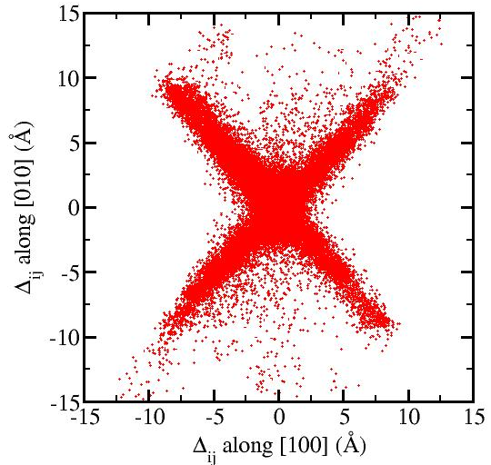
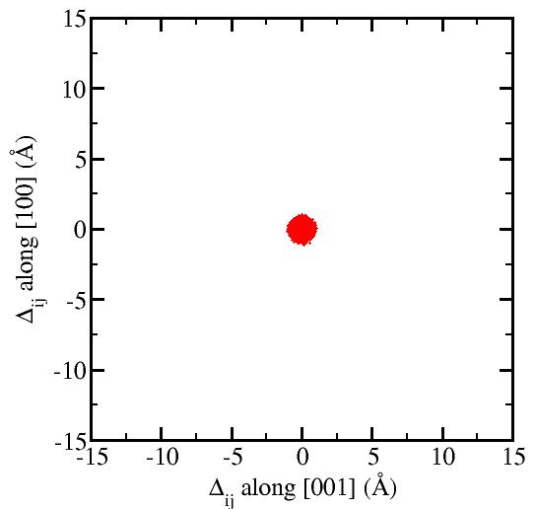
Relative Nearest Neighbor Molecular Displacements¹
Allows for an atomic level view of elastic and inelastic displacements in a material
Shock normal to (100)
Shock normal to (001)
1. Jaramillo, E.; Sewell, T. D.; Strachan, A. Physical Review B 2007, 76 064112

Slide 5
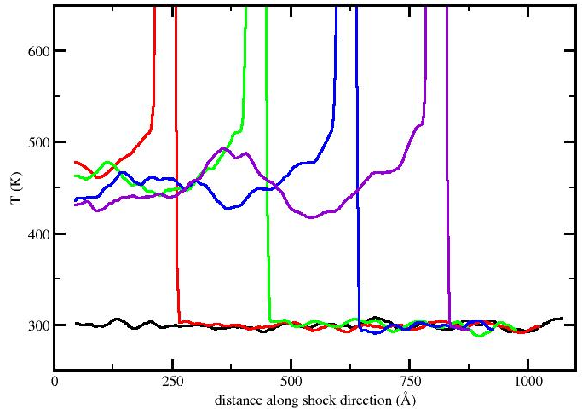
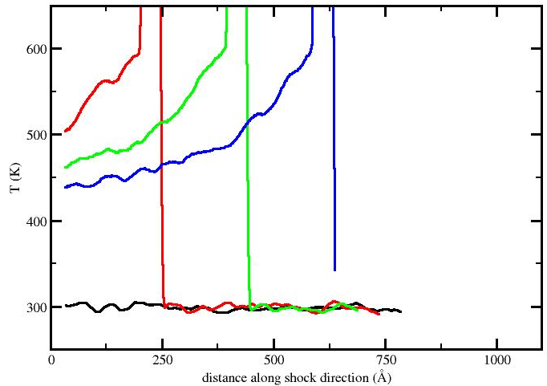
Temperature
Separated into translational (intermolecular) and rotational-vibrational (intramolecular) components
Intermolecular Temperature
Shock normal to (100)
Shock normal to (001)

Slide 6
Quasi-2D
Attempt to study in more detail the mechanisms of inelastic deformation observed for shocks propagating along the insensitive [100] orientation
Simulation cell – 120a × 120b × 6c
The methods used in previous simulations were also used for this simulation until the time of maximum compression (22 ps)
Shock Front Absorbing Boundary Conditions (SFABCs)¹ were applied at the time of maximum compression to extend the simulation time to 45 ps
1. Cawkwell, M. J.; Sewell, T. D.; Zheng, L.; Thompson, D. L. Physical Review B 2008 78, 014107

Slide 7
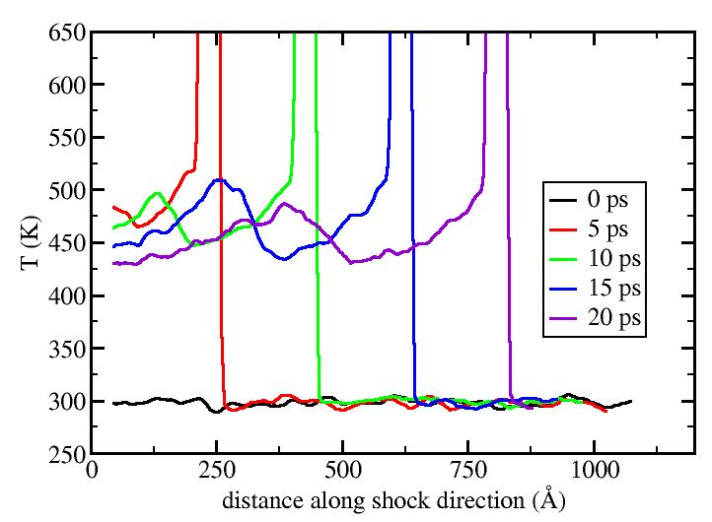
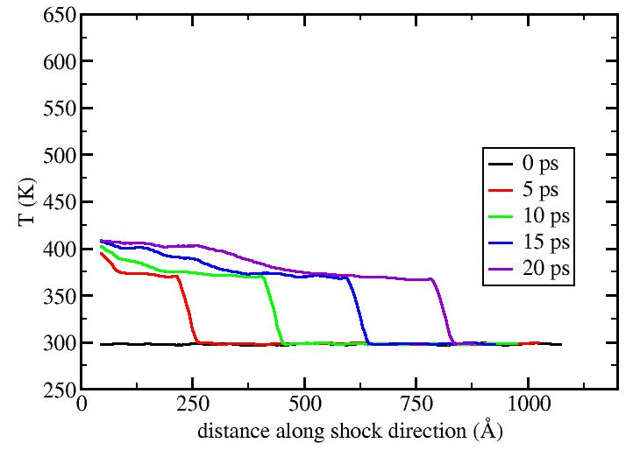
Temperature
Intermolecular
Intramolecular

Slide 8
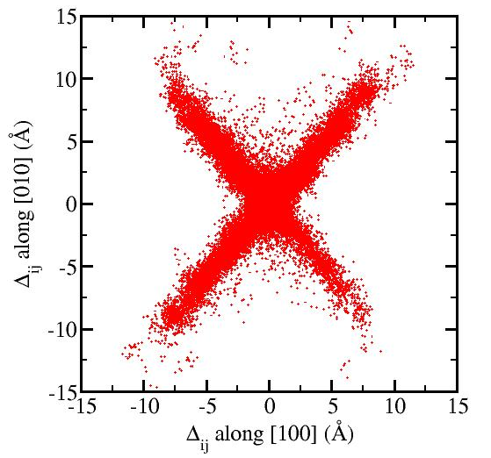
Molecular Displacements
A
B
D
[010]
C
Inelastic
Elastic
[100]

Slide 9
Region A

Slide 10
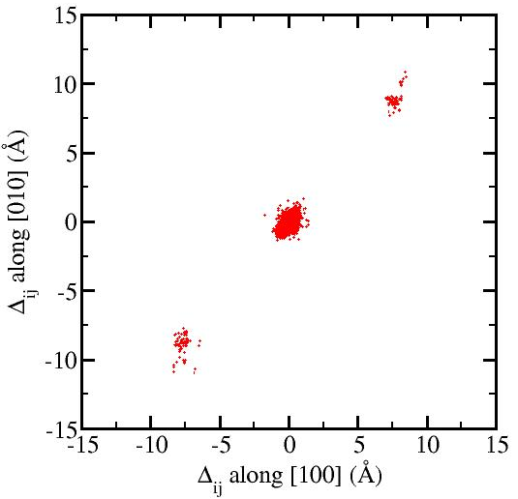
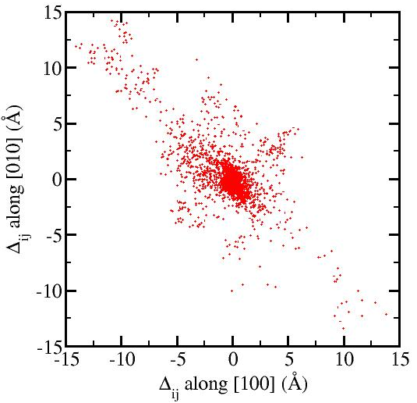
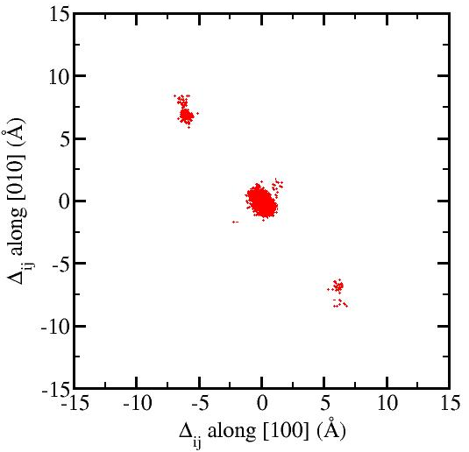
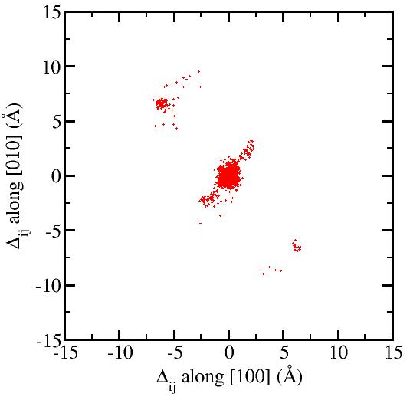
Molecular Displacements
A
C
B
D

Slide 11
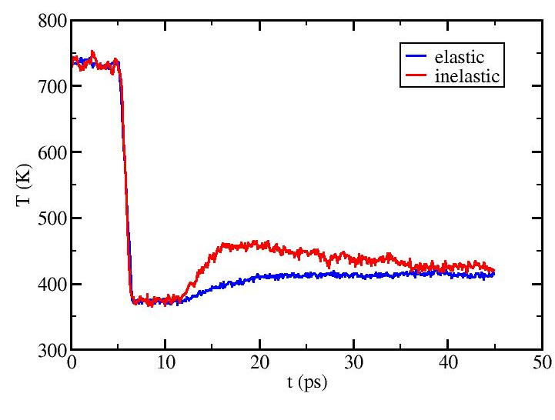
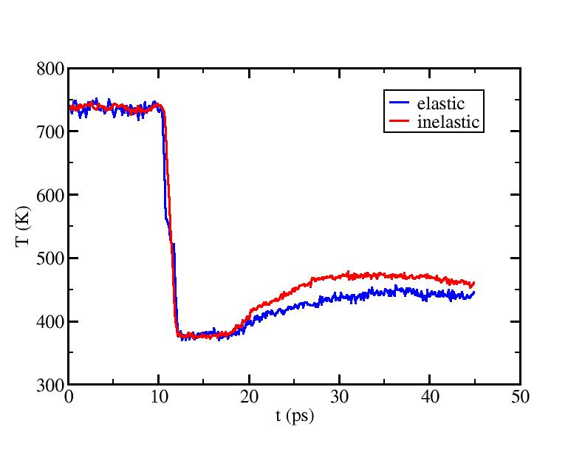
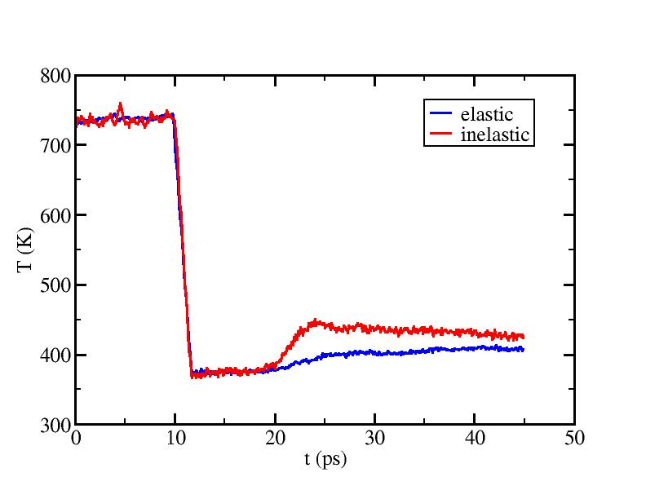
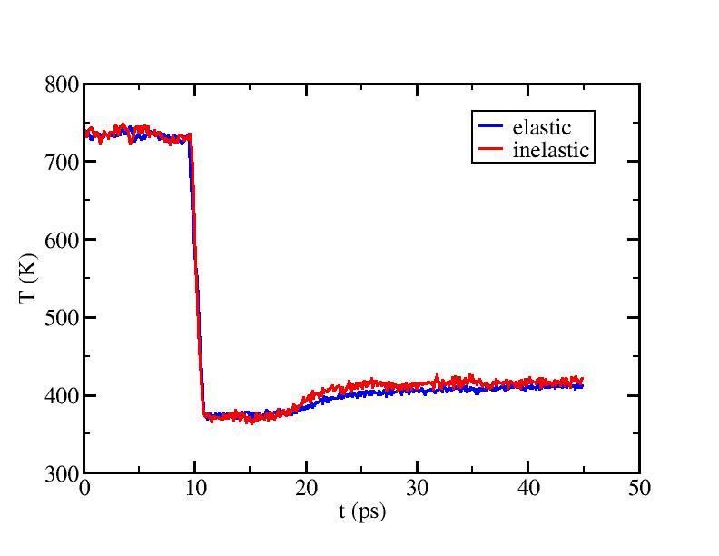
Kinetic Energy (Temperature)
A
C
B
D

Slide 12
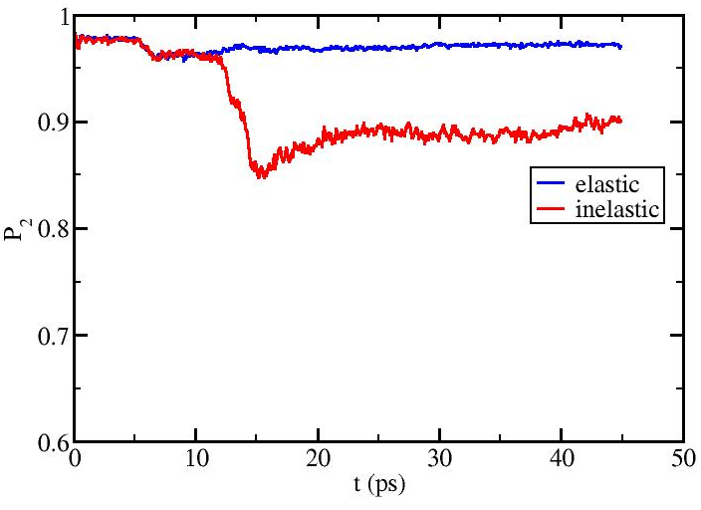
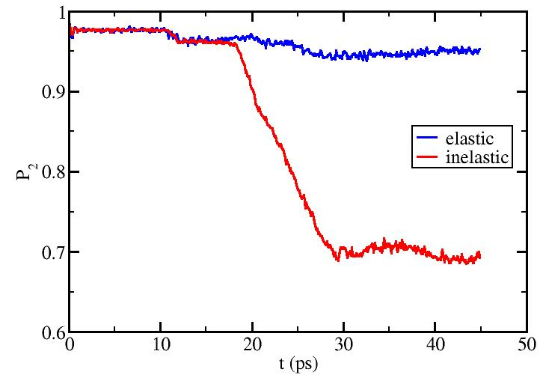
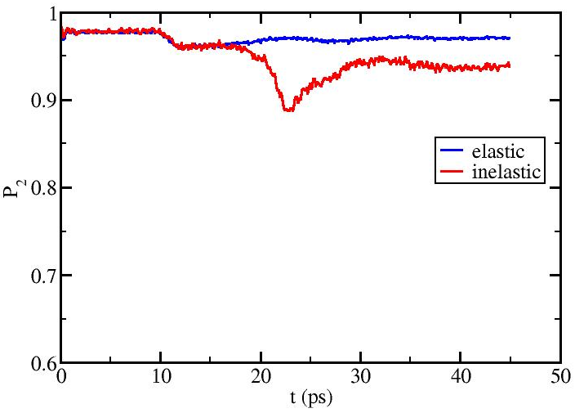
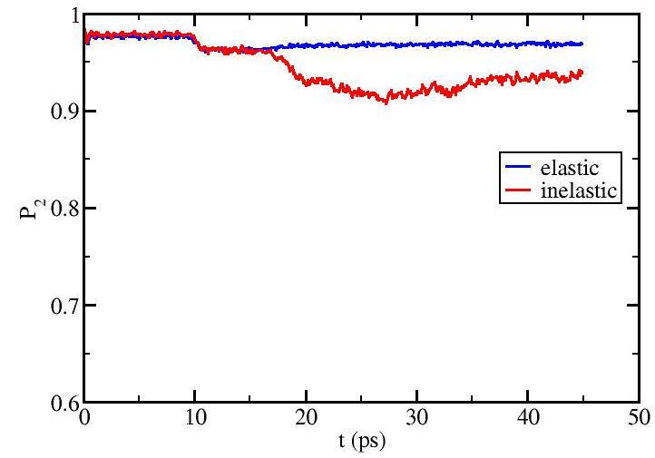
Rotational Order
A
C
B
D

Slide 13
Conclusions
Results from the simulations of the two orientations agree well with what would be expected based on the steric hindrance model
A two wave structure is observed for shocks normal to (100) while only a single wave is evident for shocks propagating normal to (001)
Results from a quasi-2D simulation showed evidence for different types of deformation for shocks normal to (100)
full dislocations
stacking faults
mass plastic flow
The elastic and plastic waves result in loss of rotational order in the system which is partially recovered by dislocations and stacking faults

