Slide 1


A brief survey of the LAMMPS particle simulation code:
introduction, case studies, and future development
Paul S. Crozier
August 10, 2011
Sandia National Laboratories
Sandia National Laboratories is a multi-program laboratory managed and operated by Sandia Corporation, a wholly owned subsidiary of Lockheed Martin Corporation, for the U.S. Department of Energy’s National Nuclear Security Administration under contract DE-AC04-94AL85000.

Slide 2
Acknowledgements
Steve Plimpton (1426)
Aidan Thompson (1425)
Many other contributors to LAMMPS
(see: http://lammps.sandia.gov/authors.html)

Slide 3
Discussion outline
MD basics
Why use LAMMPS?
Live demo #1
Basic information about LAMMPS
Live demo #2
Six very useful LAMMPS commands
Live demo #3
Vignettes of some LAMMPS research
Future areas of LAMMPS development
How to add a new feature to LAMMPS
Homework assignment

Slide 4
Review of MD basics
MD: molecular dynamics
F = ma
Classical dynamics
Rapidly grown in popularity and use in research
Computationally intensive, especially computation of nonbonded interactions
Uses force fields: mathematical models of interatomic interactions

Slide 5


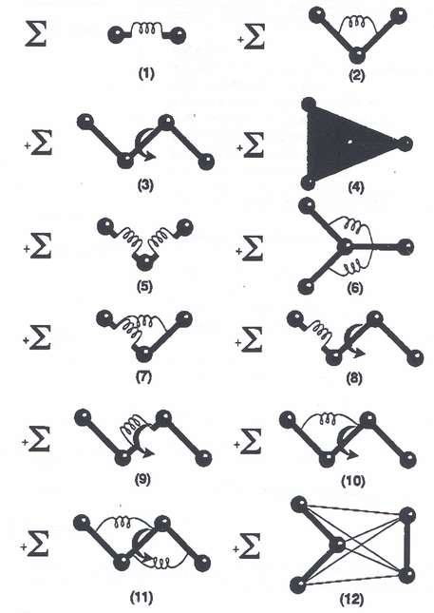
MD uses empirical force fields
Particles interact via empirical potentials
  analytic equations, fast to compute
  coefficients fit to expt or quantum calcs
Potential energy = Φ = f(x)
Force = -Grad Φ
Pair-wise forces
  Van der Waals (dipole-dipole)
  Coulombic (charge-charge)
Many-body forces
  EAM, Tersoff, bond-order, ReaxFF
Molecular forces
  springs, torsions, dihedrals, ...
Long-range Coulombic forces
  Ewald, particle-mesh methods, FFTs

Slide 6
MD in the Middle
Quantum mechanics
  electronic degrees of freedom, chemical reactions
  Schrodinger equation, wave functions
  sub-femtosecond timestep, 1000s of atoms, O(N³)
Atomistic models
  molecular dynamics (MD), Monte Carlo (MC)
  point particles, empirical forces, Newton's equations
  femtosecond timestep, millions of atoms, O(N)
Mesoscale to Continuum
  finite elements or finite difference on grids
  coarse-grain particles: DPD, PeriDynamics, ...
  PDEs, Navier-Stokes, stress-strain
  microseconds → seconds, microns → meters, O(N^{3/2})
years
Design
FEA
Time
MESO
MD
10⁻¹⁵ s
QM
Å
Distance
m

Slide 7
Algorithmic Issues in MD
Speed
  parallel implementation
Accuracy
  long-range Coulombics
Time scale
  slow versus fast degrees of freedom
Length scale
  coarse-graining

Slide 8
Classical MD in Parallel
MD is inherently parallel
  forces on each atom can be computed simultaneously
  X and V can be updated simultaneously
Most MD codes are parallel
  via distributed-memory message-passing paradigm (MPI)
Computation scales as N = number of atoms
  ideally would scale as N/P in parallel
Can distribute:
  atoms communication = scales as N
  forces communication = scales as N/sqrt(P)
  space communication = scales as N/P or (N/P)^{2/3}

Slide 9
Discussion outline
MD basics
Why use LAMMPS?
Live demo #1
Basic information about LAMMPS
Live demo #2
Six very useful LAMMPS commands
Live demo #3
Vignettes of some LAMMPS research
Future areas of LAMMPS development
How to add a new feature to LAMMPS
Homework assignment

Slide 10
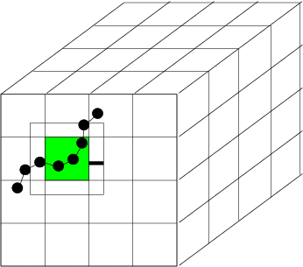
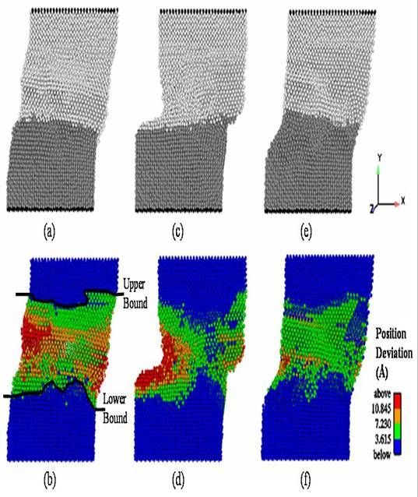
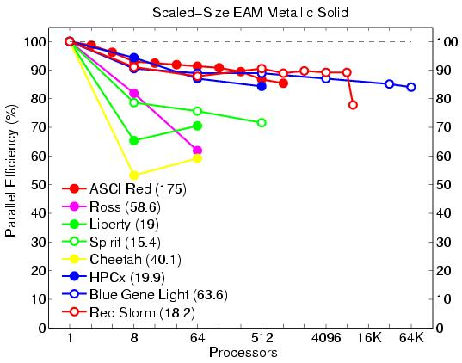
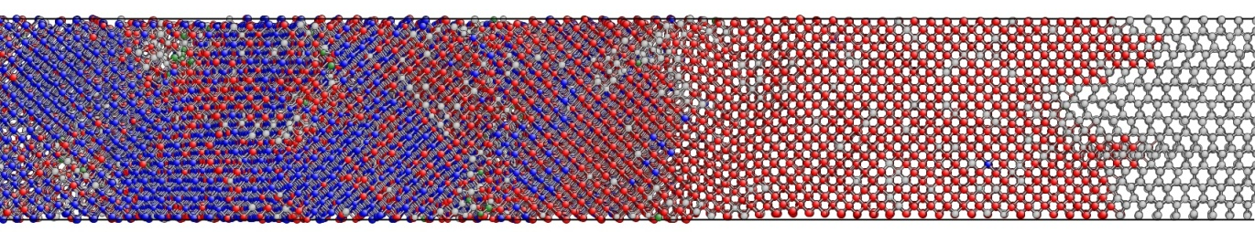
Why Use LAMMPS?
(Large-scale Atomic/Molecular Massively Parallel Simulator)
http://lammps.sandia.gov
Classical MD code.
Open source, highly portable C++.
Freely available for download under GPL.
Easy to download, install, and run.
Well documented.
Easy to modify or extend with new features and functionality.
Active user’s e-mail list with over 650 subscribers.
Upcoming users’ workshop: Aug 9 – 11, 2011.
Since Sept. 2004: over 50k downloads, grown from 53 to 175 kloc.
Spatial-decomposition of simulation domain for parallelism.
Energy minimization via conjugate-gradient relaxation.
Radiation damage and two temperature model (TTM) simulations.
Atomistic, mesoscale, and coarse-grain simulations.
Variety of potentials (including many-body and coarse-grain).
Variety of boundary conditions, constraints, etc.

Slide 11
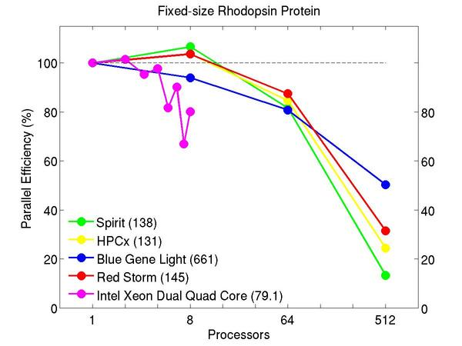
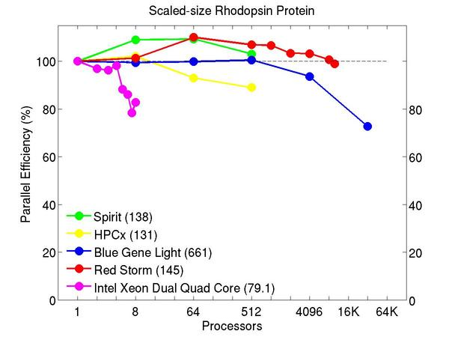
Why Use LAMMPS?
Answer 1: (Parallel) Performance
Protein (rhodopsin) in solvated lipid bilayer
Fixed-size (32K atoms) & scaled-size (32K/proc) parallel efficiencies
Billions of atoms on 64K procs of Blue Gene or Red Storm
Typical speed: 5E-5 core-sec/atom-step (LJ 1E-6, ReaxFF 1E-3)

Slide 12
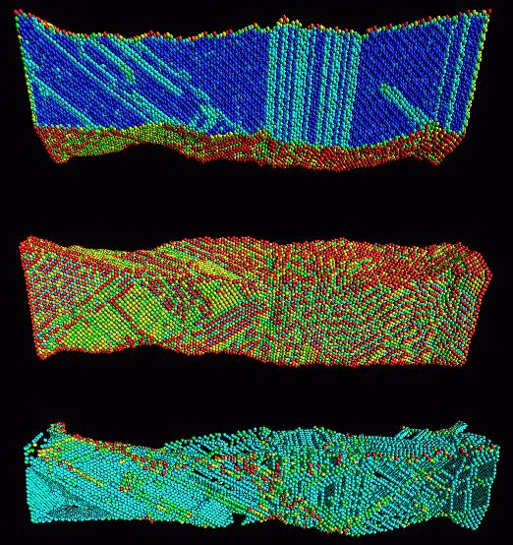
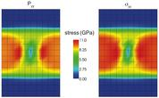
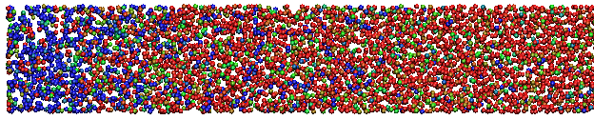
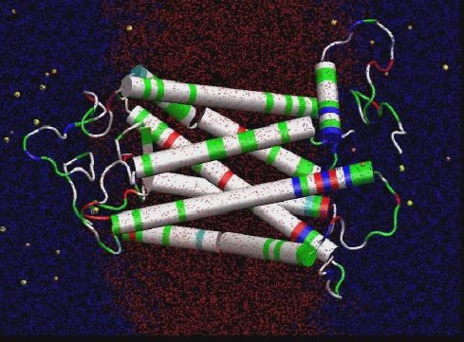
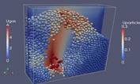
Why Use LAMMPS?
Answer 2: Versatility
Materials Science
Solid Mechanics
Chemistry
Biophysics
Granular Flow

Slide 13
Why Use LAMMPS?
Answer 3: Modularity
LAMMPS Objects
atom styles: atom, charge, colloid, ellipsoid, point dipole
pair styles: LJ, Coulomb, Tersoff, ReaxFF, AI-REBO, COMB, MEAM, EAM, Stillinger-Weber,
fix_styles: NVE dynamics, Nose-Hoover, Berendsen, Langevin, SLLOD, Indentation,...
compute styles: temperatures, pressures, per-atom energy, pair correlation function, mean square displacemnts, spatial and time averages
Goal: All computes works with all fixes work with all pair styles work with all atom styles
pair_reax.cpp fix_nve.cpp
pair_reax.h fix_nve.h

Slide 14
Why Use LAMMPS?
Answer 4: Potential Coverage
LAMMPS Potentials
pairwise potentials: Lennard-Jones, Buckingham, ...
charged pairwise potentials: Coulombic, point-dipole
manybody potentials: EAM, Finnis/Sinclair, modified EAM (MEAM), embedded ion method (EIM), Stillinger-Weber, Tersoff, AI-REBO, ReaxFF, COMB
electron force field (eFF)
coarse-grained potentials: DPD, GayBerne, ...
mesoscopic potentials: granular, peridynamics
long-range Coulombics and dispersion: Ewald, PPPM (similar to particle-mesh Ewald)

Slide 15
Why Use LAMMPS?
Answer 4: Potentials
LAMMPS Potentials (contd.)
bond potentials: harmonic, FENE,...
angle potentials: harmonic, CHARMM, ...
dihedral potentials: harmonic, CHARMM,...
improper potentials: harmonic, cvff, class 2 (COMPASS)
polymer potentials: all-atom, united-atom, bead-spring, breakable
water potentials: TIP3P, TIP4P, SPC
implicit solvent potentials: hydrodynamic lubrication, Debye
force-field compatibility with common CHARMM, AMBER, OPLS, GROMACS options

Slide 16
Why Use LAMMPS?
Answer 4: Range of Potentials
LAMMPS Potentials
Biomolecules: CHARMM, AMBER, OPLS, COMPASS (class 2),
long-range Coulombics via PPPM, point dipoles, ...
Polymers: all-atom, united-atom, coarse-grain (bead-spring FENE),
bond-breaking, …
Materials: EAM and MEAM for metals, Buckingham, Morse, Yukawa,
Stillinger-Weber, Tersoff, AI-REBO, ReaxFF, COMB, eFF...
Mesoscale: granular, DPD, Gay-Berne, colloidal, peri-dynamics, DSMC...
Hybrid: can use combinations of potentials for hybrid systems:
water on metal, polymers/semiconductor interface,
colloids in solution, …

Slide 17
Why Use LAMMPS?
Answer 5: Easily extensible
One of the best features of LAMMPS
  80% of code is “extensions” via styles
  only 35K of 175K lines is core of LAMMPS
Easy to add new features via 14 “styles”
  new particle types = atom style
  new force fields = pair style, bond style, angle style, dihedral style, improper style
  new long range = kspace style
  new minimizer = min style
  new geometric region = region style
  new output = dump style
  new integrator = integrate style
  new computations = compute style (global, per-atom, local)
  new fix = fix style = BC, constraint, time integration, ...
  new input command = command style = read_data, velocity, run, …
Enabled by C++
  virtual parent class for all styles, e.g. pair potentials
  defines interface the feature must provide
  compute(), init(), coeff(), restart(), etc

Slide 18
How to download, install, and use LAMMPS
Download page:
  lammps.sandia.gov/download.html
Installation instructions:
  lammps.sandia.gov/doc/Section_start.html
  go to lammps/src
  type “make your_system_type”
To perform a simulation:
  lmp < my_script.in

Slide 19
Live demo #1
Download LAMMPS.
  http://lammps.sandia.gov/download.html
  Try the Windows serial executable.
Download a simple LAMMPS input script.
  http://lammps.sandia.gov/inputs/in.lj.txt
Run LAMMPS
  http://lammps.sandia.gov/doc/Section_start.html#2_5

Slide 20
Discussion outline
MD basics
Why use LAMMPS?
Live demo #1
Basic information about LAMMPS
Live demo #2
Six very useful LAMMPS commands
Live demo #3
Vignettes of some LAMMPS research
Future areas of LAMMPS development
How to add a new feature to LAMMPS
Homework assignment

Slide 21
How to get help with LAMMPS
Excellent User’s Manual:
http://lammps.sandia.gov/doc/Manual.html
http://lammps.sandia.gov/doc/Section_commands.html#3_5
2. Search the web: can include “lammps-users” as a search keyword to search old e-mail archives
3. Send e-mail to the user’s e-mail list:
http://lammps.sandia.gov/mail.html
4. Contact LAMMPS developers: http://lammps.sandia.gov/authors.html
  Steve Plimpton, sjplimp@sandia.gov
  Aidan Thompson, athomps@sandia.gov
  Paul Crozier, pscrozi@sandia.gov

Slide 22
Force fields available in LAMMPS
Biomolecules: CHARMM, AMBER, OPLS, COMPASS (class 2),
  long-range Coulombics via PPPM, point dipoles, ...
Polymers: all-atom, united-atom, coarse-grain (bead-spring FENE),
  bond-breaking, …
Materials: EAM and MEAM for metals, Buckingham, Morse, Yukawa,
  Stillinger-Weber, Tersoff, AI-REBO, Reaxx FF, ...
Mesoscale: granular, DPD, Gay-Berne, colloidal, peri-dynamics, DSMC ...
Hybrid: can use combinations of potentials for hybrid systems:
  water on metal, polymers/semiconductor interface,
  colloids in solution, …

Slide 23
Parallelism via Spatial-Decomposition
Physical domain divided into 3d boxes, one per processor
Each proc computes forces on atoms in its box
  using info from nearby procs
Atoms "carry along" molecular topology
  as they migrate to new procs
Communication via
  nearest-neighbor 6-way stencil
Optimal scaling for MD: N/P
  so long as load-balanced
Computation scales as N/P
Communication scales
  sub-linear as (N/P)^{2/3}
  (for large problems)
Memory scales as N/P

Slide 24
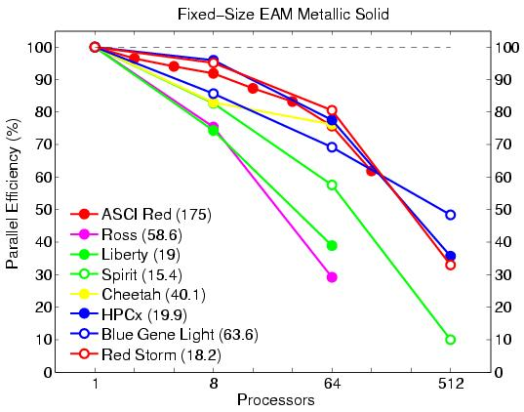
LAMMPS’s parallel performance
Fixed-size (32K atoms) and scaled-size (32K atoms/proc) parallel efficiencies
Metallic solid with EAM potential
Billions of atoms on 64K procs of Blue Gene or Red Storm
Opteron processor speed: 5.7E-6 sec/atom/step (0.5x for LJ, 12x for protein)

Slide 25
Easily add your own LAMMPS feature
New user or new simulation → always want new feature not in code
Goal: make it as easy as possible for us and others to add new features
  called “styles” in LAMMPS:
  particle type, pair or bond potential, scalar or per-atom computation
  "fix": BC, force constraint, time integration, diagnostic, ...
  input command: create_atoms, set, run, temper, ...
  over 75% of current 170K+ lines of LAMMPS is add-on styles
Enabled by C++
  "virtual" parent class for all pair potentials
  defines interface: compute(), coeff(), restart(), ...
  add feature: add 2 lines to header file, add files to src dir, re-compile
  feature won't exist if not used, won't conflict with rest of code
Of course, someone has to write the code for the feature!

Slide 26
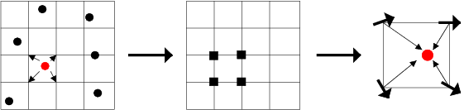
Particle-mesh Methods for Coulombics
Coulomb interactions fall off as 1/r so require long-range for accuracy
Particle-mesh methods:
  partition into short-range and long-range contributions
  short-range via direct pairwise interactions
  long-range:
  interpolate atomic charge to 3d mesh
  solve Poisson's equation on mesh (4 FFTs)
  interpolate E-fields back to atoms
FFTs scale as NlogN if cutoff is held fixed

Slide 27
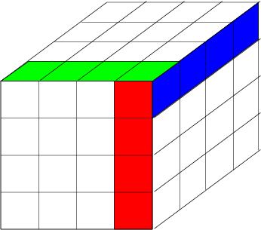
Parallel FFTs
3d FFT is 3 sets of 1d FFTs
  in parallel, 3d grid is distributed across procs
  perform 1d FFTs on-processor
  native library or FFTW (www.fftw.org)
  1d FFTs, transpose, 1d FFTs, transpose, ...
  "transpose” = data transfer
  transfer of entire grid is costly
FFTs for PPPM can scale poorly
  on large # of procs and on clusters
Good news: Cost of PPPM is only ~2x more than 8-10 Angstrom cutoff

Slide 28
Time Scale of Molecular Dynamics
Limited timescale is most serious drawback of MD
Timestep size limited by atomic oscillations:
  C-H bond = 10 fmsec → ½ to 1 fmsec timestep
  Debye frequency = 10¹³ → 2 fmsec timestep
A state-of-the-art “long” simulation is nanoseconds to
  a microsecond of real time
Reality is usually on a much longer timescale:
  protein folding (msec to seconds)
  polymer entanglement (msec and up)
  glass relaxation (seconds to decades)

Slide 29

Extending Timescale
SHAKE = bond-angle constraints, freeze fast DOF
  up to 2-3 fmsec timestep
  rigid water, all C-H bonds
  extra work to enforce constraints
rRESPA = hierarchical time stepping, sub-cycle on fast DOF
  inner loop on bonds (0.5 fmsec)
  next loop on angle, torsions (3-4 body forces)
  next loop on short-range LJ and Coulombic
  outer loop on long-range Coulombic (4 fmsec)
Rigid body time integration via quaternions
  treat groups of atom as rigid bodies (portions of polymer or protein)
  3N DOF → 6 DOF
  save computation of internal forces, longer timestep

Slide 30
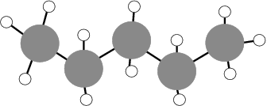
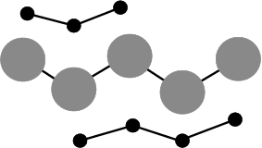
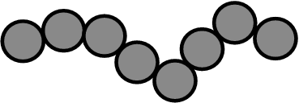
Length Scale of Molecular Dynamics
Limited length scale is 2nd most serious
  drawback of MD → coarse-graining
All-atom:
  Δt = 0.5-1.0 fmsec for C-H
  C-C distance = 1.5 Angs
  cutoff = 10 Angs
United-atom:
  # of interactions is 9x less
  Δt = 1.0-2.0 fmsec for C-C
  cutoff = 10 Angs
  20-30x savings over all-atom
Bead-Spring:
  2-3 C per bead
  Δt ←→ fmsec mapping is T-dependent
  2^{1/6} σ cutoff → 8x in interactions
  can be considerable savings over united-atom

Slide 31
Live demo #2
Modify the input script from live demo #1
  Add the line “dump 1 all atom 10 atoms.lammpstrj” between the fix and run command lines.
Run LAMMPS with the modified input script.
Visualize the simulation results using 3rd party software (VMD)
  http://www.ks.uiuc.edu/Research/vmd/
  Start up VMD and open the “atoms.lammpstrj” file
  View the “movie” you’ve made from the LAMMPS trajectory by pressing the play button.

Slide 32
Discussion outline
MD basics
Why use LAMMPS?
Live demo #1
Basic information about LAMMPS
Live demo #2
Six very useful LAMMPS commands
Live demo #3
Vignettes of some LAMMPS research
Future areas of LAMMPS development
How to add a new feature to LAMMPS
Homework assignment

Slide 33
Six very useful LAMMPS commands
fix
compute
pair_style
variable
thermo_style
dump

Slide 34
fix command
A "fix" is any operation that is applied to the system during time-stepping or minimization.
http://lammps.sandia.gov/doc/fix.html
Examples include updating of atom positions and velocities due to time integration, controlling temperature, applying constraint forces to atoms, enforcing boundary conditions, computing diagnostics, etc.
There are dozens of fixes defined in LAMMPS and new ones can be added.
Syntax: fix ID group-ID style args
ID = user-assigned name for the fix
group-ID = ID of the group of atoms to apply the fix to
style = one of a long list of possible style names
args = arguments used by a particular style
Examples:
fix 1 all nve
fix 3 all nvt temp 300.0 300.0 0.01
fix mine top setforce 0.0 NULL 0.0

Slide 35
Available “fixes” in LAMMPS
adapt - change a simulation parameter over time
addforce - add a force to each atom
aveforce - add an averaged force to each atom
ave/atom - compute per-atom time-averaged quantities
ave/histo - compute/output time-averaged histograms
ave/spatial - compute/output time-averaged per-atom quantities by layer
ave/time - compute/output global time-averaged quantities
bond/break - break bonds on the fly
bond/create - create bonds on the fly
bond/swap - Monte Carlo bond swapping
box/relax - relax box size during energy minimization
deform - change the simulation box size/shape
deposit - add new atoms above a surface
drag - drag atoms towards a defined coordinate
dt/reset - reset the timestep based on velocity, forces
efield - impose electric field on system
enforce2d - zero out z-dimension velocity and force
evaporate - remove atoms from simulation periodically
external - callback to an external driver program
freeze - freeze atoms in a granular simulation
gravity - add gravity to atoms in a granular simulation
heat - add/subtract momentum-conserving heat
indent - impose force due to an indenter
langevin - Langevin temperature control
lineforce - constrain atoms to move in a line
momentum - zero the linear and/or angular momentum of a group of atoms
move - move atoms in a prescribed fashion
msst - multi-scale shock technique (MSST) integration
neb - nudged elastic band (NEB) spring forces
nph - constant NPH time integration via Nose/Hoover
nph/asphere - NPH for aspherical particles
nph/sphere - NPH for spherical particles
npt - constant NPT time integration via Nose/Hoover
npt/asphere - NPT for aspherical particles
npt/sphere - NPT for spherical particles
nve - constant NVE time integration
nve/asphere - NVT for aspherical particles
nve/limit - NVE with limited step length
nve/noforce - NVE without forces (v only)
nve/sphere - NVT for spherical particles
nvt - constant NVT time integration via Nose/Hoover
nvt/asphere - NVT for aspherical particles
nvt/sllod - NVT for NEMD with SLLOD equations
nvt/sphere - NVT for spherical particles
orient/fcc - add grain boundary migration force
planeforce - constrain atoms to move in a plane
poems - constrain clusters of atoms to move as coupled rigid bodies
pour - pour new atoms into a granular simulation domain
press/berendsen - pressure control by Berendsen barostat
print - print text and variables during a simulation
reax/bonds - write out ReaxFF bond information
recenter - constrain the center-of-mass position of a group of atoms
rigid - constrain one or more clusters of atoms to move as a rigid body with NVE integration
rigid/nve - constrain one or more clusters of atoms to move as a rigid body with alternate NVE integration
rigid/nvt - constrain one or more clusters of atoms to move as a rigid body with NVT integration
setforce - set the force on each atom
shake - SHAKE constraints on bonds and/or angles
spring - apply harmonic spring force to group of atoms
spring/rg - spring on radius of gyration of group of atoms
spring/self - spring from each atom to its origin
srd - stochastic rotation dynamics (SRD)
store/force - store force on each atom
store/state - store attributes for each atom
temp/berendsen - temperature control by Berendsen thermostat
temp/rescale - temperature control by velocity rescaling
thermal/conductivity - Muller-Plathe kinetic energy exchange for thermal conductivity calculation
tmd - guide a group of atoms to a new configuration
ttm - two-temperature model for electronic/atomic coupling
viscosity - Muller-Plathe momentum exchange for viscosity calculation
viscous - viscous damping for granular simulations
wall/colloid - Lennard-Jones wall interacting with finite-size particles
wall/gran - frictional wall(s) for granular simulations
wall/harmonic - harmonic spring wall
wall/lj126 - Lennard-Jones 12-6 wall
wall/lj93 - Lennard-Jones 9-3 wall
wall/reflect - reflecting wall(s)
wall/region - use region surface as wall
wall/srd - slip/no-slip wall for SRD particles

Slide 36
compute command
A “compute" is a diagnostic performed on a group of atoms, and used to extract quantitative information from a simulation while it is running.
http://lammps.sandia.gov/doc/compute.html
Quantities calculated by a compute are instantaneous values, meaning they are calculated from information about atoms on the current timestep or iteration, though a compute may internally store some information about a previous state of the system.
Computes calculate one of three styles of quantities: global, per-atom, or local.
Syntax: compute ID group-ID style args
ID = user-assigned name for the computation
group-ID = ID of the group of atoms to perform the computation on
style = one of a list of possible style names (see below)
args = arguments used by a particular style
Examples:
compute 1 all temp
compute newtemp flow temp/partial 1 1 0
compute 3 all ke/atom

Slide 37
Available “computes” in LAMMPS
angle/local - theta and energy of each angle
atom/molecule - sum per-atom properties for each molecule
bond/local - distance and energy of each bond
centro/atom - centro-symmetry parameter for each atom
cluster/atom - cluster ID for each atom
cna/atom - common neighbor analysis (CNA) for each atom
com - center-of-mass of group of atoms
com/molecule - center-of-mass for each molecule
coord/atom - coordination number for each atom
damage/atom - Peridynamic damage for each atom
dihedral/local - angle of each dihedral
displace/atom - displacement of each atom
erotate/asphere - rotational energy of aspherical particles
erotate/sphere - rotational energy of spherical particles
event/displace - detect event on atom displacement
group/group - energy/force between two groups of atoms
gyration - radius of gyration of group of atoms
gyration/molecule - radius of gyration for each molecule
heat/flux - heat flux through a group of atoms
improper/local - angle of each improper
ke - translational kinetic energy
ke/atom - kinetic energy for each atom
msd - mean-squared displacement of group of atoms
msd/molecule - mean-squared displacement for each molecule
pair - values computed by a pair style
pair/local - distance/energy/force of each pairwise interaction
pe - potential energy
pe/atom - potential energy for each atom
pressure - total pressure and pressure tensor
property/atom - convert atom attributes to per-atom vectors/arrays
property/local - convert local attributes to localvectors/arrays
property/molecule - convert molecule attributes to localvectors/arrays
rdf - radial distribution function g(r) histogram of group of atoms
reduce - combine per-atom quantities into a single global value
reduce/region - same as compute reduce, within a region
stress/atom - stress tensor for each atom
temp - temperature of group of atoms
temp/asphere - temperature of aspherical particles
temp/com - temperature after subtracting center-of-mass velocity
temp/deform - temperature excluding box deformation velocity
temp/partial - temperature excluding one or more dimensions of velocity
temp/profile - temperature excluding a binned velocity profile
temp/ramp - temperature excluding ramped velocity component
temp/region - temperature of a region of atoms
temp/sphere - temperature of spherical particles
ti - thermodyanmic integration free energy values

Slide 38
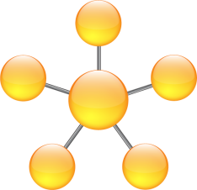
pair_style command
A “pair_style" sets the formula(s) LAMMPS uses to compute pair-wise interactions.
http://lammps.sandia.gov/doc/pair_style.html
Pair potentials are defined between pairs of atoms that are within a cutoff distance and the set of active interactions typically changes over time.
Syntax: pair_style style args
style = one of the styles from the list below
args = arguments used by a particular style
Examples:
pair_style lj/cut 2.5
pair_style eam/alloy
pair_style hybrid lj/charmm/coul/long 10.0 eam
pair_style table linear 1000
pair_style none

Slide 39
Available “pair_styles” in LAMMPS
pair_style none - turn off pairwise interactions
pair_style hybrid - multiple styles of pairwise interactions
pair_style hybrid/overlay - multiple styles of superposed pairwise interactions
pair_style airebo - AI-REBO potential
pair_style born - Born-Mayer-Huggins potential
pair_style born/coul/long - Born-Mayer-Huggins with long-range Coulomb
pair_style buck - Buckingham potential
pair_style buck/coul/cut - Buckingham with cutoff Coulomb
pair_style buck/coul/long - Buckingham with long-range Coulomb
pair_style colloid - integrated colloidal potential
pair_style coul/cut - cutoff Coulombic potential
pair_style coul/debye - cutoff Coulombic potential with Debye screening
pair_style coul/long - long-range Coulombic potential
pair_style dipole/cut - point dipoles with cutoff
pair_style dpd - dissipative particle dynamics (DPD)
pair_style dpd/tstat - DPD thermostatting
pair_style dsmc - Direct Simulation Monte Carlo (DSMC)
pair_style eam - embedded atom method (EAM)
pair_style eam/opt - optimized version of EAM
pair_style eam/alloy - alloy EAM
pair_style eam/alloy/opt - optimized version of alloy EAM
pair_style eam/fs - Finnis-Sinclair EAM
pair_style eam/fs/opt - optimized version of Finnis-Sinclair EAM
pair_style eim - embedded ion method (EIM)
pair_style gauss - Gaussian potential
pair_style gayberne - Gay-Berne ellipsoidal potential
pair_style gayberne/gpu - GPU-enabled Gay-Berne ellipsoidal potential
pair_style gran/hertz/history - granular potential with Hertzian interactions
pair_style gran/hooke - granular potential with history effects
pair_style gran/hooke/history - granular potential without history effects
pair_style hbond/dreiding/lj - DREIDING hydrogen bonding LJ potential
pair_style hbond/dreiding/morse - DREIDING hydrogen bonding Morse potential
pair_style lj/charmm/coul/charmm - CHARMM potential with cutoff Coulomb
pair_style lj/charmm/coul/charmm/implicit - CHARMM for implicit solvent
pair_style lj/charmm/coul/long - CHARMM with long-range Coulomb
pair_style lj/charmm/coul/long/gpu - GPU-enabled version of CHARMM with long-range Coulomb
pair_style lj/charmm/coul/long/opt - optimized version of CHARMM with long-range Coulomb
pair_style lj/class2 - COMPASS (class 2) force field with no Coulomb
pair_style lj/class2/coul/cut - COMPASS with cutoff Coulomb
pair_style lj/class2/coul/long - COMPASS with long-range Coulomb
pair_style lj/cut - cutoff Lennard-Jones potential with no Coulomb
pair_style lj/cut/gpu - GPU-enabled version of cutoff LJ
pair_style lj/cut/opt - optimized version of cutoff LJ
pair_style lj/cut/coul/cut - LJ with cutoff Coulomb
pair_style lj/cut/coul/cut/gpu - GPU-enabled version of LJ with cutoff Coulomb
pair_style lj/cut/coul/debye - LJ with Debye screening added to Coulomb
pair_style lj/cut/coul/long - LJ with long-range Coulomb
pair_style lj/cut/coul/long/gpu - GPU-enabled version of LJ with long-range Coulomb
pair_style lj/cut/coul/long/tip4p - LJ with long-range Coulomb for TIP4P water
pair_style lj/expand - Lennard-Jones for variable size particles
pair_style lj/gromacs - GROMACS-style Lennard-Jones potential
pair_style lj/gromacs/coul/gromacs - GROMACS-style LJ and Coulombic potential
pair_style lj/smooth - smoothed Lennard-Jones potential
pair_style lj96/cut - Lennard-Jones 9/6 potential
pair_style lj96/cut/gpu - GPU-enabled version of Lennard-Jones 9/6
pair_style lubricate - hydrodynamic lubrication forces
pair_style meam - modified embedded atom method (MEAM)
pair_style morse - Morse potential
pair_style morse/opt - optimized version of Morse potential
pair_style peri/lps - peridynamic LPS potential
pair_style peri/pmb - peridynamic PMB potential
pair_style reax - ReaxFF potential
pair_style resquared - Everaers RE-Squared ellipsoidal potential
pair_style soft - Soft (cosine) potential
pair_style sw - Stillinger-Weber 3-body potential
pair_style table - tabulated pair potential
pair_style tersoff - Tersoff 3-body potential
pair_style tersoff/zbl - Tersoff/ZBL 3-body potential
pair_style yukawa - Yukawa potential
pair_style yukawa/colloid - screened Yukawa potential for finite-size particles

Slide 40
variable command
This command assigns one or more strings to a variable name for evaluation later in the input script or during a simulation.
http://lammps.sandia.gov/doc/variable.html
A variable can be referenced elsewhere in an input script to become part of a new input command.
For variable styles that store multiple strings, the next command can be used to increment which string is assigned to the variable.
Variables of style equal store a formula which when evaluated produces a single numeric value which can be output either directly (see the print, fix print, and run every commands) or as part of thermodynamic output (see the thermo_style command), or used as input to an averaging fix (see the fix ave/time command).
Variables of style atom store a formula which when evaluated produces one numeric value per atom which can be output to a dump file (see the dump custom command) or used as input to an averaging fix (see the fix ave/spatial and fix ave/atom commands).

Slide 41
variable command (cont.)
Syntax: variable name style args ...
name = name of variable to define
style = delete or index or loop or world or universe or uloop or string or equal or atom
Examples:
variable x index run1 run2 run3 run4 run5 run6 run7 run8
variable LoopVar loop $n
variable beta equal temp/3.0
variable b1 equal x[234]+0.5*vol
variable b1 equal "x[234] + 0.5*vol"
variable b equal xcm(mol1,x)/2.0
variable b equal c_myTemp
variable b atom x*y/vol variable foo myfile
variable temp world 300.0 310.0 320.0 ${Tfinal}
variable x universe 1 2 3 4 5 6 7 8 9 10 11 12 13 14 15
variable x uloop 15 pad
variable x delete

Slide 42
thermo_style command
Set the style and content for printing data to the screen and log file.
http://lammps.sandia.gov/doc/thermo_style.html
Syntax: thermo_style style args
style = one or multi or custom
args = list of arguments for a particular style
Examples:
thermo_style multi
thermo_style custom step temp pe etotal press vol
thermo_style custom step temp etotal c_myTemp v_abc

Slide 43
Available “thermo_style” attributes
step = timestep
elapsed = timesteps since start of this run
elaplong = timesteps since start of initial run in a series of runs
dt = timestep size
cpu = elapsed CPU time in seconds
tpcpu = time per CPU second
spcpu = timesteps per CPU second
atoms = # of atoms
temp = temperature
press = pressure
pe = total potential energy
ke = kinetic energy
etotal = total energy (pe + ke)
enthalpy = enthalpy (etotal + press*vol)
evdwl = VanderWaal pairwise energy
ecoul = Coulombic pairwise energy
epair = pairwise energy (evdwl + ecoul + elong + etail)
ebond = bond energy
eangle = angle energy
edihed = dihedral energy
eimp = improper energy
emol = molecular energy (ebond + eangle + edihed + eimp)
elong = long-range kspace energy
etail = VanderWaal energy long-range tail correction
vol = volume
lx,ly,lz = box lengths in x,y,z
xlo,xhi,ylo,yhi,zlo,zhi = box boundaries
xy,xz,yz = box tilt for triclinic (non-orthogonal) simulation boxes
xlat,ylat,zlat = lattice spacings as calculated by "lattice"_lattice.html command
pxx,pyy,pzz,pxy,pxz,pyz = 6 components of pressure tensor
fmax = max component of force on any atom in any dimension
fnorm = length of force vector for all atoms
c_ID = global scalar value calculated by a compute with ID
c_ID\[I\] = Ith component of global vector calculated by a compute with ID
c_ID\[I\]\[J\] = I,J component of global array calculated by a compute with ID
f_ID = global scalar value calculated by a fix with ID
f_ID\[I\] = Ith component of global vector calculated by a fix with ID
f_ID\[I\]\[J\] = I,J component of global array calculated by a fix with ID
v_name = scalar value calculated by an equal-style variable with name

Slide 44
dump command
Dump a snapshot of atom quantities to one or more files every N timesteps in one of several styles.
http://lammps.sandia.gov/doc/dump.html
Syntax:
dump ID group-ID style N file args ID = user-assigned name for the dump
group-ID = ID of the group of atoms to be dumped
style = atom or cfg or dcd or xtc or xyz or local or custom
N = dump every this many timesteps
file = name of file to write dump info to
args = list of arguments for a particular style atom
Examples:
dump myDump all atom 100 dump.atom
dump 2 subgroup atom 50 dump.run.bin
dump 4a all custom 100 dump.myforce.* id type x y vx fx
dump 4b flow custom 100 dump.%.myforce id type c_myF[3] v_ke
dump 2 inner cfg 10 dump.snap.*.cfg id type xs ys zs vx vy vz
dump snap all cfg 100 dump.config.*.cfg id type xs ys zs id type c_Stress2
dump 1 all xtc 1000 file.xtc
dump e_data all custom 100 dump.eff id type x y z spin eradius fx fy fz eforce

Slide 45
Available “dump” atom attributes
id = atom ID
mol = molecule ID
type = atom type
mass = atom mass
x,y,z = unscaled atom coordinates
xs,ys,zs = scaled atom coordinates
xu,yu,zu = unwrapped atom coordinates
ix,iy,iz = box image that the atom is in
vx,vy,vz = atom velocities
fx,fy,fz = forces on atoms
q = atom charge
mux,muy,muz = orientation of dipolar atom
radius = radius of extended spherical particle
omegax,omegay,omegaz = angular velocity of extended particle
angmomx,angmomy,angmomz = angular momentum of extended particle
quatw,quati,quatj,quatk = quaternion components for aspherical particles
tqx,tqy,tqz = torque on extended particles
spin = electron spin
eradius = electron radius
ervel = electron radial velocity
erforce = electron radial force
c_ID = per-atom vector calculated by a compute with ID
c_ID\[N\] = Nth column of per-atom array calculated by a compute with ID
f_ID = per-atom vector calculated by a fix with ID
f_ID\[N\] = Nth column of per-atom array calculated by a fix with ID
v_name = per-atom vector calculated by an atom-style variable with name

Slide 46
Live demo #3
Modify the LAMMPS input script from demo #2 so that it includes at least one example of each of the following six commands:
    fix
    compute
    pair_style
    variable
    thermo_style
    dump
Run LAMMPS with the modified input script.

Slide 47
Discussion outline
MD basics
Why use LAMMPS?
Live demo #1
Basic information about LAMMPS
Live demo #2
Six very useful LAMMPS commands
Live demo #3
Vignettes of some LAMMPS research
Future areas of LAMMPS development
How to add a new feature to LAMMPS
Homework assignment

Slide 48
Vignettes of some LAMMPS research
Interfaces in melting solids
Adhesion properties of polymers
Shear response in metals
Tensile pull on nanowires
Surface growth on mismatched lattice
Shock-induced phase transformations
Silica nanopores for water desalination
Coated nanoparticles in solution and at interfaces
Self-assembly (2d micelles and 3d lipid bilayers)
Rhodopsin protein isomerization
Whole vesicle simulation
Radiation damage

Slide 49
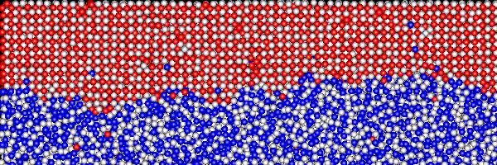
Melt Interface in NiAl
Mark Asta (UC Davis) and Jeff Hoyt (Sandia)
Careful thermostatting and equilibration of alloy system
Track motion and structure of melt interface

Slide 50
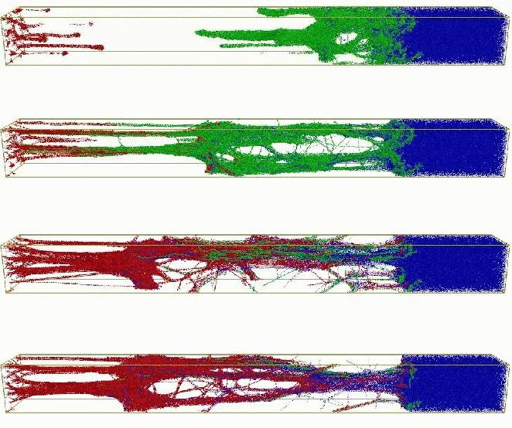
Polymer Adhesive Properties
Mark Stevens and Gary Grest (Sandia)
Bead/spring polymer model, allow for bond breaking

Slide 51
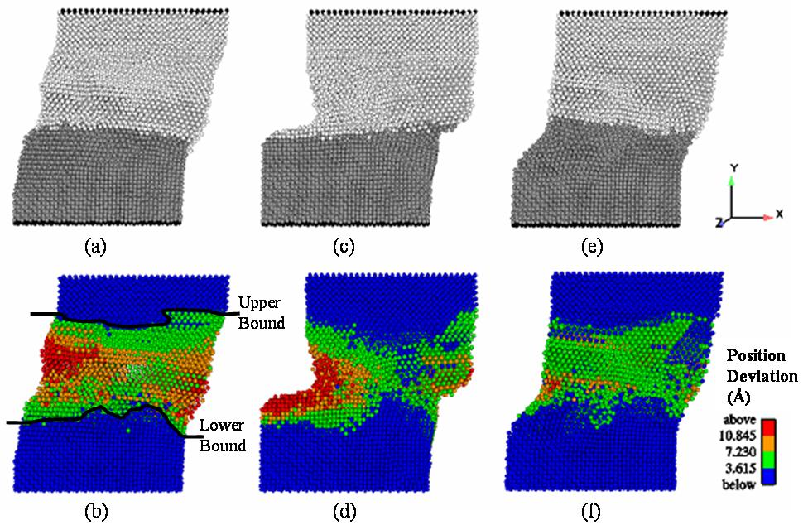
Shear Response of Cu Bicrystal
David McDowell group (GA Tech)
Defect formation, stress relaxation, energetics of boundary region

Slide 52
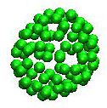
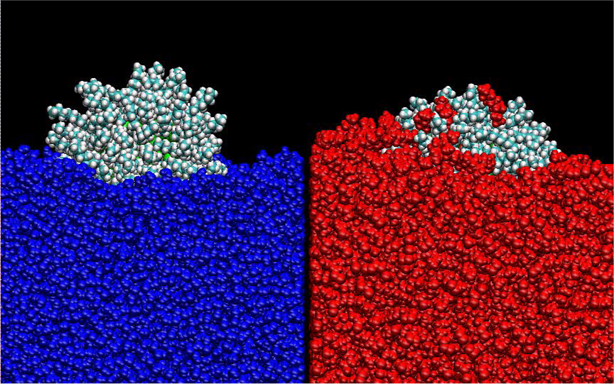
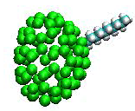
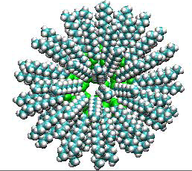
Coated Nanoparticles at Interfaces
Matt Lane, Gary Grest (Sandia)
S sites on Au nanoparticle, alkane-thiol chains, methyl-terminated, 3 ns sim
water
decane

Slide 53
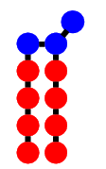
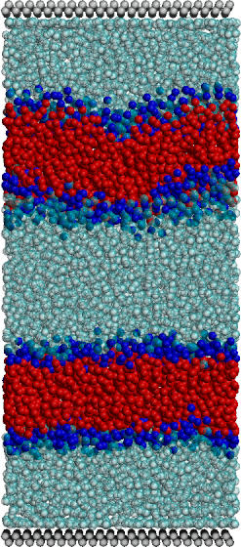
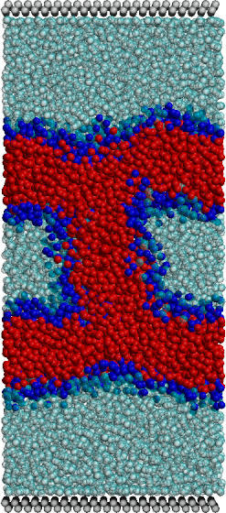
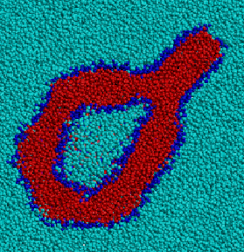
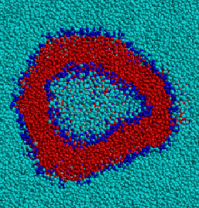
3d Membrane Self-Assembly
Mark Stevens (Sandia)
Coarse-grain lipid model in monomeric solvent
Angle terms for rigidity
Hydrophilic head-group & solvent, hydrophobic tail
100Ks of particles for millions of timesteps
Bilayer & vesicle formation
15K monomers for 1M steps

Slide 54
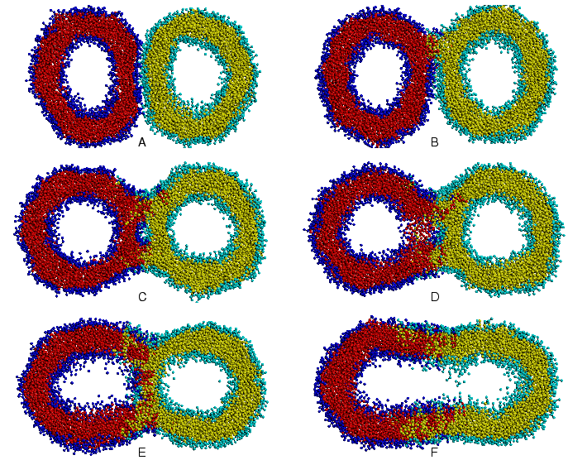
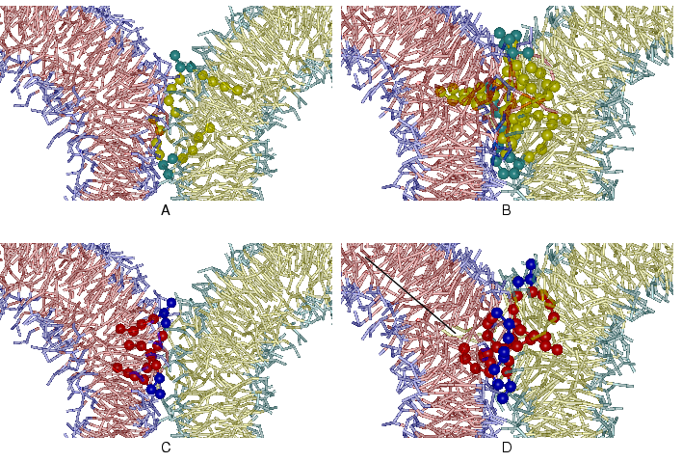
Membrane Fusion
Gently push together ...

Slide 55
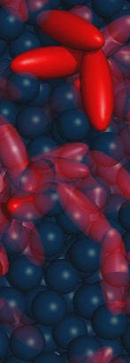
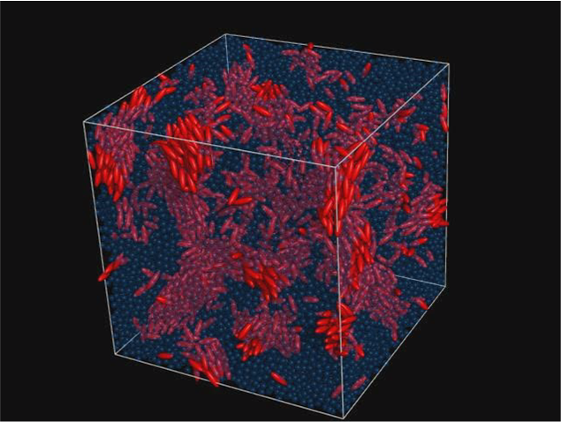
Aspherical Nanoparticles
Mike Brown (Sandia)
Ellipsoidal particles interacting via Gay-Berne potentials (LC), LJ solvent
Nanodroplet formation in certain regimes of phase space

Slide 56
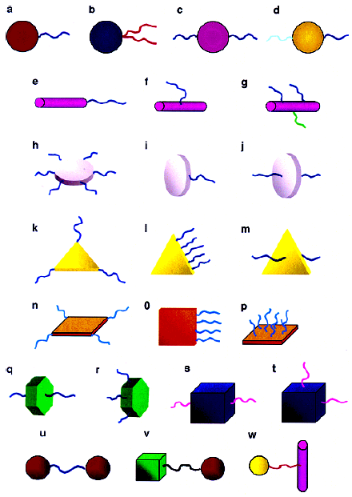
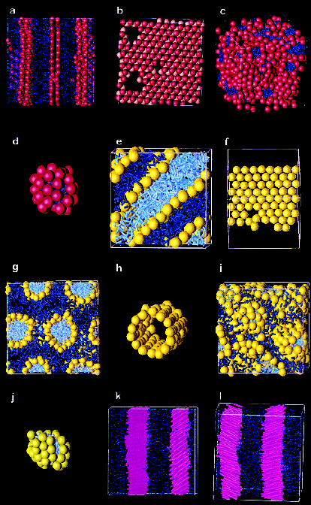
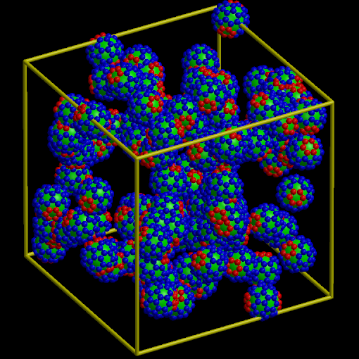
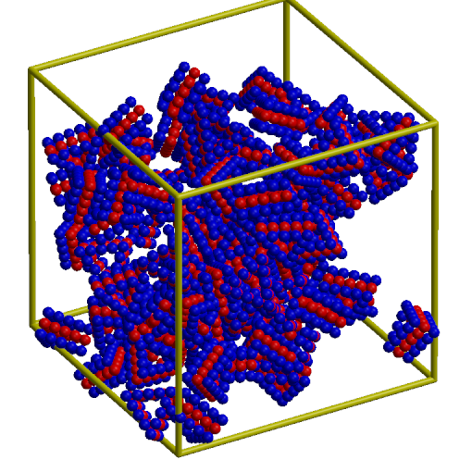
Rigid Nanoparticle Self-Assembly
Multiple rigid bodies
Quaternion integration
Brownian dynamics
Self-assembly → phases
  (Sharon Glotzer et al., Nano Letters, 3, 1341 (2003).

Slide 57
LAMMPS’s Reactive Force Fields Capability
Why Reactive Force Fields?
Material behavior often dominated by chemical processes
HE, Complex Solids, Polymer Aging
Quantum methods limited to hundreds of atoms
Ordinary classical force fields limited accuracy
We need to have the best of both worlds ⇒Reactive force fields
Why build Reactive Force Fields into LAMMPS?
Reactive force fields typically exist as custom serial MD codes
LAMMPS is a general parallel MD code
Notes:
Key Points:
Reactive force fields are the key to predictive materials modelling
Need a parallel MD code that can become the work horse for these force fields that LAMMPS is for non-reactive force fields
Leveraging staff through collaborations with other projects.
I’m just going to take a couple of minutes to summarize the proposal and then I’ll turn it over to you all for questions.
First the motivation.
During the past 20 years or so, atomistic materials modeling has relied heavily on simple interatomic potentials
In recent years, there has been dramatic growth in the use of more complex force fields which are sometimes called reactive.
They allow things such as atomic charge and bond order to vary in response to the local environment.
They don’t work in existing molecular dynamics codes, which have been heavily optimized for the simpler interatomic potentials
We are proposing to build a new scalable MD code which will be capable of handling a wide variety of reactive force fields.
There is widespread support for this amongst Sandia’s materials modeling community. They are especially interested in the idea that new force fields could be implemented and tried out on large calculations with minimal effort, something which is currently impossible.

Slide 58
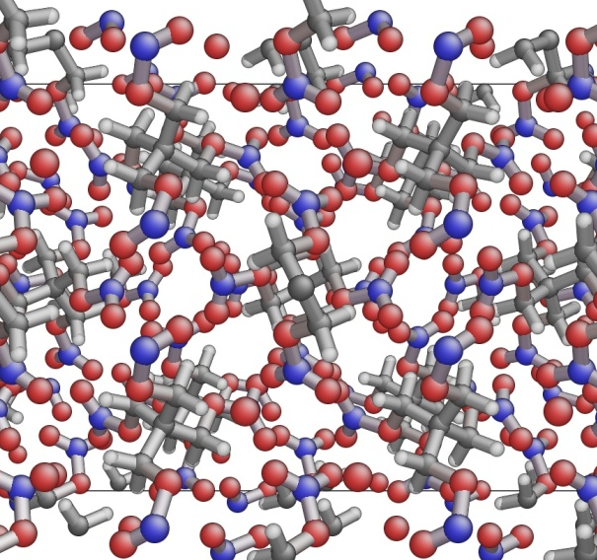
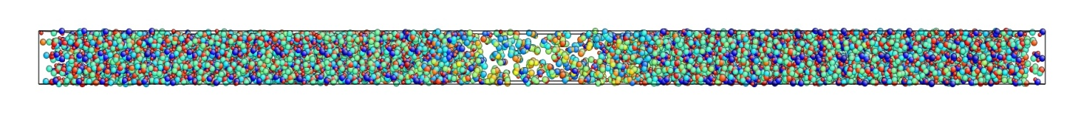
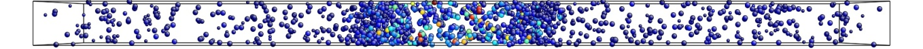
LAMMPS+ReaxFF enables direct simulation of detailed initial energy propagation in HE
  Improved understanding of sensitivity will aid development of more reliable microenergetic components
  Goal: Identify the specific atomistic processes that cause orientation-dependent detonation sensitivity in PETN
  Thermal excitation simulations used as proof-of-concept
  Collaborating with parallel DoD-funded effort at Caltech (Bill Goddard, Sergey Zybin)
  Now running multi-million atom shock-initiated simulations with different orientations
  Contracted Grant Smith to extend his HMX/RDX non-reactive force field to PETN
Complex molecular structure of unreacted tetragonal PETN crystal, C (gray), N (blue), O (red), and H (white).
Propagation of reaction front due to thermal excitation of a thin layer at the center of the sample for 10 picoseconds. Top: atoms colored by potential energy. Bottom: atoms colored by temperature (atoms below 1000K are not shown).

Slide 59
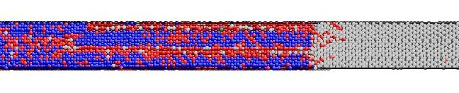

MD Simulation of Shock-induced Structural Phase Transformation in Cadmium Selenide
c-direction: 2-Wave Structure: rocksalt emerges directly from elastically compressed material
[1000]
[0001]
a-direction: 3-Wave Structure: tetragonal region forms between elastic wave and rocksalt phase
[0110]
[1000]

Slide 60
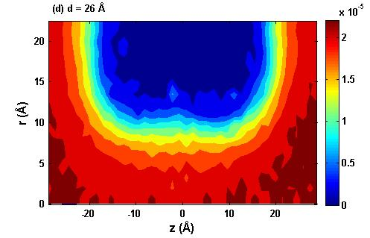
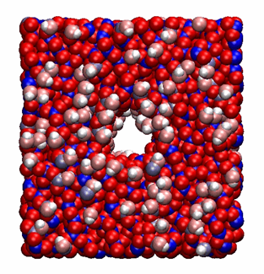
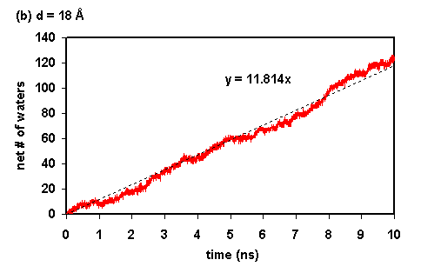
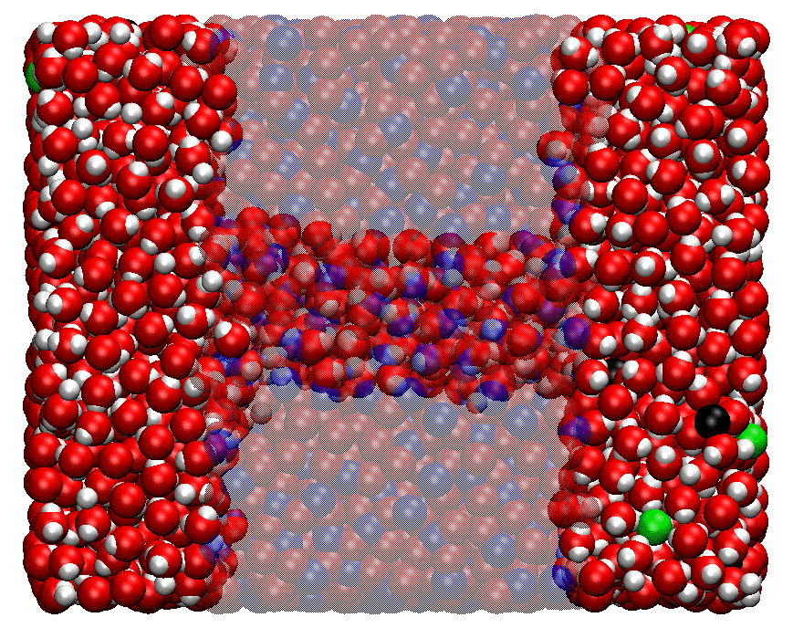
Non-equilibrium MD simulations of brackish water flow through silica and titania nanopores
Small flow field successfully induces steady state solvent flow through amorphous SiO₂ and TiO₂ nanopores in NEMD simulations.
Complex model systems built through a detailed processs involving melting, quenching, annealing, pore drilling, defect capping, and equilibration.
10-ns simulations carried out for a variety of pore diameters for for both SiO₂ and TiO₂ nanopores.
Densities, diffusivities, and flows of the various species computed spatially, temporally, and as a function of pore diameter.
Spatial map of water diffusivities in a 26 Å TiO₂ nanopore.
Water is tightly bound to hydrophilic TiO₂ surface, greatly hampering mobility within 5 Å of the surface.
Simulations show that amorphous nanopores of diameter at least 14 Å can conduct water as well as Na+ and Cl- ions.
No evidence of selectivity that allows water passage and precludes ion passage --- functional groups on pore interior may be able to achieve this.
r
z
Water flux through an 18 Å TiO₂ nanopore.

Slide 61
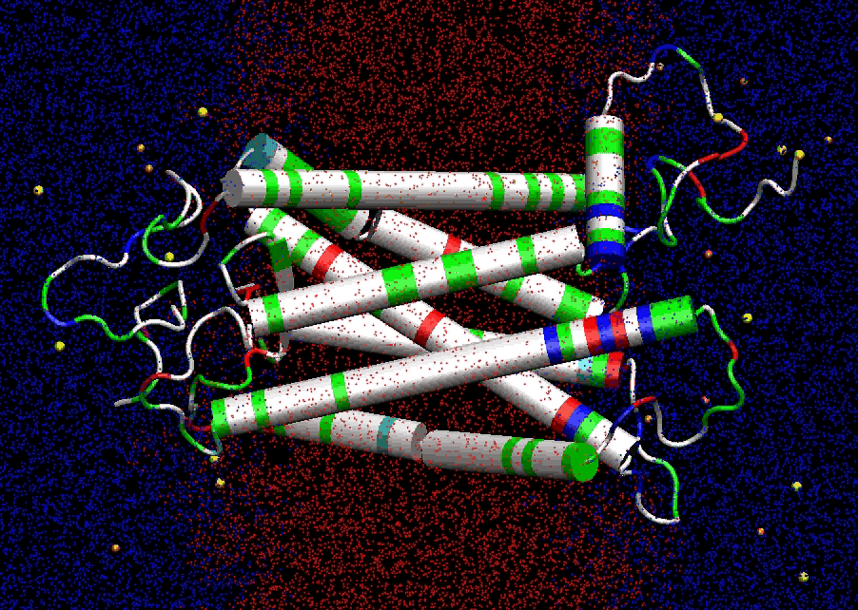
Rhodopsin photoisomerization simulation
190 ns simulation
  40 ns in dark-adapted state (J. Mol. Biol., 333, 493, (2003))
  150 ns after photoisomerization
CHARMM force field
P³M full electrostatics
Parallel on ~40 processors; more than 1 ns simulation / day of real time
Shake, 2 fs time step, velocity Verlet integrator
Constant membrane surface area
System description
  All atom representation
  99 DOPC lipids
  7441 TIP3P waters
  348 rhodopsin residues
  41,623 total atoms
  L_{x}=55 Å, L_{y}=77 Å, L_{z}=94-98 Å

Slide 62
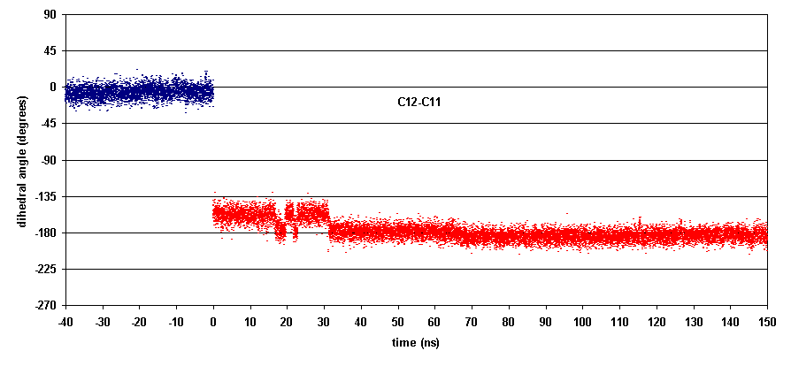
Photoisomerization of retinal
Dihedral remains in trans during subsequent 150 ns of relaxation
Isomerization occurs within 200 fs.
40-ns simulation in dark-adapted state

Slide 63
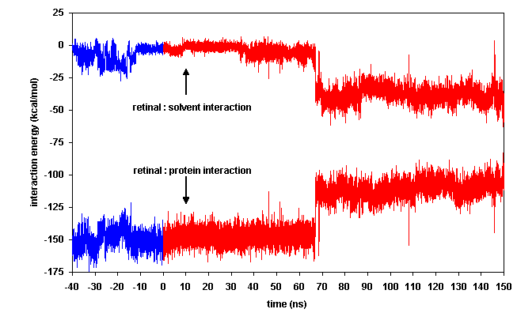

Transition in retinal’s interaction environment
Retinal’s interaction with the rest of the rhodopsin molecule weakens and is partially compensated by a stronger solvent interaction
Most of the shift is caused by breaking of the salt bridge between Glu 113 and the PSB

Slide 64


Whole vesicle simulation
Enormous challenge due to sheer size of the system
  5 million atoms prior to filling box with water
  Estimate > 100 million atoms total
Sphere of tris built using Cubit software, then triangular patches of DOPC lipid bilayers were cut and placed on sphere surface.

Slide 65
Radiation damage simulations
Radiation damage is directly relevant to several nuclear energy applications
    Reactor core materials
    Fuels and cladding
    Waste forms
Experiments are not able to elucidate the mechanism involved in structural disorder following irradiation
Classical simulations can help provide atomistic detail for relaxation processes involved
Electronic effects have been successfully used in cascade simulations of metallic systems

Slide 66


MD model for radiation damage simulations
Gadolinium pyrochlore waste form (Gd₂Zr₂O₇)
Natural pyrochlores are stable over geologic times and shown to be resistant to irradiation (Lumpkin, Elements 2006).
Recent simulations (without electronic effects) exist for comparison (Todorov et al, J. Phys. Condens. Matter 2006).
10.8 Å
162 Å
1 unit cell, 88 atoms
15 x 15 x 15 supercell, 297k atoms
(only Gd atoms shown)

Slide 67


Defect analysis
How the defect analysis works:
  Shape matching algorithm was used.*
  Nearest neighbors defined as those atoms in the first RDF peak.
  Clusters formed by each Gd atom and its nearest Gd neighbors are compared with clusters formed by those neighbors and their nearest Gd neighbors.
  If the cluster shapes match, the atom is considered “crystalline”; otherwise, it is considered “amorphous.”
Why only Gd atoms were used:
  RDF analysis produces clear picture of crystal structure.
  Clearly shows the cascade damage.
* Auer and Frenkel, J. Chem. Phys. 2004
Ten et al, J. Chem. Phys. 1996

Slide 68
Discussion outline
MD basics
Why use LAMMPS?
Live demo #1
Basic information about LAMMPS
Live demo #2
Six very useful LAMMPS commands
Live demo #3
Vignettes of some LAMMPS research
Future areas of LAMMPS development
How to add a new feature to LAMMPS
Homework assignment

Slide 69
Future areas of LAMMPS development
Alleviations of time-scale and spatial-scale limitations
Improved force fields for better molecular physics
New features for the convenience of users

Slide 71
How to add a new feature to LAMMPS
Case study: simulation of gas uptake into microporous materials.

Slide 72
What are microporous materials and what are their uses?
“A microporous material is a material containing pores with diameters less than 2 nm. Porous materials are classified into several kinds by their size.”
“Microporous materials have pore diameters of less than 2 nm, mesoporous materials have pore diameters between 2 nm and 50 nm and macroporous materials have pore diameters of greater than 50 nm.”
Facilitate contaminant-free exchange of gases. Mold spores, bacteria, and other airborne contaminants will become trapped, while allowing gases to pass through the material.
Microporous materials are also used in first aid.
http://en.wikipedia.org/wiki/Microporous_material
Radioactive materials separation or storage.

Slide 73
What are ZIFs?
ZIF = zeolitic imidazolate framework
“ZIFs are one kind of metal-organic frameworks' subsidiaries which could be used to keep industrial emissions of carbon dioxide out of the atmosphere. One litre of the crystals could store about 83 litres of CO2. The crystals are non-toxic and require little energy to create, making them an attractive possibility for carbon capture and storage. The porous structures can be heated to high temperatures without decomposing and can be boiled in water or solvents for a week and remain stable, making them suitable for use in hot, energy-producing environments like power plants.”
“Like zeolites and other porous materials, zeolitic imidazolate framework membranes can be used for the separation of gases because of its highly porous structure, large accessible pore volume with fully exposed edges and faces of the organic links, pore apertures in the range of the kinetic diameter of several gas molecules, and high CO₂ adsorption capacity.”
http://en.wikipedia.org/wiki/Zeolitic_imidazolate_frameworks

Slide 74

ZIF-8
Synonym: | 2-Methylimidazole zinc salt, ZIF 8
CAS Number: | 59061-53-9
Empirical Formula (Hill Notation): | C₈H₁₂N₄Zn
Molecular Weight: | 229.60
Crystal structure of ZIF-8 with void space shown in yellow.
Figure credit: Praveen K. Thallapally

Slide 75
What questions about iodine uptake in ZIF-8 might we hope to address with molecular simulation?
How much I₂ can ZIF-8 hold? (What is the loading vs pressure relationship? Can we compute a loading iostherm?)
How mobile is I₂ once it is adsorbed within the ZIF-8 framework?
What is the structure of I₂-loaded ZIF-8 and where are the main binding locations?
How well do simulation results compare with available experimental measurements?

Slide 76
What simulation tools might we use to address our questions?
Molecular dynamics (MD): is computer simulation of physical movements by atoms and molecules. http://en.wikipedia.org/wiki/Molecular_dynamics
Monte Carlo (MC): This approach relies on statistical mechanics rather than molecular dynamics. Instead of trying to reproduce the dynamics of a system, it generates states according to appropriate Boltzmann probabilities. (http://en.wikipedia.org/wiki/Monte_Carlo_molecular_modeling)
Grand canonical Monte Carlo (GCMC): a very versatile and powerful Monte Carlo technique that explicitly accounts for density fluctuations at fixed volume and temperature. This is achieved by means of trial insertion and deletion of molecules. Although this feature has made it the preferred choice for the study of interfacial phenomena, in the last decade grand-canonical ensemble simulations have also found widespread applications in the study of bulk properties. Such applications had been hitherto limited by the very low particle insertion and deletion probabilities, but the development of the configurational bias grand canonical technique has very much improved the situation. (http://www.sklogwiki.org)
Gibbs ensemble Monte Carlo (GEMC): The Gibbs ensemble Monte Carlo method has been specifically designed to characterize phase transitions. It was mainly developed by Panagiotopoulos (Refs. 1 and 2) to avoid the problem of finite size interfacial effects. In this method, an NVT (or NpT) ensemble containing two (or more) species is divided into two (or more) boxes. In addition to the usual particle moves in each one of the boxes, the algorithm includes moves steps to change the volume and composition of the boxes at mechanical and chemical equilibrium. Transferring a chain molecule from a box to the other requires the use of an efficient method to insert chains. The configurational bias method is specially recommended for this purpose. (http://www.sklogwiki.org)

Slide 77
Which molecular simulation tool is best suited for each task?
How much I₂ can ZIF-8 hold?
How mobile is I₂ once it is adsorbed within the ZIF-8 framework?
What is the structure of I₂-loaded ZIF-8 and where are the main binding locations?
Molecular dynamics (MD)
Monte Carlo (micro-canonical) (MC)
Grand canonical Monte Carlo (GCMC)
Gibbs ensemble Monte Carlo (GEMC)

Slide 78
Which molecular simulation tool is best suited for each task?
How much I₂ can ZIF-8 hold?
How mobile is I₂ once it is adsorbed within the ZIF-8 framework?
What is the structure of I₂-loaded ZIF-8 and where are the main binding locations?
Molecular dynamics (MD)
Monte Carlo (micro-canonical) (MC)
Grand canonical Monte Carlo (GCMC)
Gibbs ensemble Monte Carlo (GEMC)

Slide 79
Why would we want to use LAMMPS to perform molecular simulation of gas uptake into a ZIF?
Can already do the following for free:
  Molecular dynamics
  Model ZIF-8 force fields we’d like to use
  I/O: we already know how to work with LAMMPS input, output, versatile scripting options, etc.
  Many useful computes, fixes, available.
  Combine features in new useful combinations.
  Runs efficiently on available HPC resources.
  Great user support.
  New features can be donated to the community.
Can’t do (yet): GCMC

Slide 80
What would we have to add to LAMMPS to be able to do GCMC simulations?
A new “fix” (i.e. BC, constraint, mid-step instruction).
Let’s call it “fix GCMC.”
Need to find a textbook GCMC algorithm to implement.
Should include the following features:
  Support particle creation/destruction.
  Compute pre- and post-creation/deletion potential energies.
  Work efficiently, and in parallel on multiple processors.
  Written in LAMMPS coding style and include documentation so that it can be shared.
  Be compatible with other LAMMPS features (MD, ensembles, force fields, computes, etc.)
  Allow creation/deletion of molecules.
  Report relevant statistics to users.

Slide 81

GCMC algorithm by Frenkel and Smit *
* Frenkel and Smit, “Understanding Molecular Simulation,” Academic Press, London, 2002.

Slide 82

Excerpts from LAMMPS’s new fix GCMC
(GCMC algorithm: select move, deletion, or insertion)

Slide 83

Excerpts from LAMMPS’s new fix GCMC
(move algorithm)

Slide 84

Excerpts from LAMMPS’s new fix GCMC
(deletion algorithm)

Slide 85

Excerpts from LAMMPS’s new fix GCMC
(insertion algorithm)

Slide 86


How do we know that we’ve implemented the algorithm correctly?
Verification exercise: code-to-code comparison versus an established Monte Carlo code (Towhee).
Gas = Kr (with LJ parameters from Pellenq and Levitz)
T = 300 K
= -10.284 kcal/mol
P = ?
If ideal gas:
P_{(ideal gas)} = 1 bar
Also, from Towhee calculation: P_{(Towhee)} = 1 bar
Corrected a sign error in the new code that caused a slight discrepancy
Now, with our new fix GCMC for LAMMPS, we have: P_{(LAMMPS)} = 1 bar

Slide 87
Results of GCMC simulations of I₂ loading of ZIF-8 structure

Slide 88

GCMC loading movie

Slide 89

Time-lapse image of MC loading simulation

Slide 90

I₂ loading of 16 ZIF-8 cages vs MC cycles

Slide 91

GCMC saturation movie

Slide 92

Loading isotherm

Slide 93
Homework assignment
Repeat the live demo exercises yourself, with your own personal modifications.

Slide 94
HW #1
Download LAMMPS.
  http://lammps.sandia.gov/download.html
  Try the Windows serial executable.
Download a simple LAMMPS input script.
  http://lammps.sandia.gov/inputs/in.lj.txt
Run LAMMPS
  http://lammps.sandia.gov/doc/Section_start.html#2_5

Slide 95
HW #2
Modify the input script from live demo #1
  Add the line “dump 1 all atom 10 atoms.lammpstrj” between the fix and run command lines.
Run LAMMPS with the modified input script.
Visualize the simulation results using 3rd party software (VMD)
  http://www.ks.uiuc.edu/Research/vmd/
  Start up VMD and open the “atoms.lammpstrj” file
  View the “movie” you’ve made from the LAMMPS trajectory by pressing the play button.

Slide 96
HW #3
Modify the LAMMPS input script from demo #2 so that it includes at least one example of each of the following six commands:
    fix
    compute
    pair_style
    variable
    thermo_style
    dump
Run LAMMPS with the modified input script.

