Slide 1
Performance Evaluation of USER-REAXC Package
Hasan Metin Aktulga
Postdoctoral Researcher
Scientific Computing Group
Lawrence Berkeley National Laboratory
email: hmaktulga@lbl.gov
LAMMPS Users’ Workshop
Aug. 10, 2011, Albuquerque NM

Slide 2
ReaxFF vs. Classical MD
ReaxFF
Classical MD
Basis: atoms
Parameterized interactions
Newtonian mechanics
Several common interactions
Fully atomistic
Dynamic bonds
Dynamic charges
Can study reactive systems
Sub-femtosecond time-steps
May represent atoms in groups
Static bonds
Static charges (in general)
Only non-reactive systems
Femtoseconds long time-steps

Slide 3
USER-REAXC Package
IS BASED ON…
PuReMD (Purdue Reactive Molecular Dynamics)
Built on sPuReMD using 3D Mesh decomposition
Extends its capabilities to large systems, longer time-scales
Demonstrated scalability over 3000 processors
GENERAL FEATURES
Implemented from scratch in C
Modular implementation for further improvements, extensions
Distributed freely under GPL
RELATED PUBLICATION
Parallel Reactive Molecular Dynamics: Numerical Methods and Algorithmic Techniques
H. M. Aktulga, J. C. Fogarty, S. A. Pandit, A. Y. Grama
To Appear in the Parallel Computing Journal

Slide 4
USER-REAXC: Key Contributions
Elimination of Bond Order Derivatives List
Tabulated Long-Range Interactions
Natural cubic splines for excellent accuracy, low memory footprint
Observed speed-ups of 3x
Advanced Dynamic Memory Management
Compact data structures
Dynamic and adaptive lists
Low memory footprint, linear scaling with system size!

Slide 5
USER-REAXC: QEq Solver
Charge Equilibration (QEq) Problem
→ Need to solve the following equations:
→
FIX QEQ/REAX
Preconditioned Conjugate Gradient (PCG) solver
Diagonal pre-conditioner
Smart initial guesses (through linear and quadratic extrapolations)
Redundant computations to eliminate a communication step
Iterate both systems together to save on communication (TO DO)

Slide 6
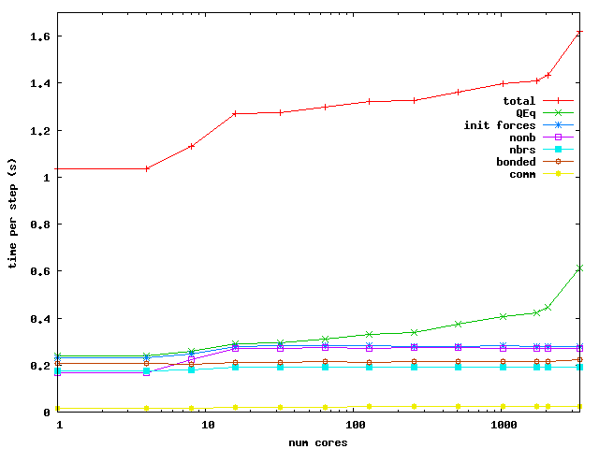
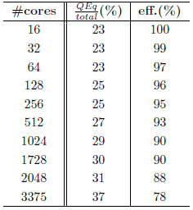
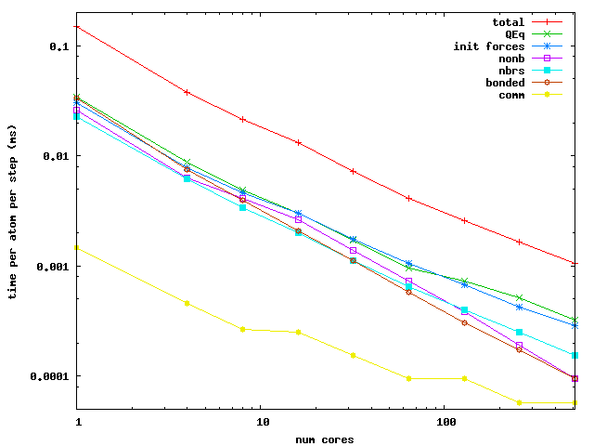
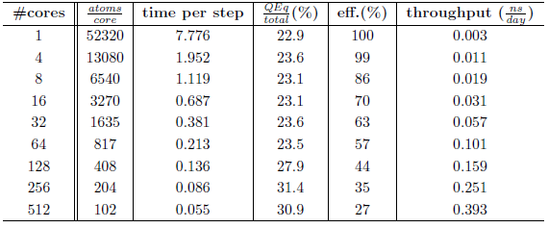
PuReMD (USER-REAXC) Scaling
Weak Scaling: Bulk Water
Per core: 6540 atoms
in a 40x40x40 A³ box
Strong Scaling: Bulk Water 52320 atoms in a 80x80x80 A³ box

Slide 7
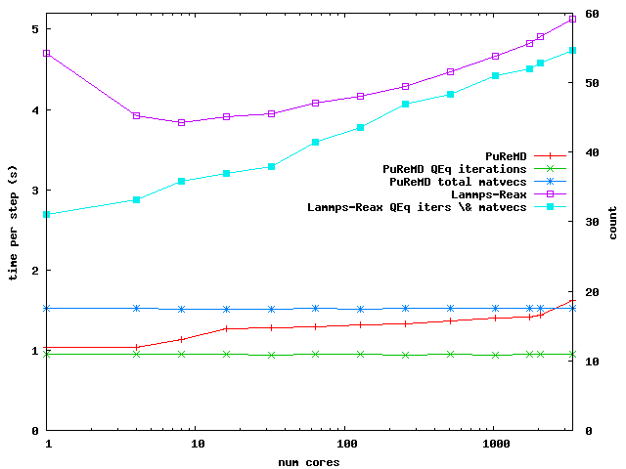
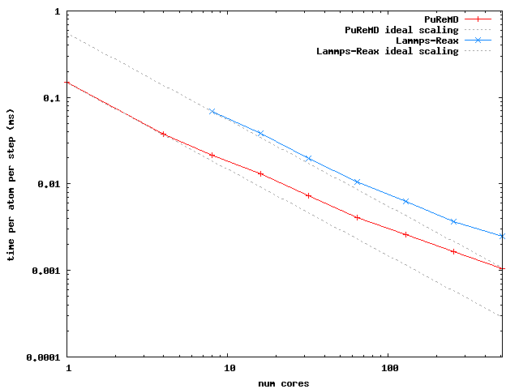
PuReMD (USER-REAXC) vs. REAX
Weak Scaling: Bulk Water
Per core: 6540 atoms
in a 40x40x40 A³ box
Strong Scaling: Bulk Water
52320 atoms
in a 80x80x80 A³ box

Slide 8
On Memory Footprints
LAMMPS-REAX:
static allocations during compile time
USER-REAXC:
dynamic and adaptive allocations at runtime
Memory Footprints of LAMMPS-REAX vs sPuReMD*
* PuReMD: slightly larger memory footprint than sPuReMD
* USER-REAXC: extra storage space for LAMMPS internals

Slide 9
Future Work
Improve the QEq Solver
Improve the SpMV in the iterative solve
Use a Neutral-Territory (NT) Method to reduce communication
Maybe use communication-avoiding solvers (like CA-GMRES + CA-ILUT)
Hybrid OpenMP/MPI implementation to reduce communication
Especially necessary as we move towards many-core era
THANK YOU!
QUESTIONS?

